Slide 1

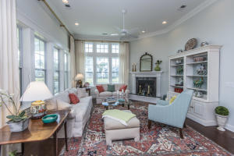
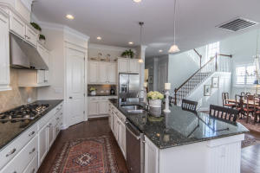
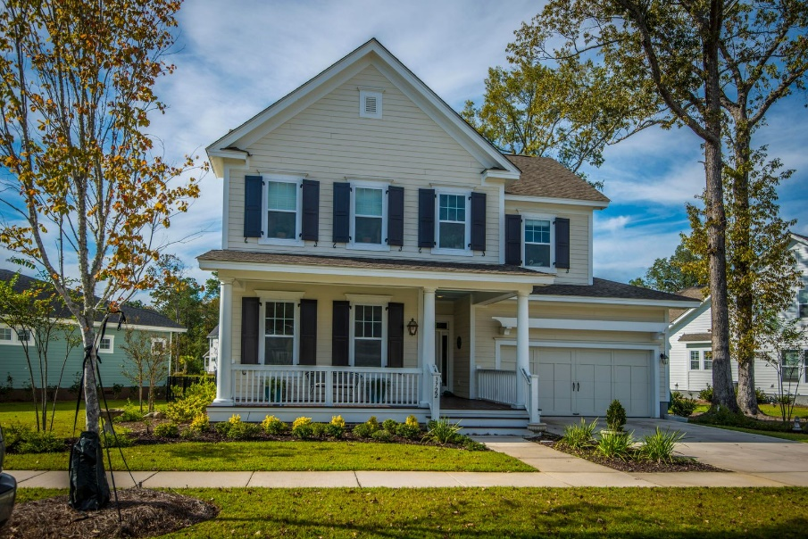
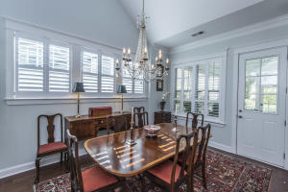
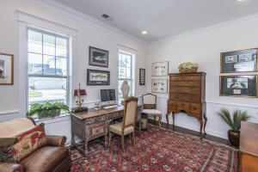
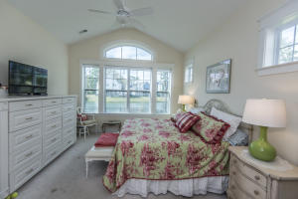
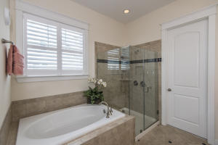
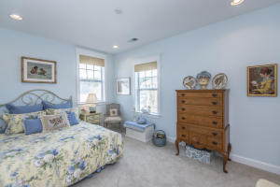
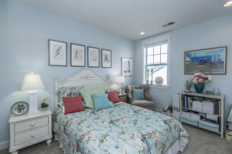
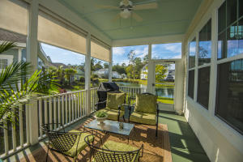
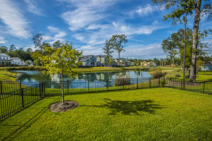
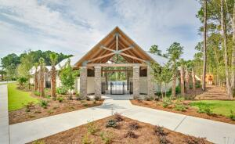
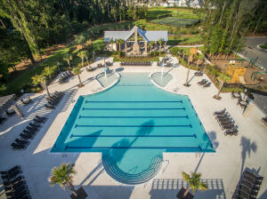


3722 Orion Lane
Carolina Park
Mount Pleasant, SC 29466
MLS# 21027883 | $845,000
Shows Like A Model!
Old Charleston elegance meets coastal casual in this Carolina Park favorite Whitham Plan! Amble up the drive toward the relaxing front porch and you'll feel the desire to pour a glass of iced tea and sit a spell, waving to neighbors as you relax on your front piazza. Step inside and you'll immediately notice details that hint at custom treatments found throughout the home. Extensive crown molding, striking dark hardwood floors, custom plantation shutters, and soaring ceilings lend an air of upscale refinement.
This beautiful home is situated on a prime pond lot with a fully fenced backyard, which is the perfect space for children and pets to frolic, and a nice sized screened-in porch offers a space to enjoy al-fesco dining or your morning coffee while shaded from the sun. Located in desirable Carolina Park, you'll have access to luxury amenities such as a resort style swimming pool, tennis courts, children's play park, dog park, miles of walking/jogging trails, and a 20 acre lake with boardwalk and kayak launch. Carolina Park Elementary, Wando High School, Wando Center for Advanced Studies, Oceanside Academy and the Pre-K Children's Center are all within walking distance. In addition, a brand new public library is situated just outside of the neighborhood. All of this and still close to beaches, dining, shopping and all of the world-class offerings of historic downtown Charleston.
Don Dawson
843-514-0452
ddawson@carolinaone.com
Carolina One Real Estate • 2713 Highway 17 North • Mount Pleasant, SC 29466
www.TeamDawsonSC.com

