Slide 1
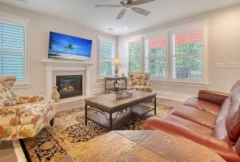
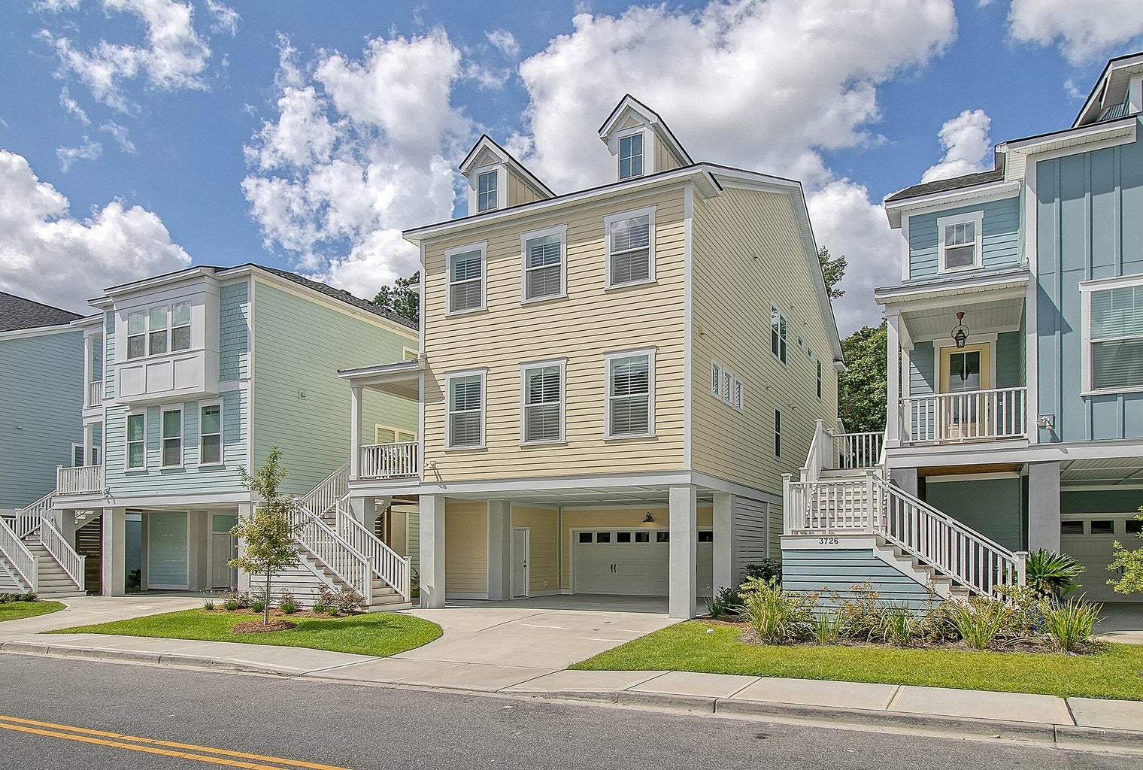
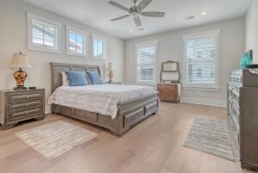
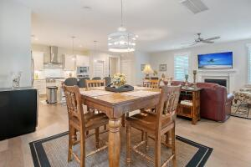
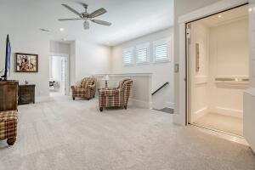
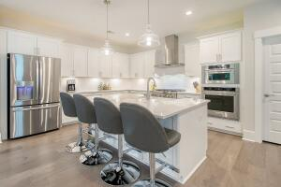
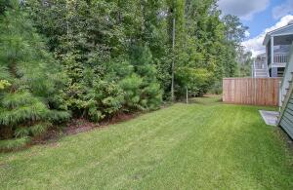
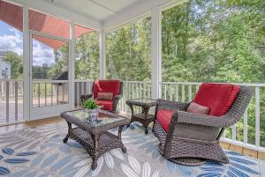
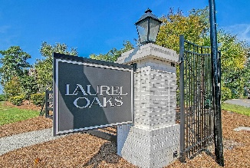
Johns Island WITHOUT THE TRAFFIC!
3730 APIARY LANE
LAUREL OAK | JOHNS ISLAND, SC 29455 | MLS# 23021305 | $839,000
5 BEDS, 4.5 BATHS ∙ 3172 SQ. FT
Less than a year old!! Johns Island w/out Johns Island traffic! Open raised construction plan offering tons of storage underneath the home. 3+ car garage for your boats and toys as well as a covered carport in front with a high end elevator to access all floors. Open green space behind home offers wonderful walks and adventures through the easement area. Super close to shopping, tons of restaurants, AND...the West Ashley Greenway biking/running/walking trail. 2-3 boat ramps within a couple of miles from the house...it's paradise! Upgrades include but not limited to: elevator, extended deck ,enclosed garage, epoxy garage floor, LeafFilter gutters, high end window shades, mega slider door, concrete under ext. stairs, outside gas/electric for grill, luxury chef's cooking package and more!
Johnny Crosby
jcrosby@propertyadvisorsinc.com | 843-270-9407 | www.charlestonhomeproviders.com
Brand Name Real Estate | 4 Carriage Lane, Suite 106 | Charleston, SC 29407

