Slide 1
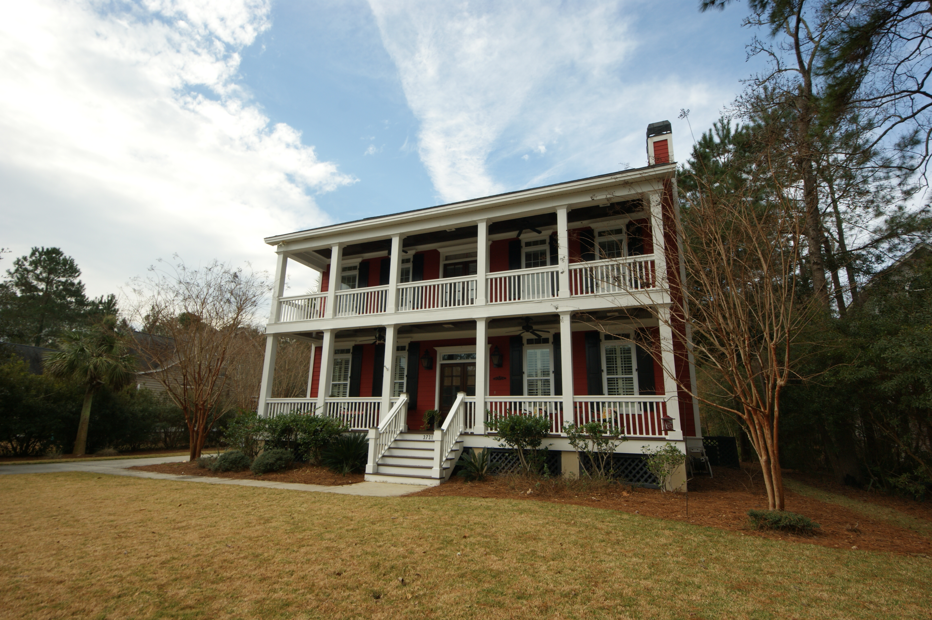
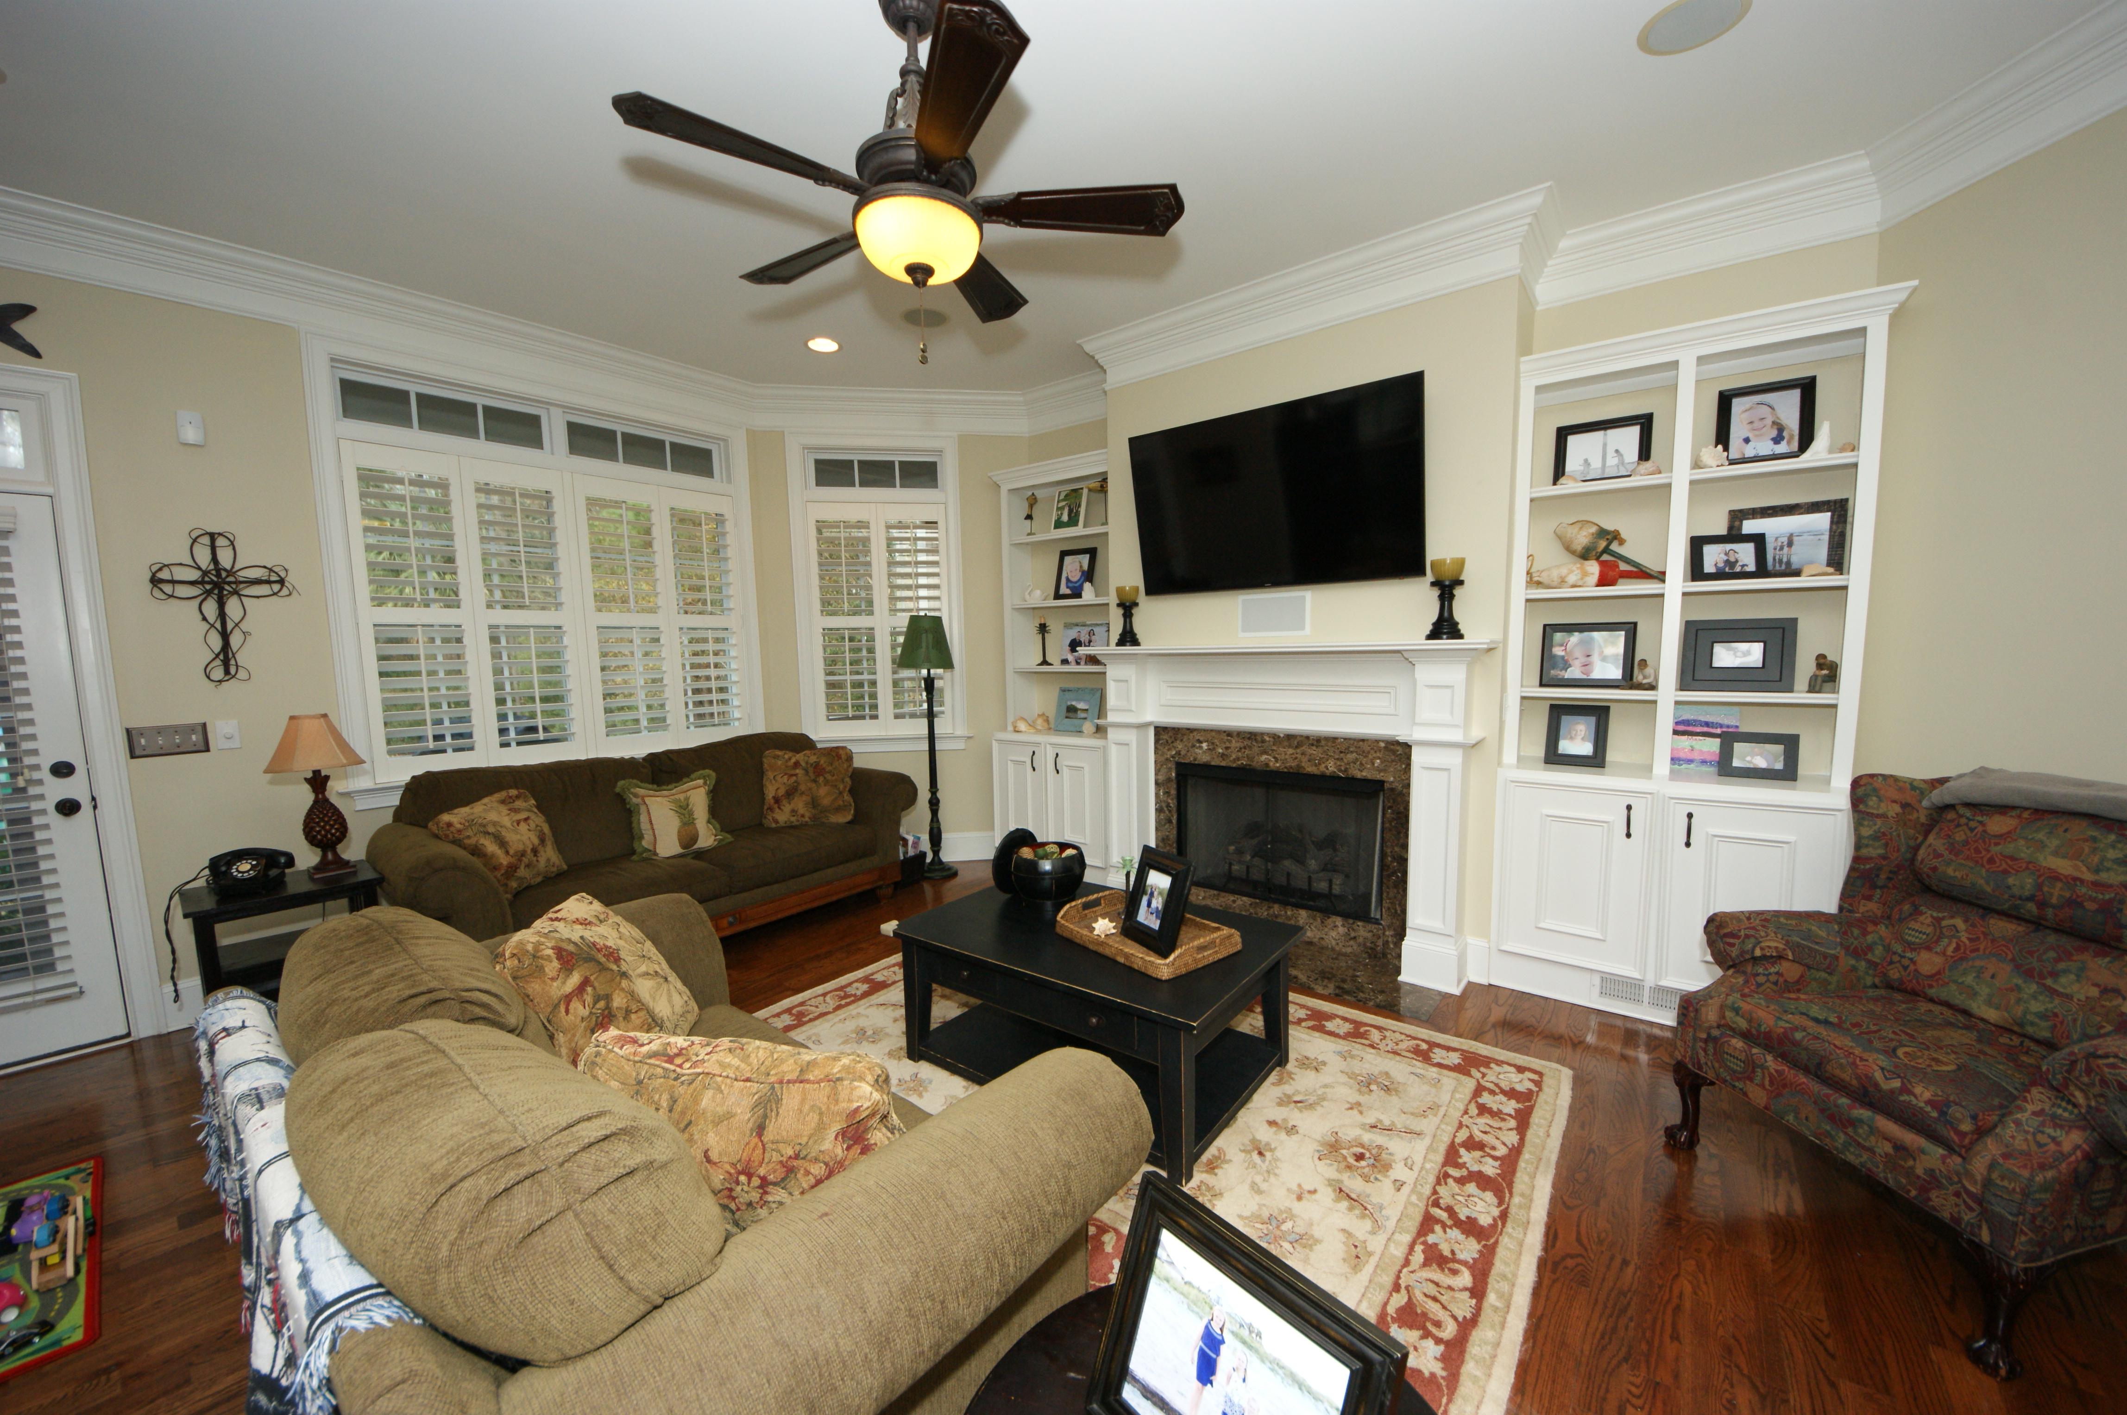
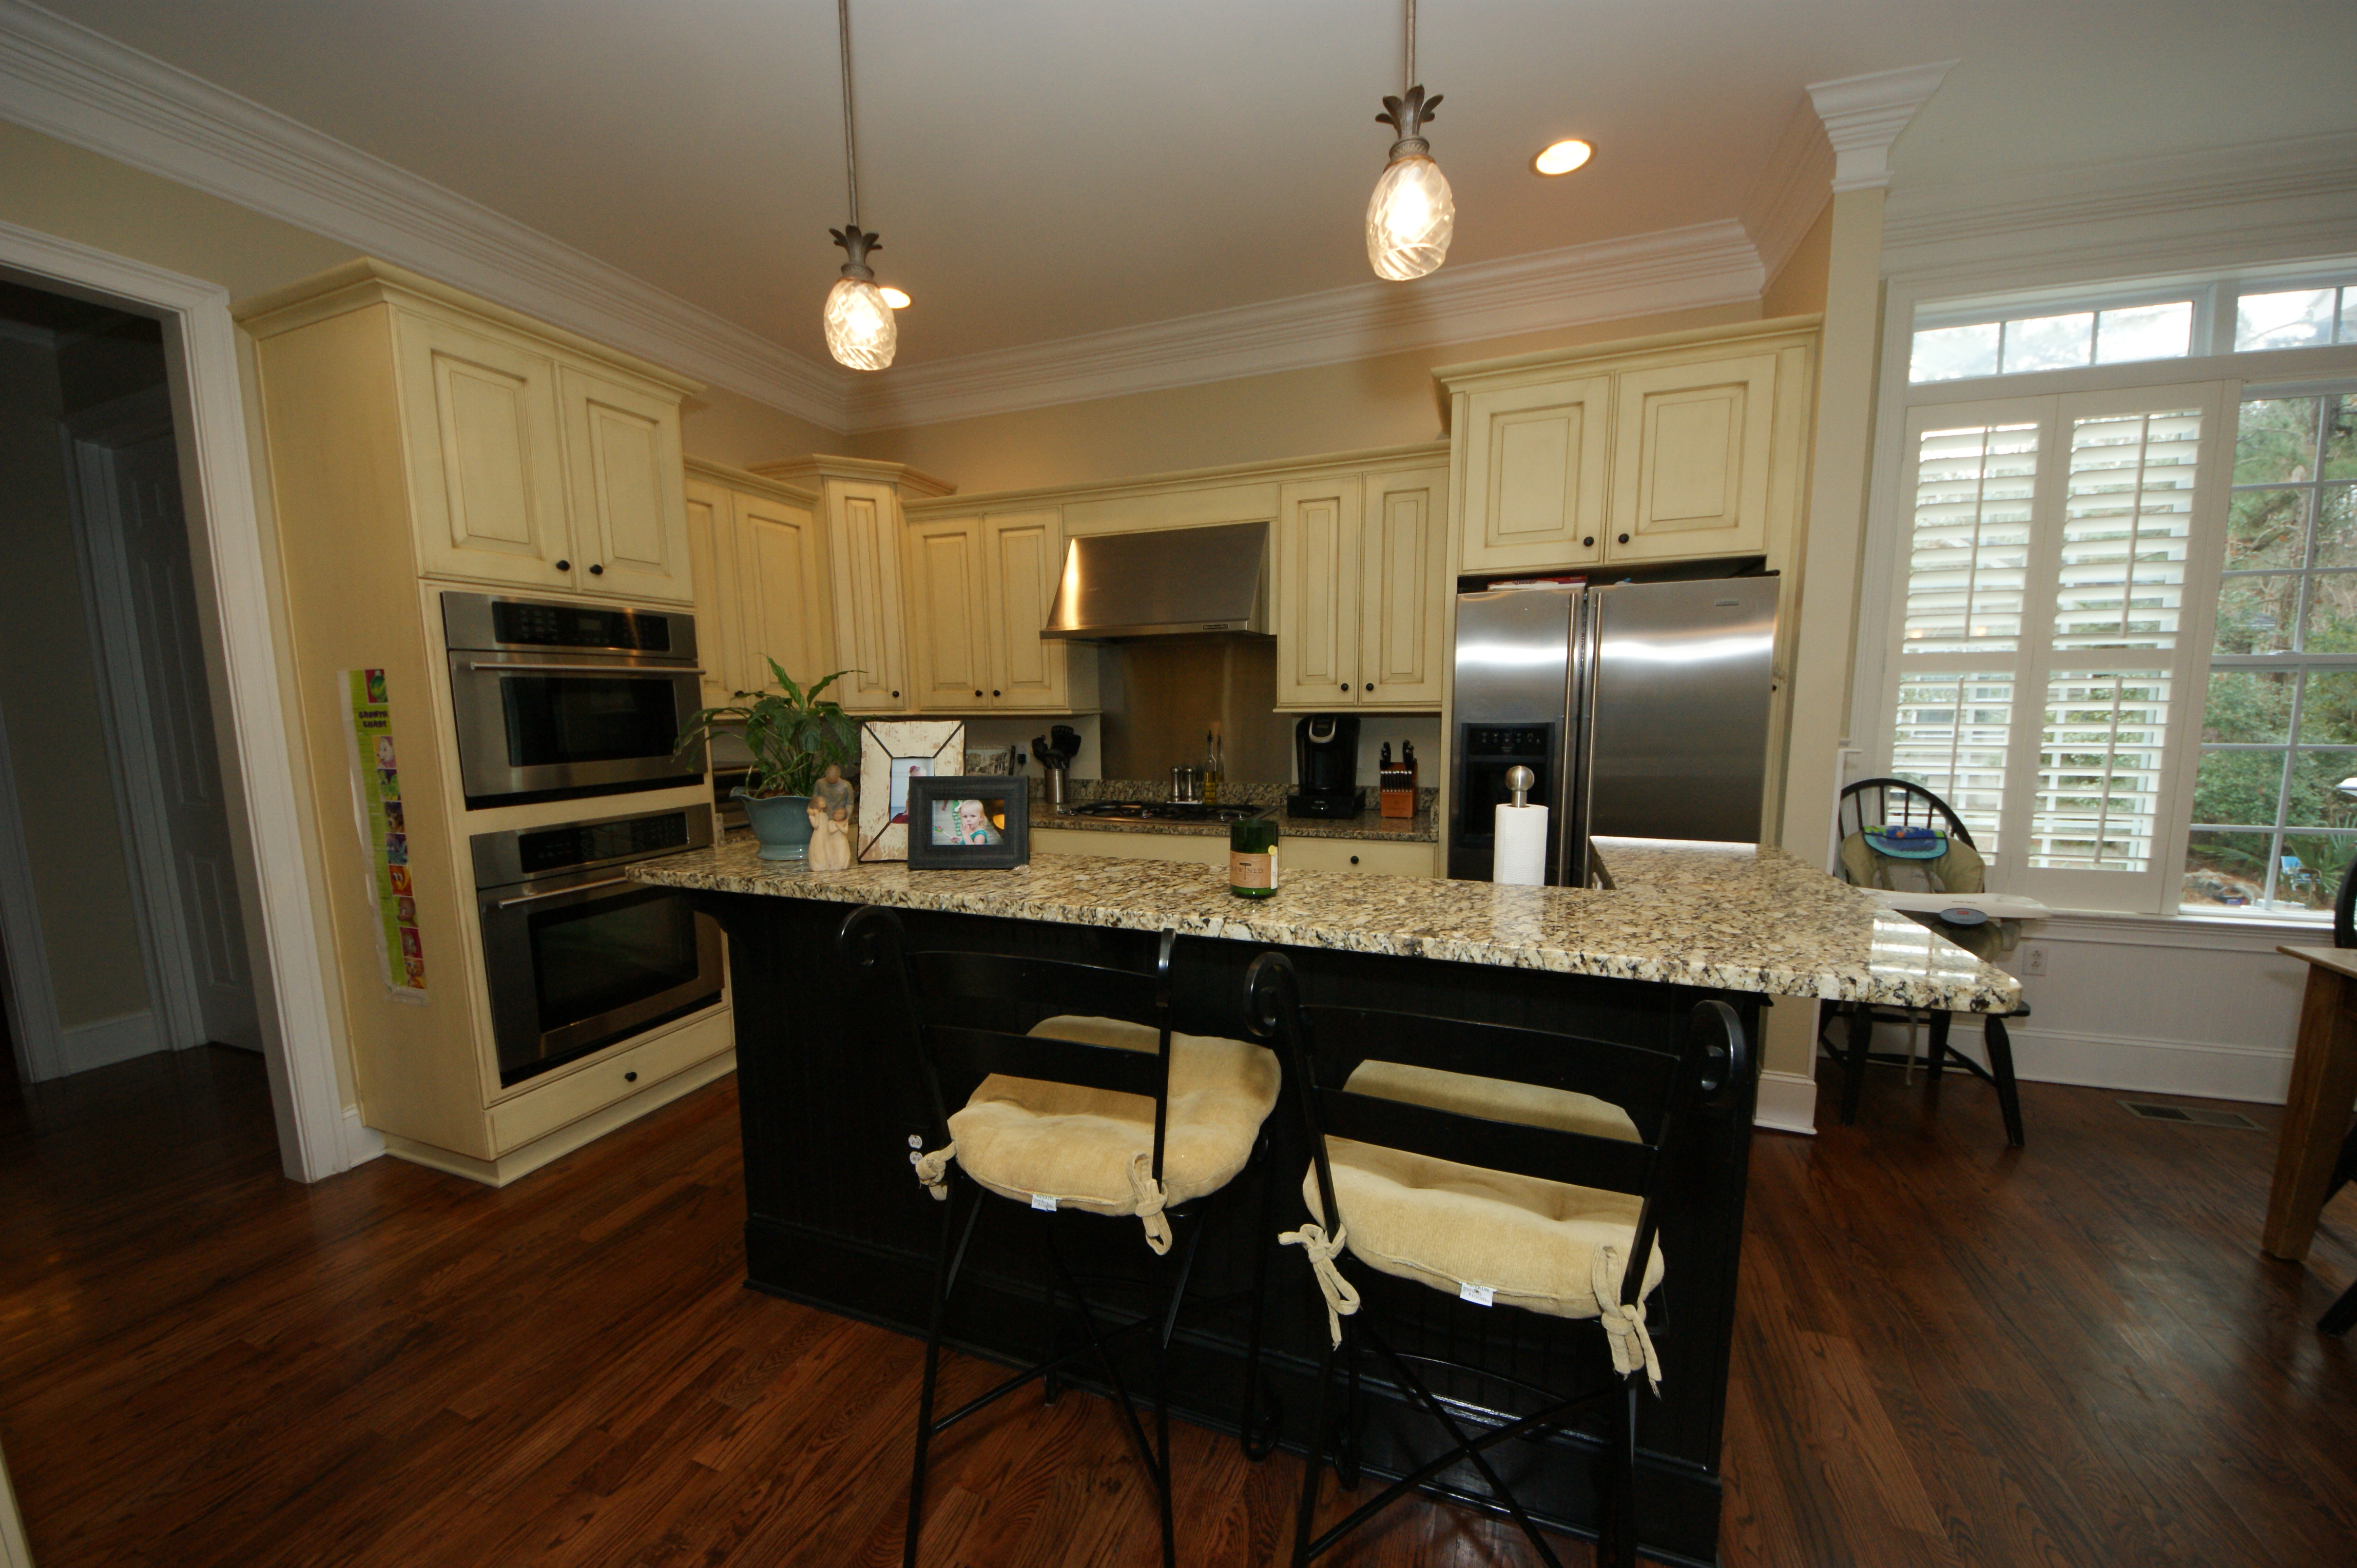
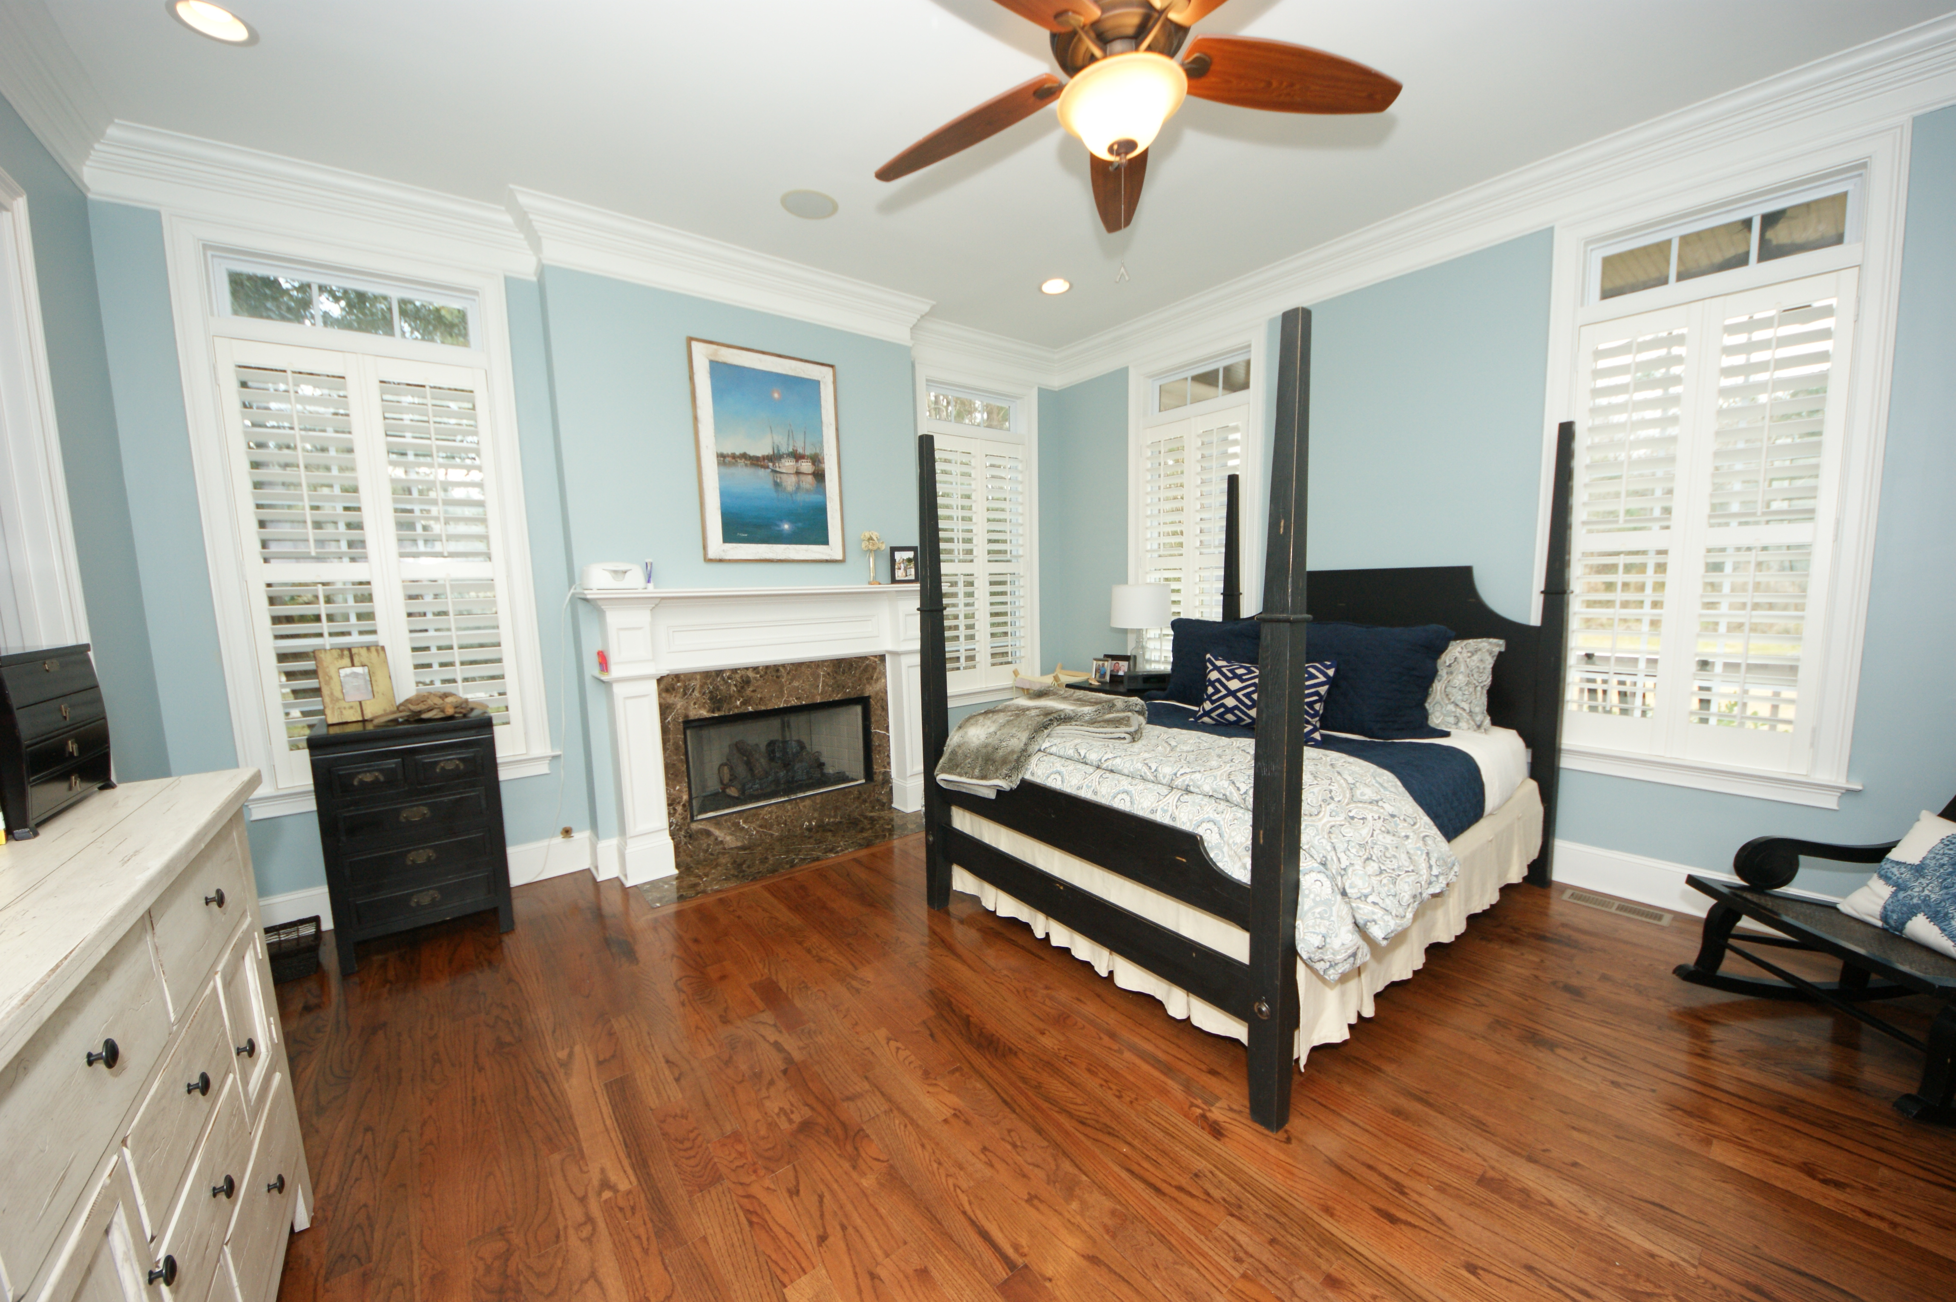
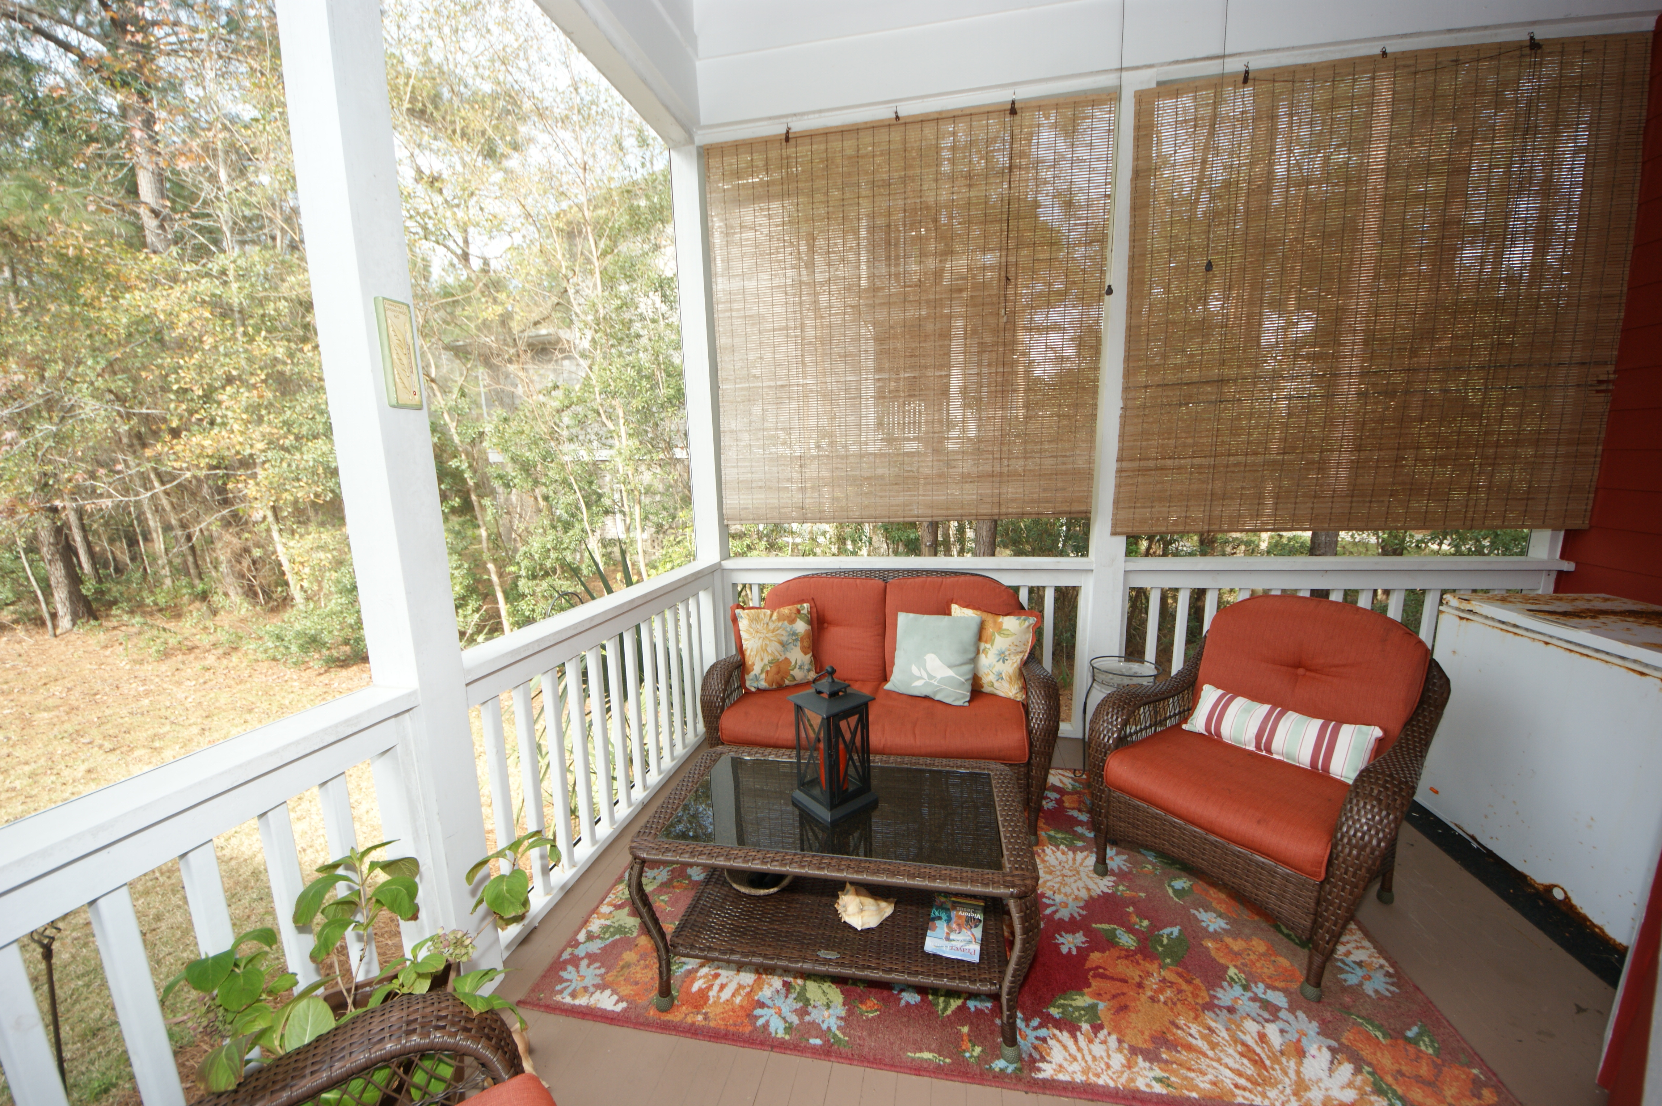
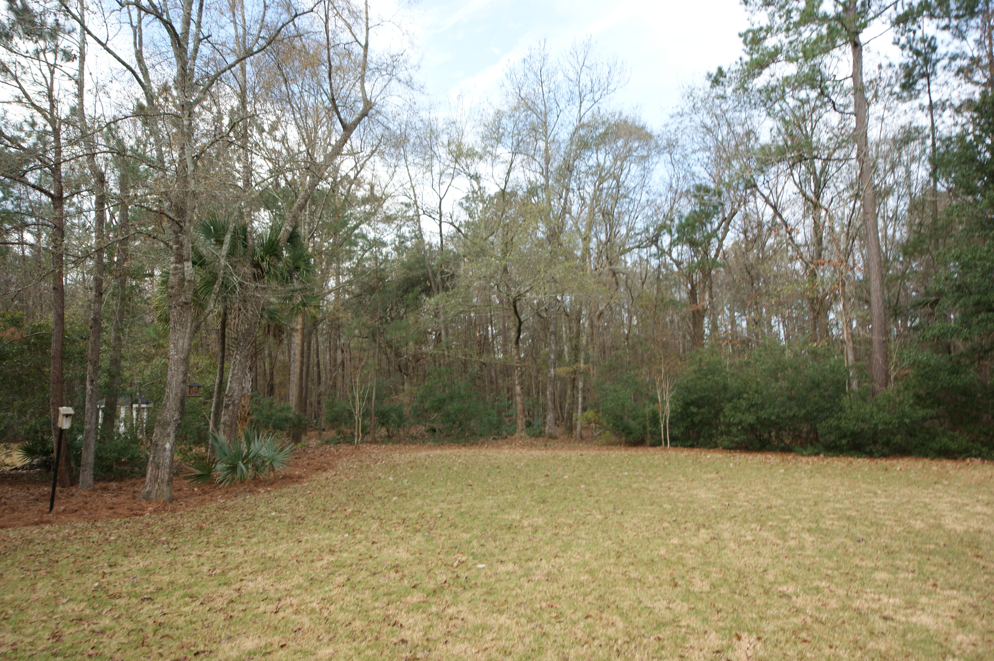


Beautiful Southern Home on Large Lot in Darrell Creek
3731 Saint Ellens Drive
Mount Pleasant, SC 29466
MLS# 15031212
$594,000
Reduced!!
If you ever wanted to live in true Charleston style, this fabulous home is a MUST SEE!!!!! This lowcountry home pays attention to its southern roots. When you drive up to the home, you will find spacious double porches, gas lanterns, folding shutters and a beautifully landscaped yard all in line with true southern style. The home sits on .62 acres surrounded by rich landscaping with aged trees, palms and a growing legacy with the young live oaks to be here for generations to come. Taking to the water is easy with a driveway that can accommodate your boat or other toys. Entering the front door you will see the house is decorated beautifully from the gorgeous hardwood floors to the unique light fixtures. The downstairs has extensive woodwork that adds a lot of character to the home. The large dining room is filled with natural light and has plenty of room to entertain. Hosting has never been easier with the flow of the floor planâ€”from the spacious dining room which leads straight through the butler's pantry into the fully custom kitchen. The butler's pantry features lots of storage, distressed black cabinets, granite countertops, and a wine cooler. From here, you will enter a kitchen with everything a cook desires: stainless steel appliances, a gas cook top, built-in microwave, oven, granite countertops and a side-by-side refrigerator. There is plenty of room for a casual dinner with an eating area off of the kitchen as well as bar stools at the bar. The kitchen is open to the family room where many good times are shared. There is a flat screen TV, built-in bookshelves, a gas fireplace, and a fabulous screened porch off of the back of the house. The Master Suite is located on the first floor. It features a gas fireplace (it could also be a wood burning fireplace), a large walk-in closet, and a fabulous Master bath with dual vanities, a tiled shower and a claw foot tub. On the second floor, you will find 2 large bedrooms with their own baths, a study that opens up to the upstairs porch, and a huge "bonus" area. There are several storage areas on the second floor as well. Please Note: the 9 zone irrigation system is on a well that keeps the EMPIRE Zoysia grass looking GREAT. *The second floor has a new HVAC unit. *The dishwasher has also been replaced. Start living your low country dream today! Call today to schedule a time to see this fantastic home!
Kea Whatley
Mobile 843-408-8704
keawhat@aol.com
AgentOwned Preferred Group | 824 Johnnie Dodds Blvd | Mt Pleasant, SC 29464

