Slide 1
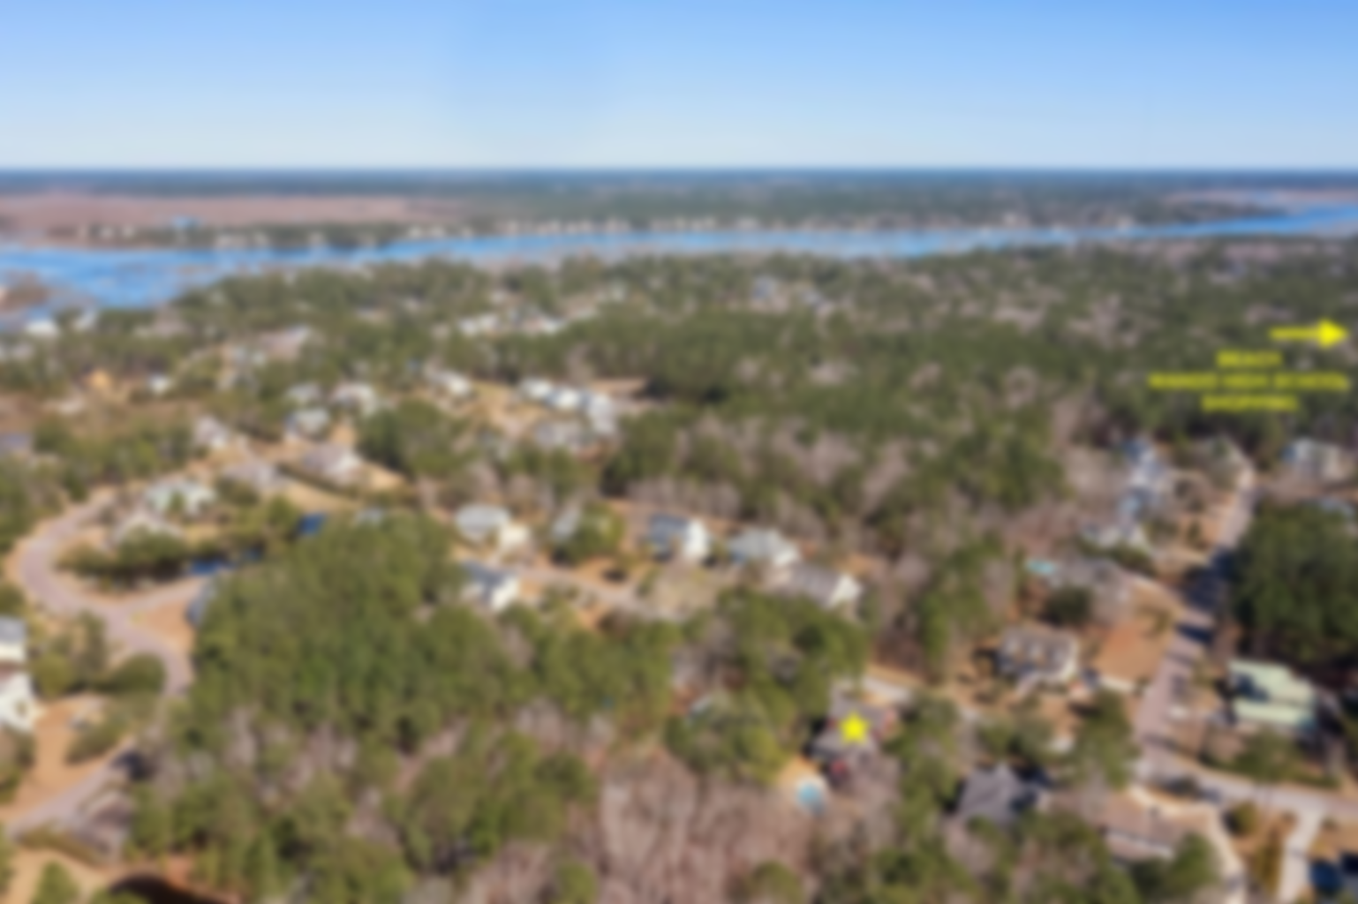
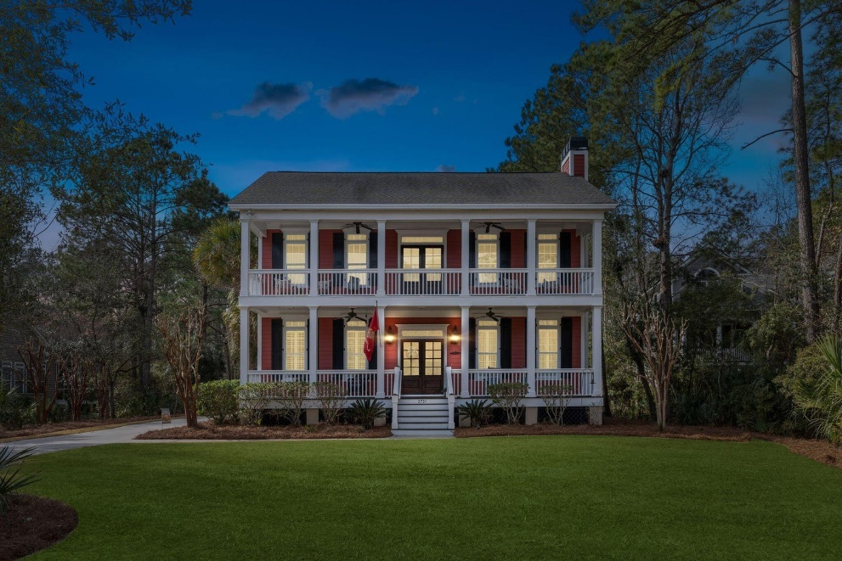
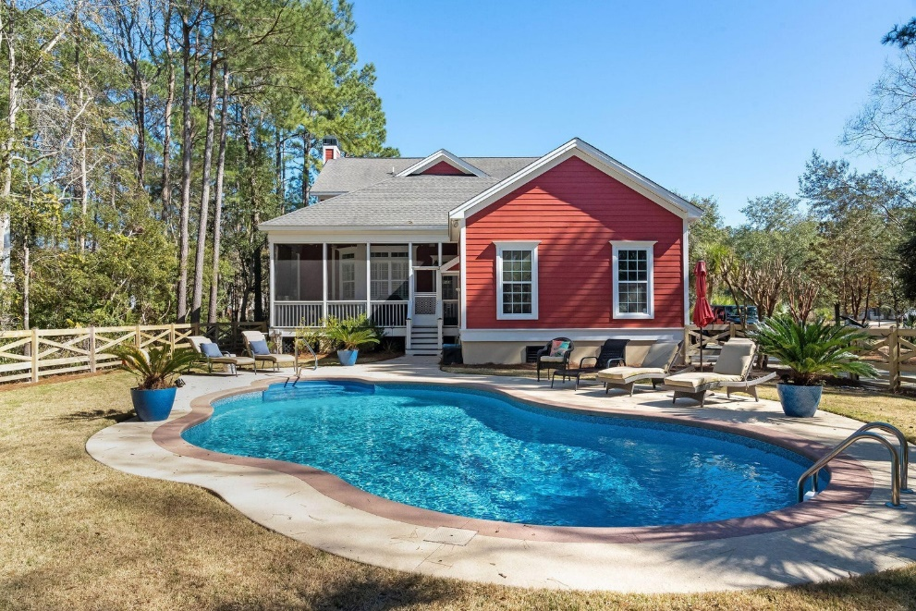
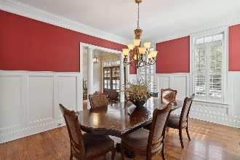
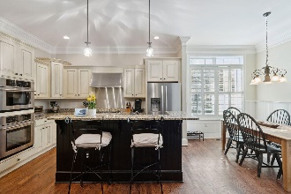
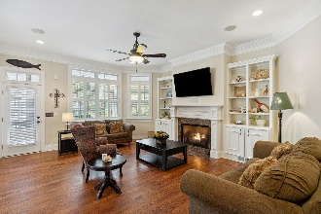
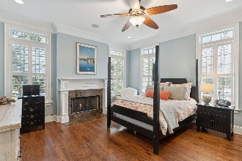
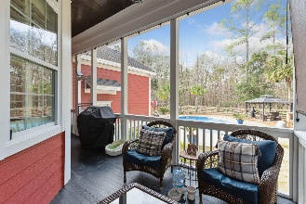
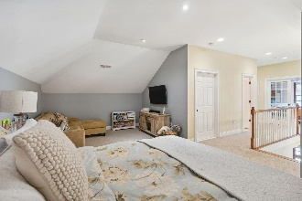
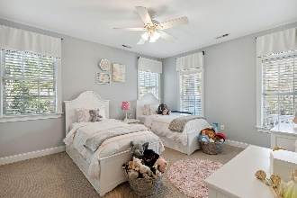
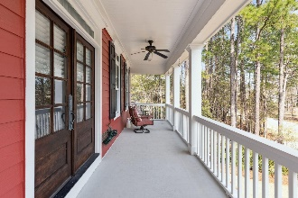
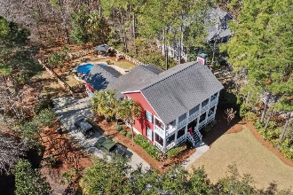



JUST LISTED DARRELL CREEK WITH POOL!
3731 St Ellens Drive
Mount Pleasant, SC 29466 | MLS# 23003280 | $1,199,000
Welcome to 3731 Saint Ellens Drive! Southern charm meets classic elegance in this custom built home in the highly desirable neighborhood, Darrell Creek. Welcomed by generous double stacked porches with privacy on all sides, you will notice the many custom features when entering the home. The upgraded crown and decorative mouldings, smooth finish 10'+ceilings, plantation shutters, and hardwood flooring, gives you a true sense of sophistication in this Lowcountry home. This home is situated on over half an acre that is surrounded by protected wetlands with a 15 foot buffer in the back. The lawn and landscape has been pristinely maintained and includes a 9 zone irrigation sprinkler system that is run by a well. The outdoor living space includes an in-ground pool, patio, screened porch, gazebo, area for a garden, and play set, making this a perfect place for entertaining guests and enjoying Charleston summers. As you enter the home, you will be greeted by the grand staircase in the foyer and the abundance of natural light generated from the multitude of windows. The heart of this home is the living space which offers a perfect entertaining flow to include an eat-in kitchen open to the family room, separate dining room, and a butlers pantry to include a wine fridge. The family room includes built-ins surrounding the gas fireplace dining and a half bath. The custom kitchen features a gas range cooktop, range hood, new dishwasher, upgraded appliances, and granite countertops. The laundry room is downstairs as well as the master suite. The master bedroom includes a gas fireplace, walk-in closet, and en suite bathroom with his and hers sink, upgraded claw foot bath tub, and a large tiled shower. Arriving upstairs, you will find a bonus loft space perfect for a second family room or play room. There is a separate office space/4th bedroom option to include french glass doors upstairs with access to the top porch. The two upstairs bedrooms are very generous in size to include large closets as well as two full bathrooms. All of this exceptional living space is complimented by plenty of outdoor space. In addition to the double front porches, there is a screened porch off of the family room. This space is perfect for enjoying al fresco dining while looking out onto your private, protected wetlands/wood yard and pool. The private driveway leads you to the attached garage, that has been upgraded with epoxy and includes storage. Darrell Creek amenities includes a pool and future additional outdoor gathering facility and tennis courts. Love boating? There is a public boat launch minutes from this home and the HOA allows homeowners to keep their boats in the driveway or garage. Walk or ride your bike to the neighborhood library or schools; Carolina Park Elementary School, Wando High and Oceanside Collegiate Academy, Mount Pleasant's top rated schools. Minutes to Shopping, Hospital, Dining, Charleston International Airport, Isle of Palms and Sullivans Island, and Downtown Charleston.
*New HVAC 2021(down), New HVAC 2015 (up), New Water Heater 2023, Exterior painted 2022*
Virginia Landon 803-493-9202
virginialandon@kw.com
Keller Williams Realty | 496 Bramson Ct Ste 200 | Mt. Pleasant, SC 29464

