Slide 1

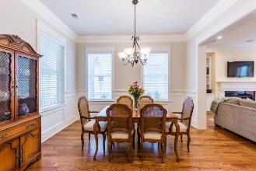
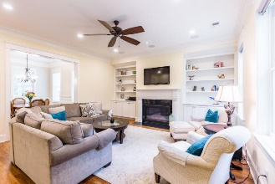
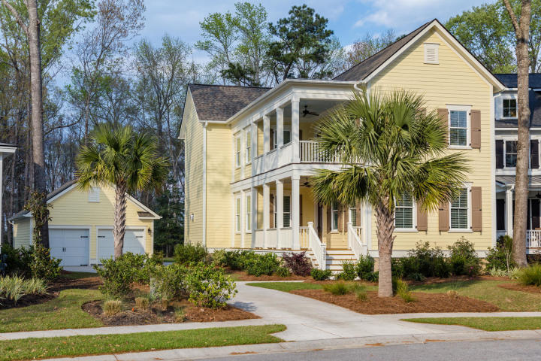
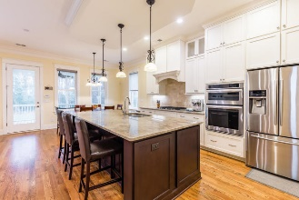
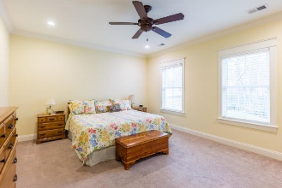
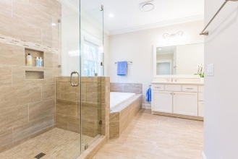
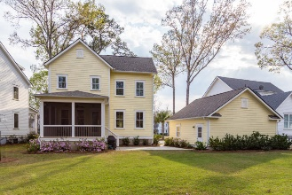
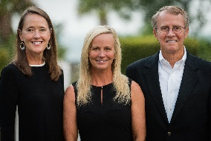

3732 Oconee Loop Mount Pleasant, SC 29466 | MLS# 19008492 | $700,000
Classic Lowcountry Home in Carolina Park
Classic Lowcountry home settled on a tree-lined street in the prestigious Riverside at Carolina Park. Lush tropical landscaping and double side piazzas welcome you to this southern charmer. Step inside and take note of the custom millwork found throughout, including gorgeous hardwood flooring, multi-piece crown moulding and tall baseboards. The walls are adorned with custom wainscotting and a large cased opening provides for open, easy flow into the family room. The spacious family room boasts a gas fireplace with custom surround and mantle and is flanked by built-ins on either side. The large designer inspired kitchen will be a joy for the family chef! A large center island separates the kitchen from the family room and offers plenty of space for kids to spread out and complete homework while dinner is prepared. Outdoor living is a hallmark of life in the Lowcountry and this home provides an abundance of options. In addition to the two front porches, a screened-in back porch provides a shady spot to dine alfresco or just relax while watching the kids and pets play in the large backyard. A detached, two car garage provides just enough room to park your cars or store all of those outdoor toys! Located in the sought after Riverside at Carolina Park, you'll have access to luxury amenities such as a resort style swimming pool, tennis courts, children's play park, dog park, miles of walking/jogging trails, and 20 acre Bolden Lake with boardwalk and kayak launch. The new Carolina Park Elementary opened this year to join Wando High School, Wando Center for Advanced Studies, and Oceanside Academy. In addition, a brand new public library is slated to open later this year. All of this and still close to beaches, dining, shopping and all of the world-class offerings of historic downtown Charleston.
Asking $1,200,000
MLS# 17023051
3,692 SqFt
4 Bed/3½ Baths
Short Drive to Historic Downtown Charleston & Beaches
Don Dawson 843-514-0452 ddawson@carolinaone.com Carolina One Real Estate • 2713 Highway 17 North • Mount Pleasant, SC 29466
www.TeamDawsonSC.com

