Slide 1
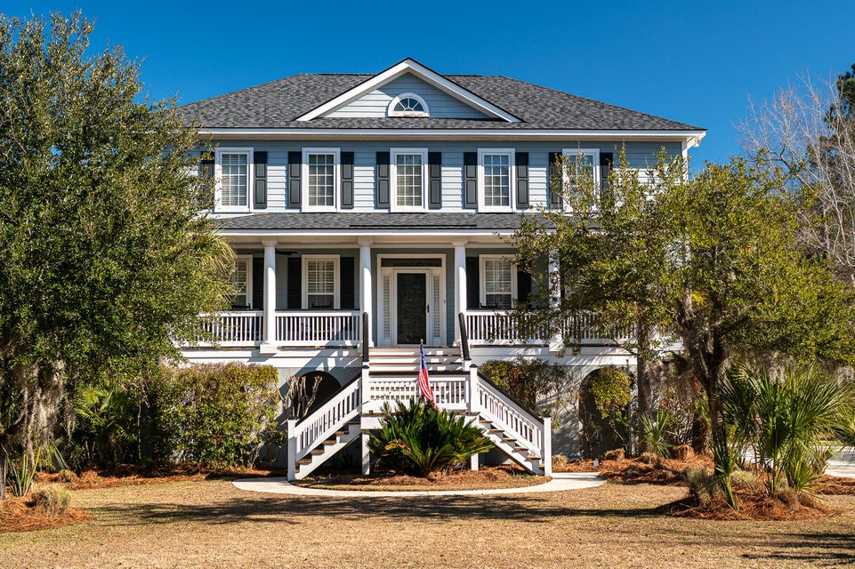
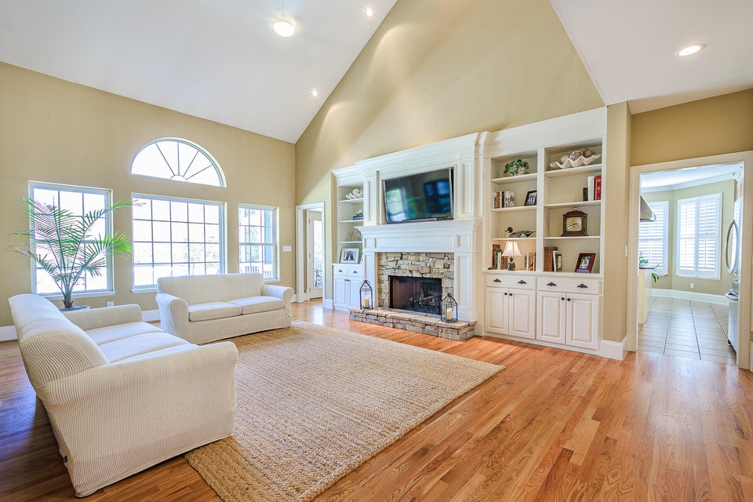
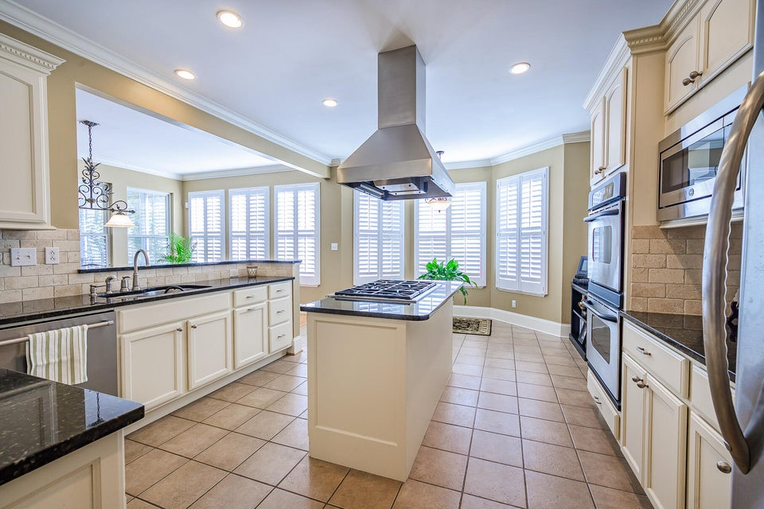
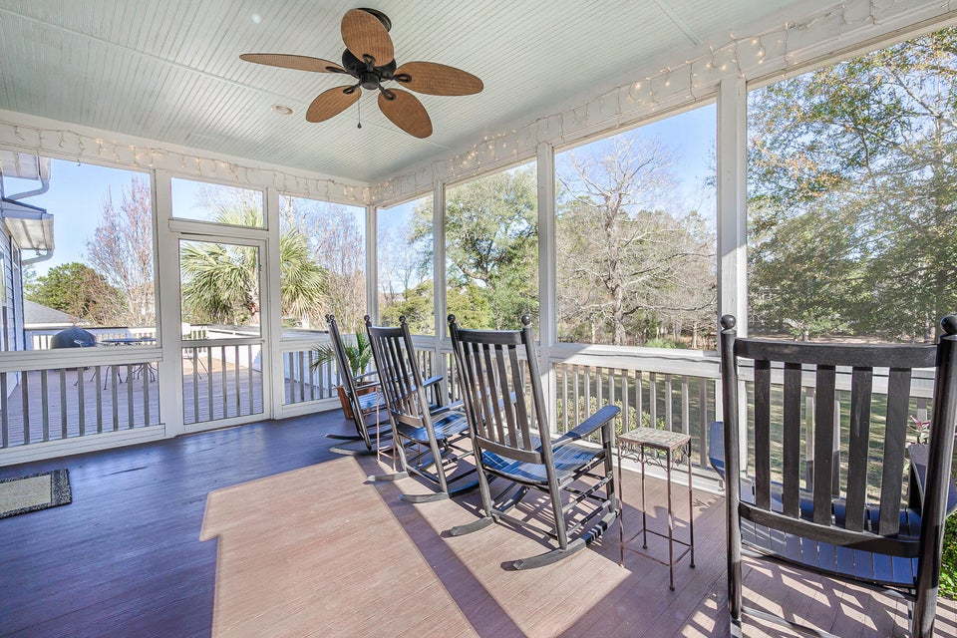


3734 Saint Ellens Drive
Darrell Creek
Mount Pleasant, SC 29466
MLS# 25002613 | $1,495,000
Open House Weekend
Stop by March 22nd or 23rd from 1-3
This beautiful 4 bedroom home located in the desirable Darrell Creek subdivision offers you the chance to experience true South Carolina lowcountry lifestyle with all it has to offer. Gaze upon wood ducks and herons on the water as you relax in your rocking chair on your screened back porch overlooking the large private backyard. Watch the fish jump in your own backyard lagoon as you plan your next oyster roast under a 200 year-old oaks tree. The lot features a 160-ft frontage on a lagoon that feeds Darrell Creek, which feeds into the Wando River. Catch redfish, tarpon, speckled trout and crab 100 feet from your back door. At dusk, observe the deer feeding in your backyard as you listen to the hoot owls off in the distance. Grill fresh fish on your back deck as you entertain guests.
These and many other lowcountry experiences await you with this property.
The huge 5-car garage allows for plenty of room to store a variety of vehicles. The large driveway provides ample room to store your boat without hindering car parking. There is even a public boat ramp (Paradise Boat Landing) located 3 miles away on Hwy 17 North. There is also a covered parking place under your back porch. The veranda front porch provides a perfect spot to sit and read a book or enjoy the sunsets. The large primary bedroom is located downstairs for easy access. The den features a custom stone fireplace with bookcases for your library. The modern kitchen features a 6-burner gas stove with large counter spaces. There is even a formal dining room for holiday entertaining.
Elementary, middle and high schools are located a mile away from your property. Shopping, restaurants and churches are located close by for your convenience.
Mac Jenkinson
843-224-0210
mac@carolinaone.com
Gordon Jenkinson
843-530-2688
gordon.jenkinson@carolinaone.com
Carolina One Real Estate | 195 W Coleman Blvd | Mt Pleasant, SC 29464-3495

