Slide 1
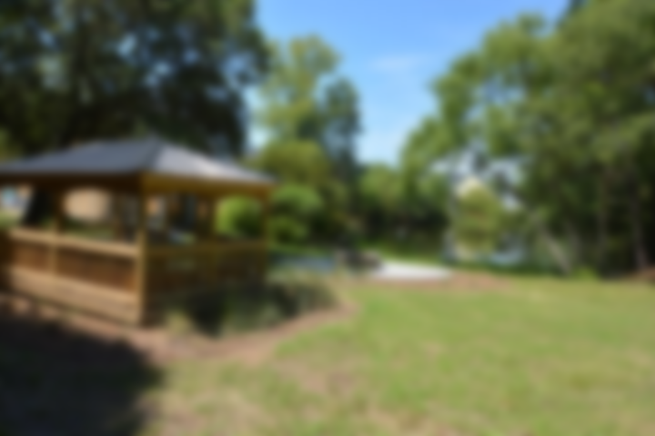
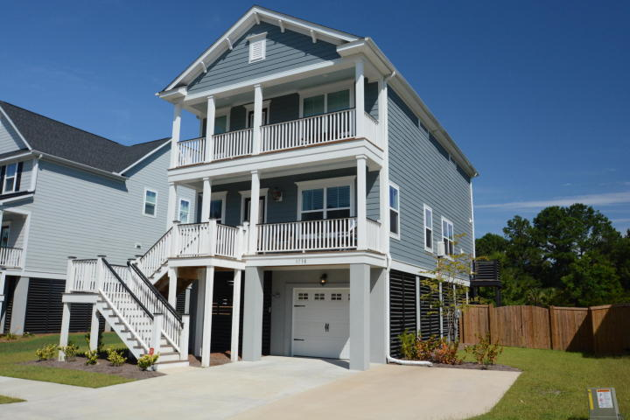
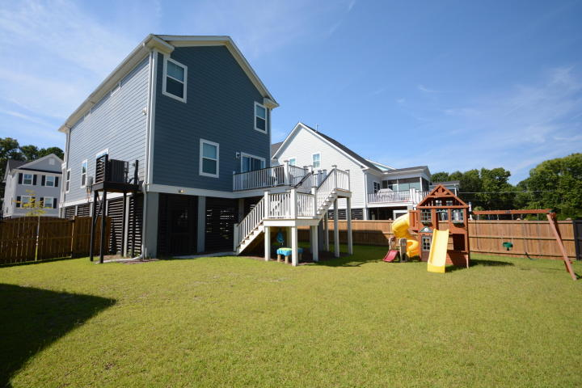
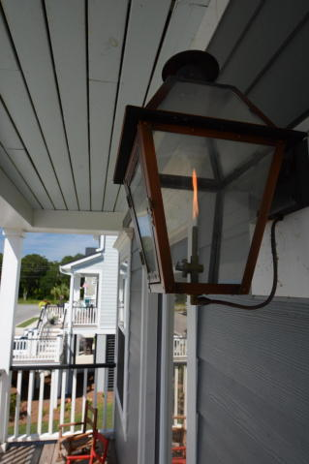
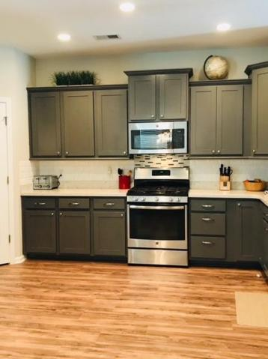
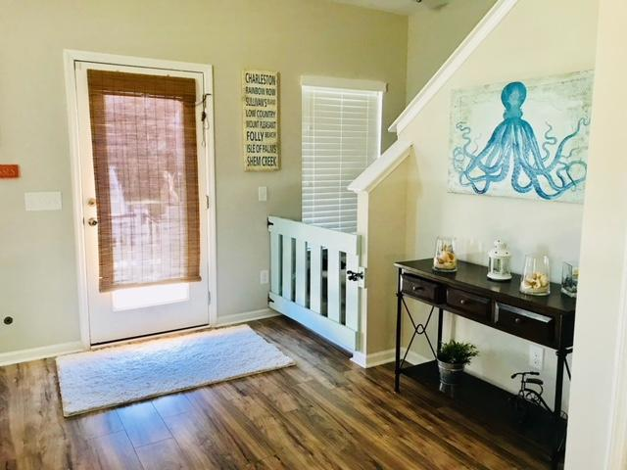
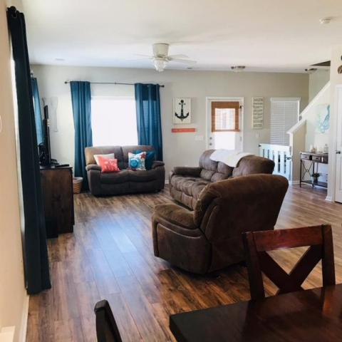
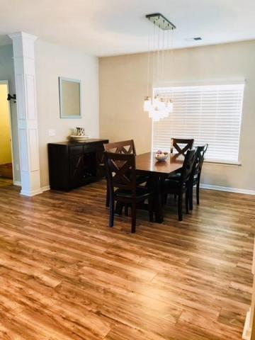
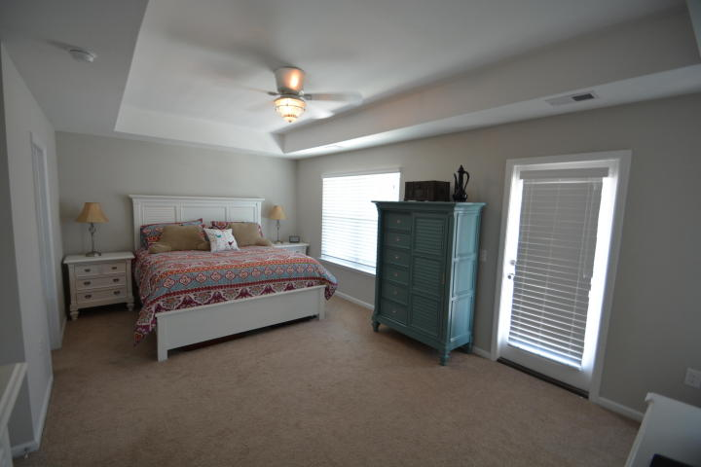
Just Listed!
3738 Copahee Sound Drive
Mount Pleasant, SC 29466 ~ MLS# 18005799 ~ $394,900
New, durable laminate floors installed through out the entire first floor creates a very open feel! Beautiful kitchen back splash, sile stone counters, and upgraded cabinets really adds to the elegance of this home.
Flex space in the back of the home can be used as a formal dining, living, sitting, office, or play room. Gas line on back deck for your gas grilling needs. From the back deck you can watch your pets or children play in the large, fenced-in backyard.
Upstairs is a loft that is perfect for second family area or playroom. Large master bedroom has its own porch and bathroom has dual shower heads in oversized shower. The home is still covered under the builder home warranty for the next 8 years.
Patricia "Patti" Nickerson
(843) 312-7478
pattinickerson@hotmail.com
Brand Name Real Estate
4 Carriage Lane Suite 106
Charleston, SC 29407
Michael Albenesius
(843) 343-5870
m.albenesius@gmail.com

