Slide 1
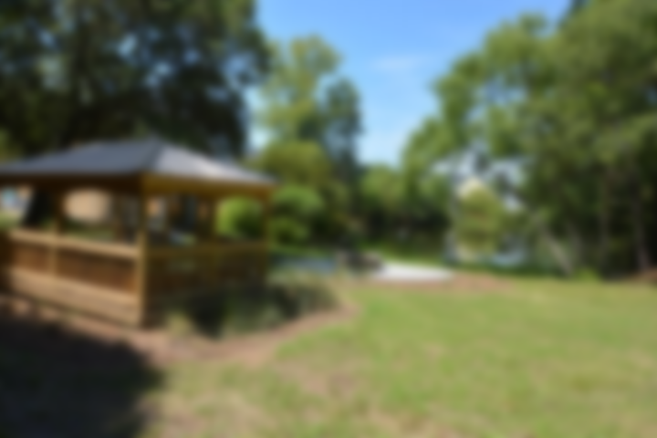
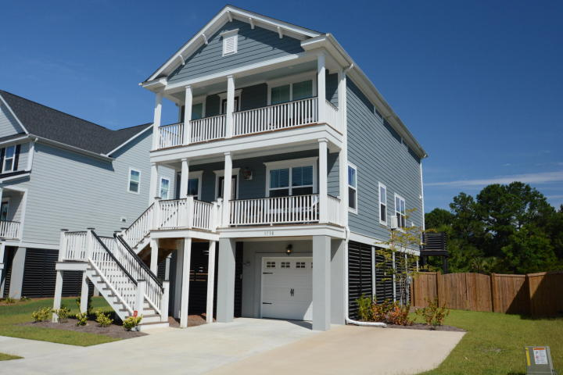
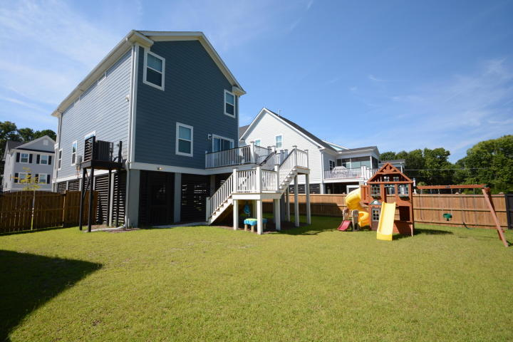
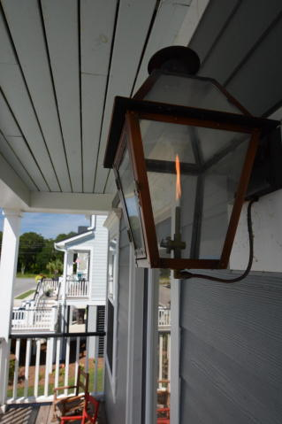
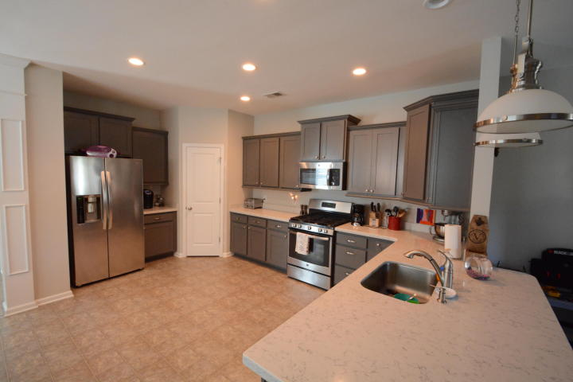
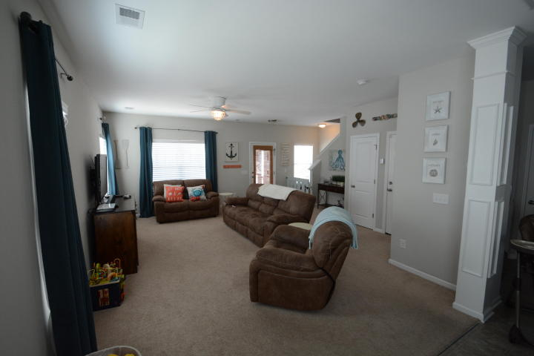
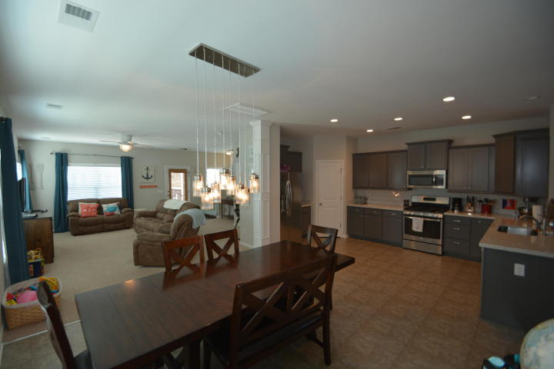
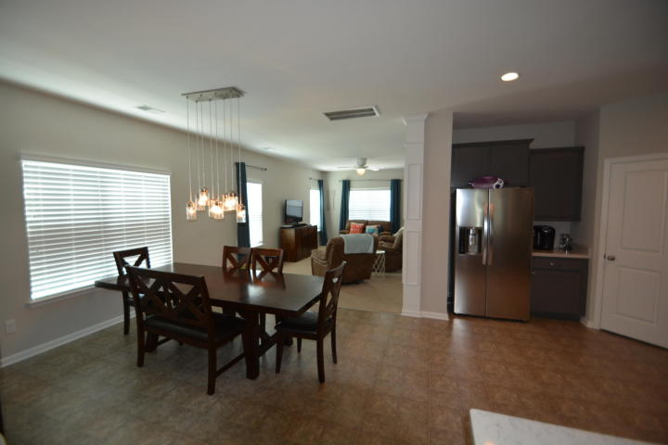
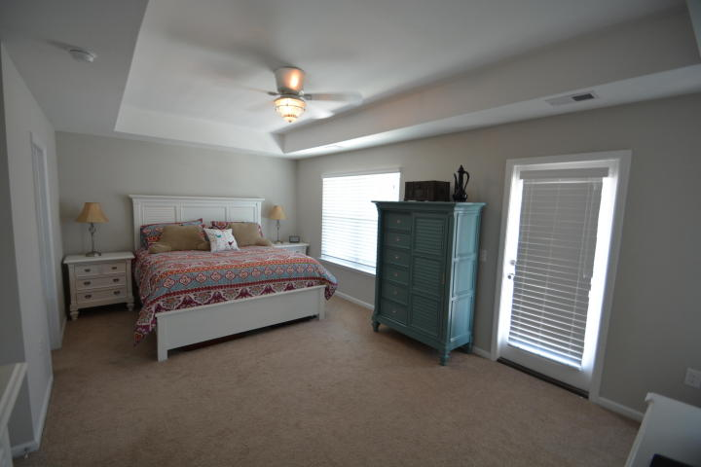
Price Reduced, Motivated Seller!
3738 Copahee Sound Drive
Mount Pleasant, SC 29466 ~ MLS# 17019317 ~ $415,000
Better than new construction and you don't have to wait, still covered by 10 year home warranty!! This home has a beautiful, open floor plan! Zoned for the new Carolina Park Elementary School.
Ceiling fans and beautiful light fixtures through out the home. Sile stone counters in the kitchen and upgraded cabinets.
Flex space in back of the house can be formal dining room, play room, sitting area, or office. Gas line on the back deck for your gas grilling needs.
Upstairs there is a loft for second family area or playroom. Large master bedroom with dual sinks and dual shower heads in the oversized shower.
Patricia "Patti" Nickerson
(843) 312-7478
pattinickerson@hotmail.com
Brand Name Real Estate
4 Carriage Lane Suite 106
Charleston, SC 29407
Michael Albenesius
(843) 343-5870
m.albenesius@gmail.com

