Slide 1
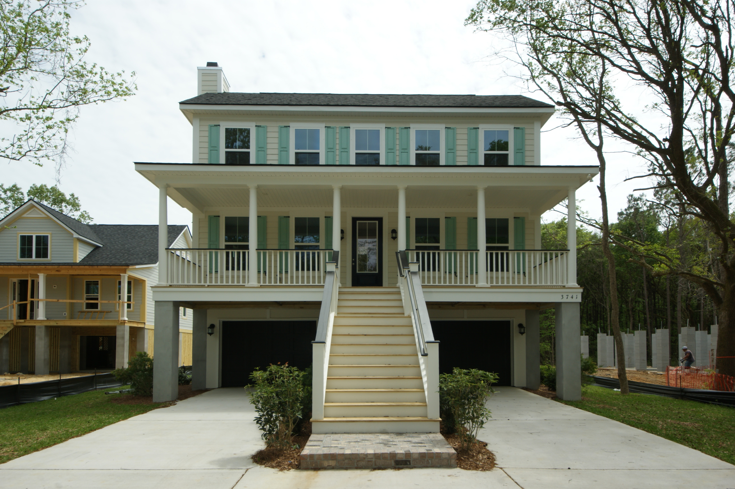
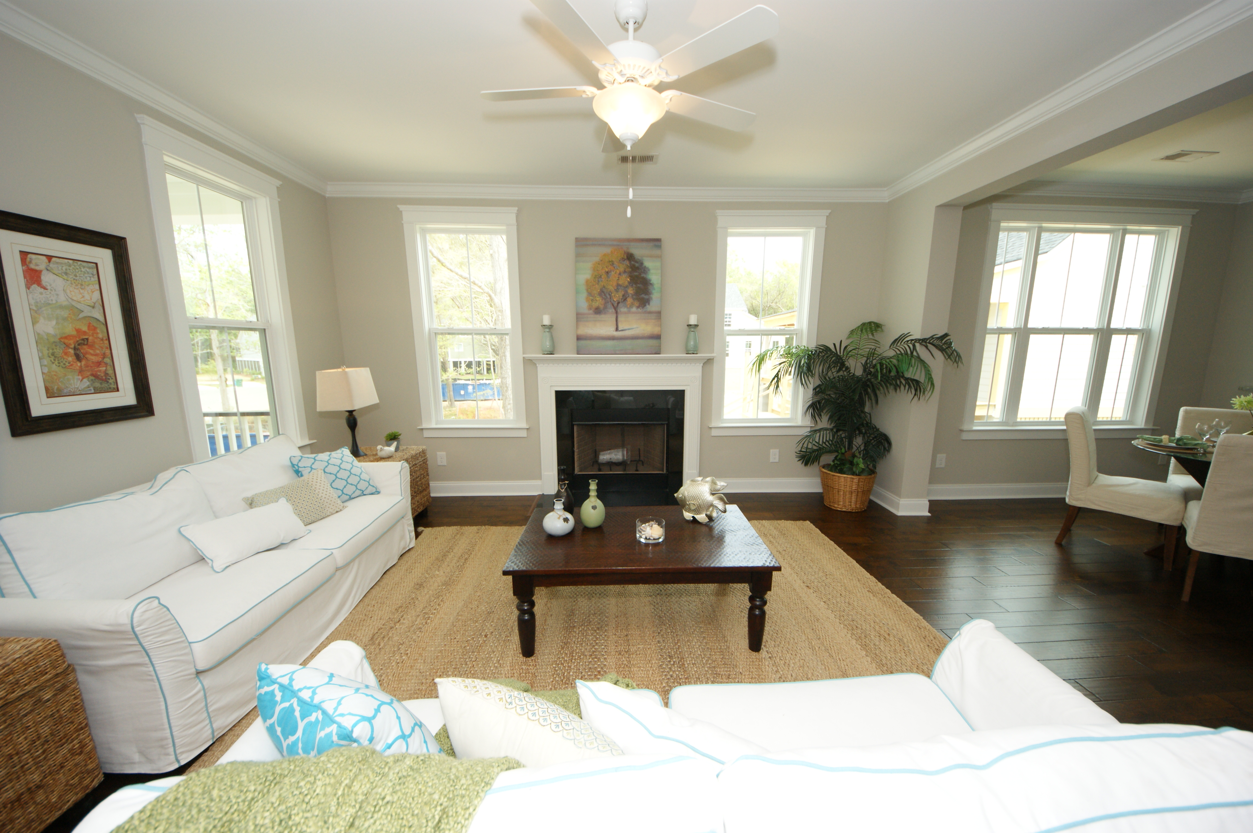
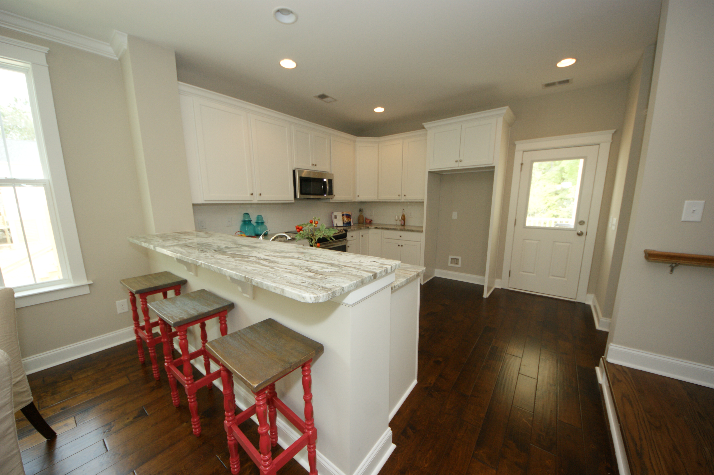
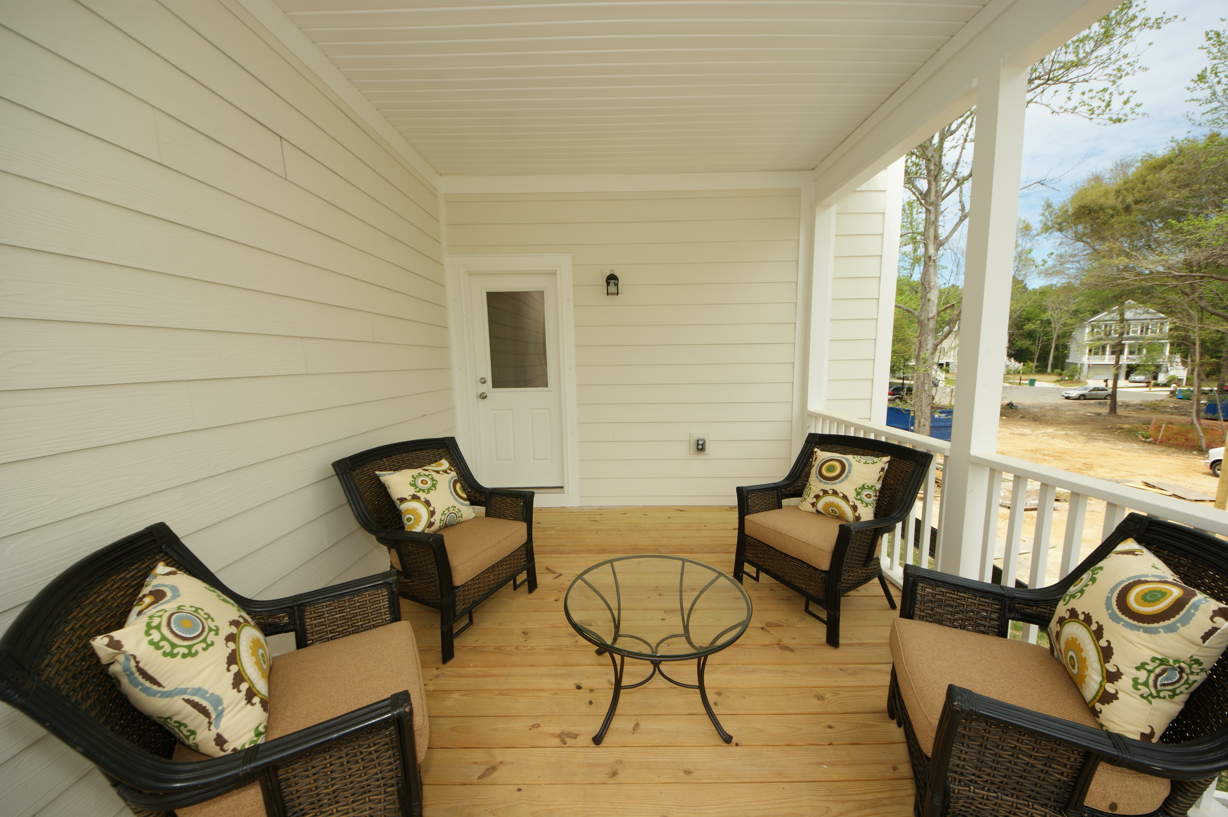
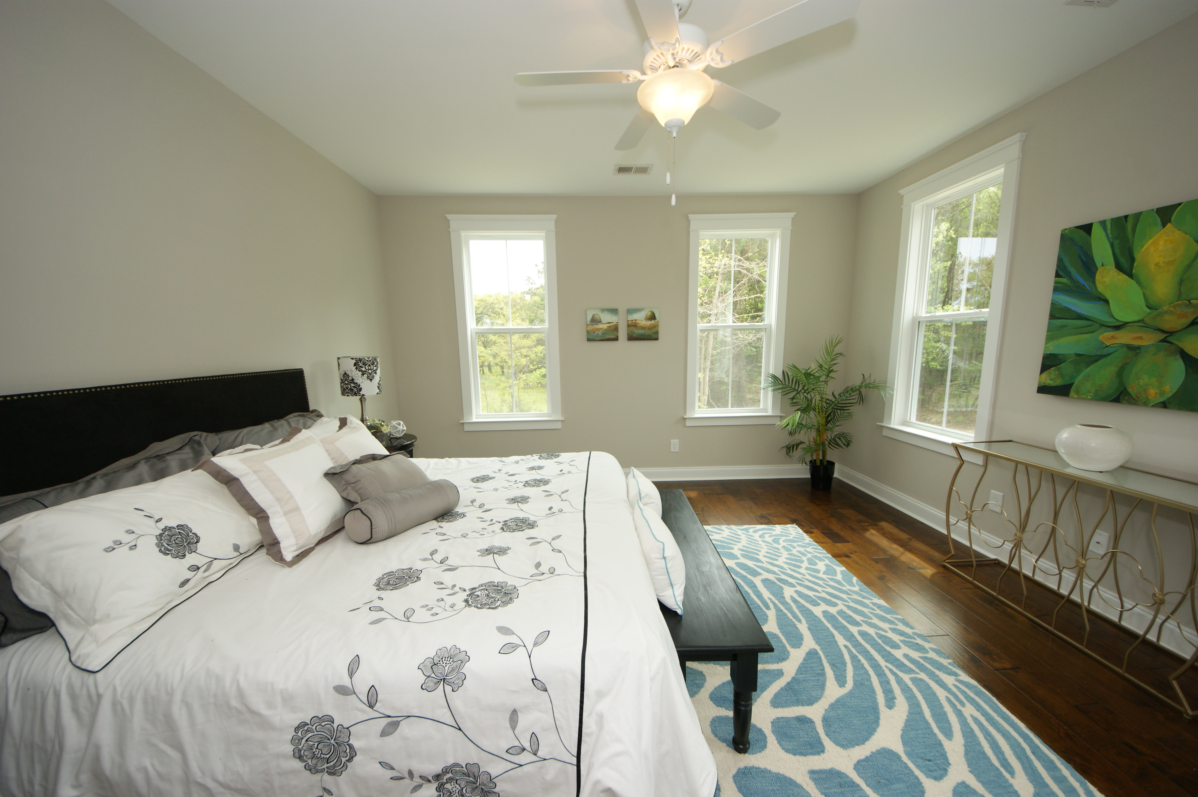
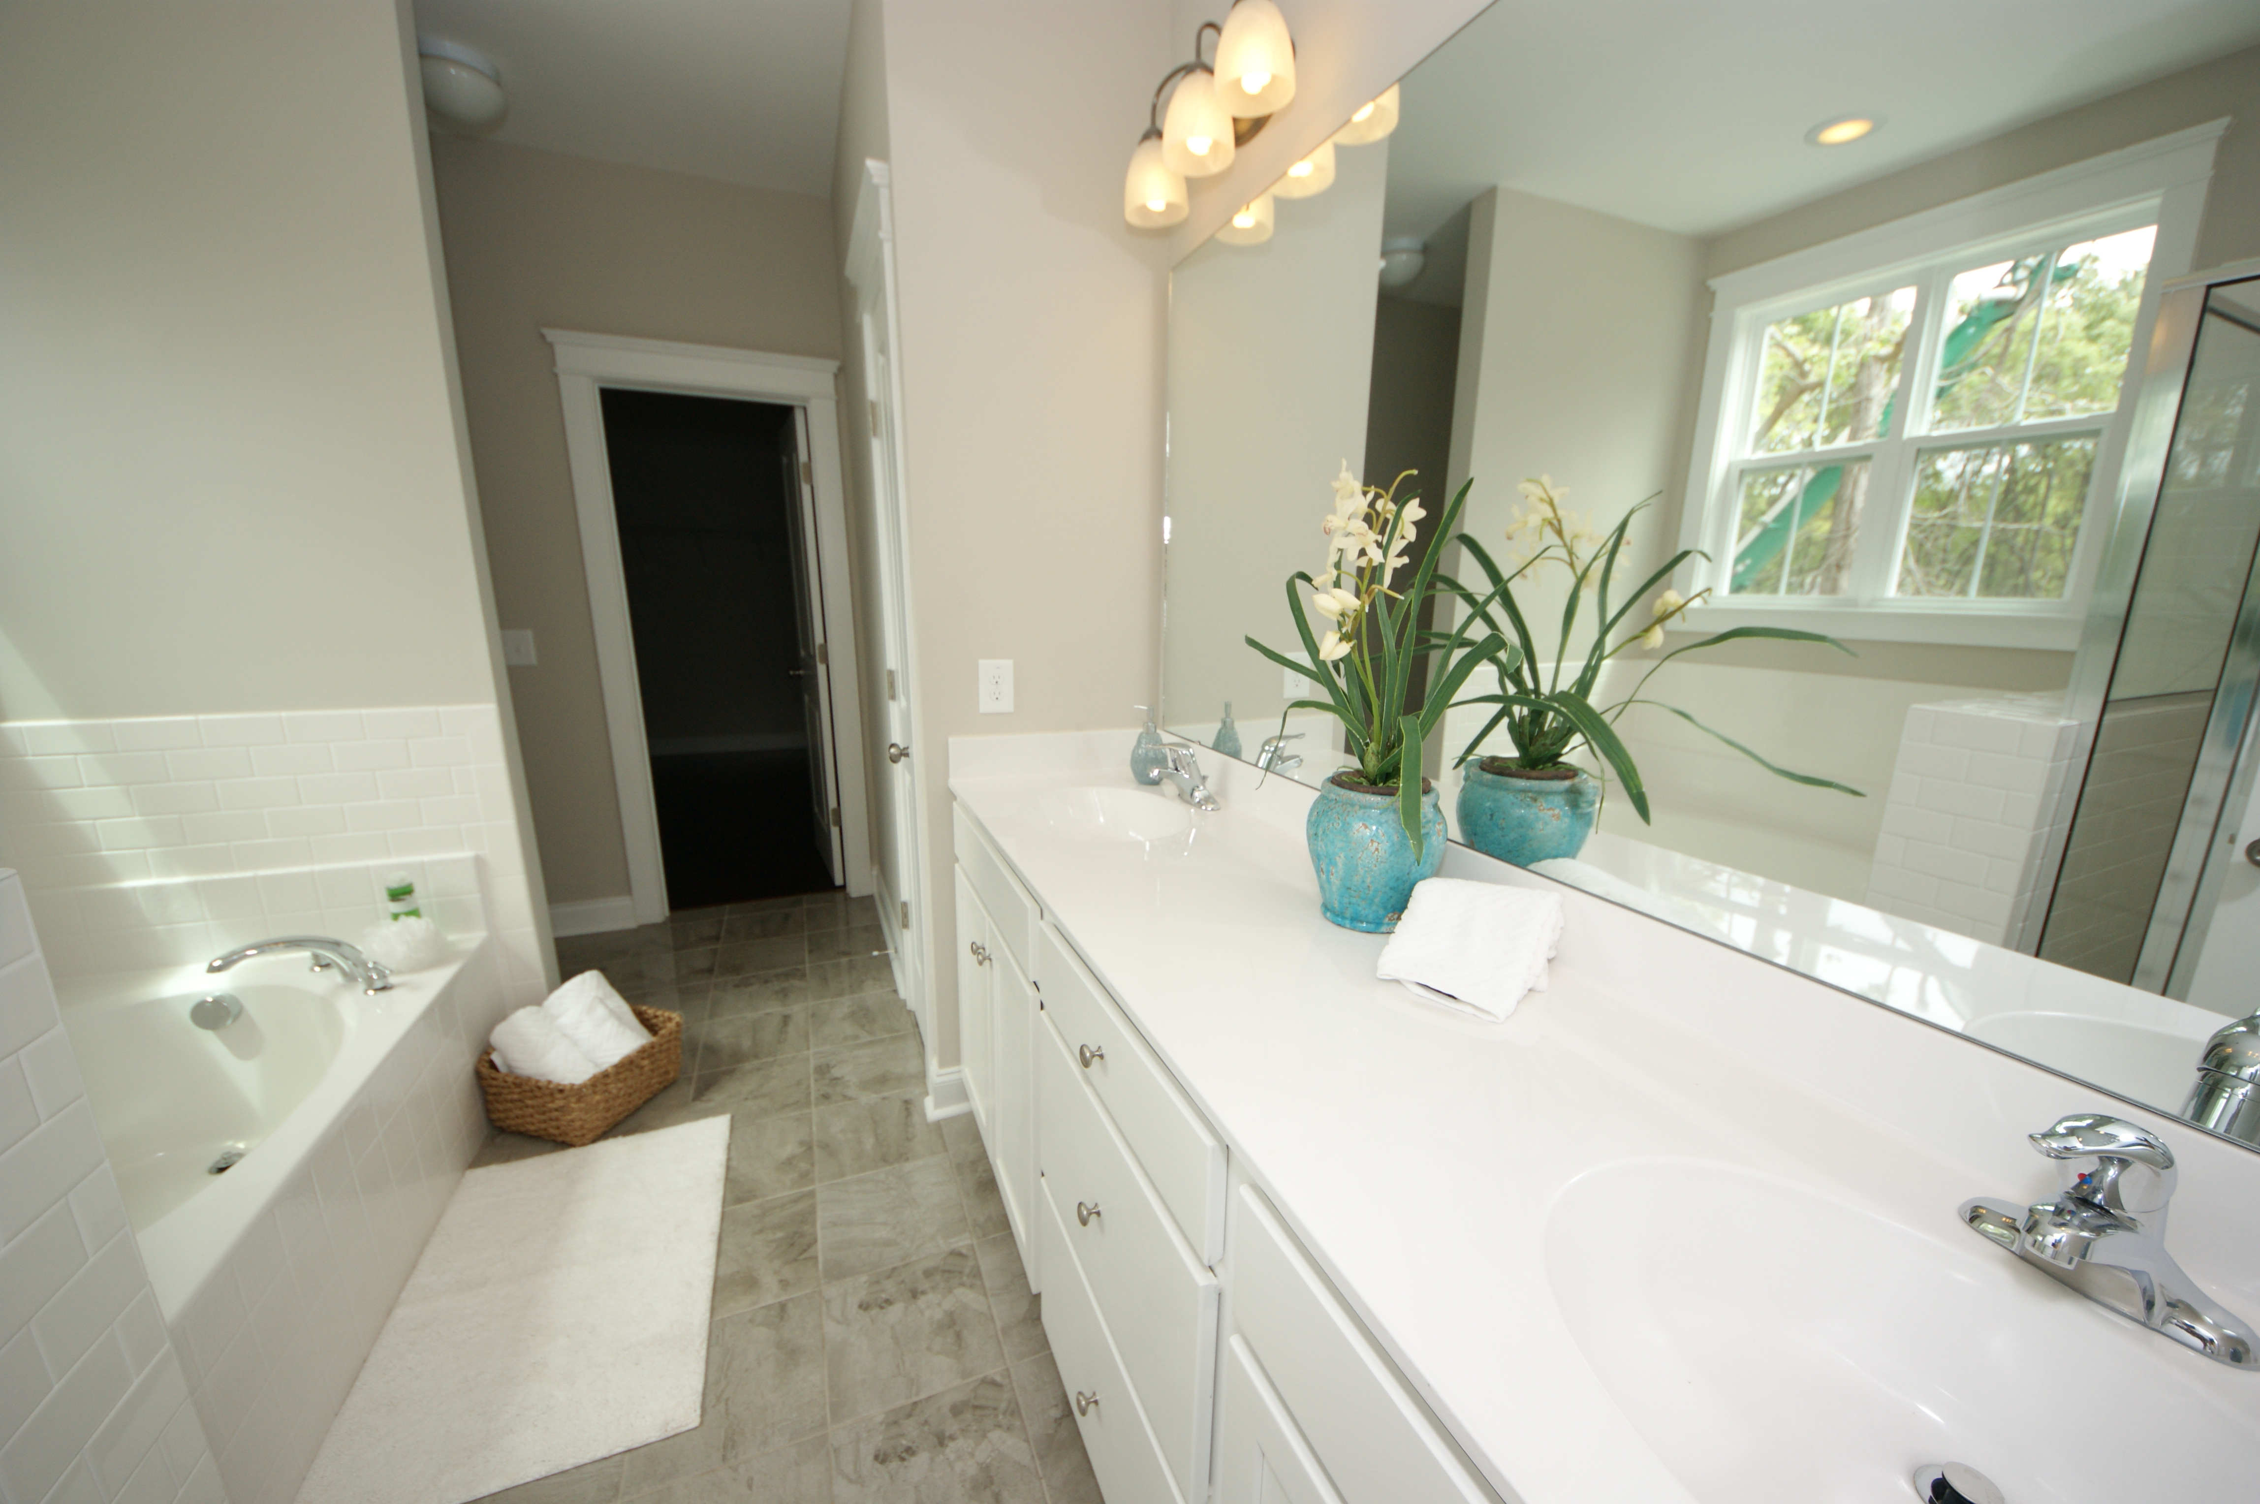
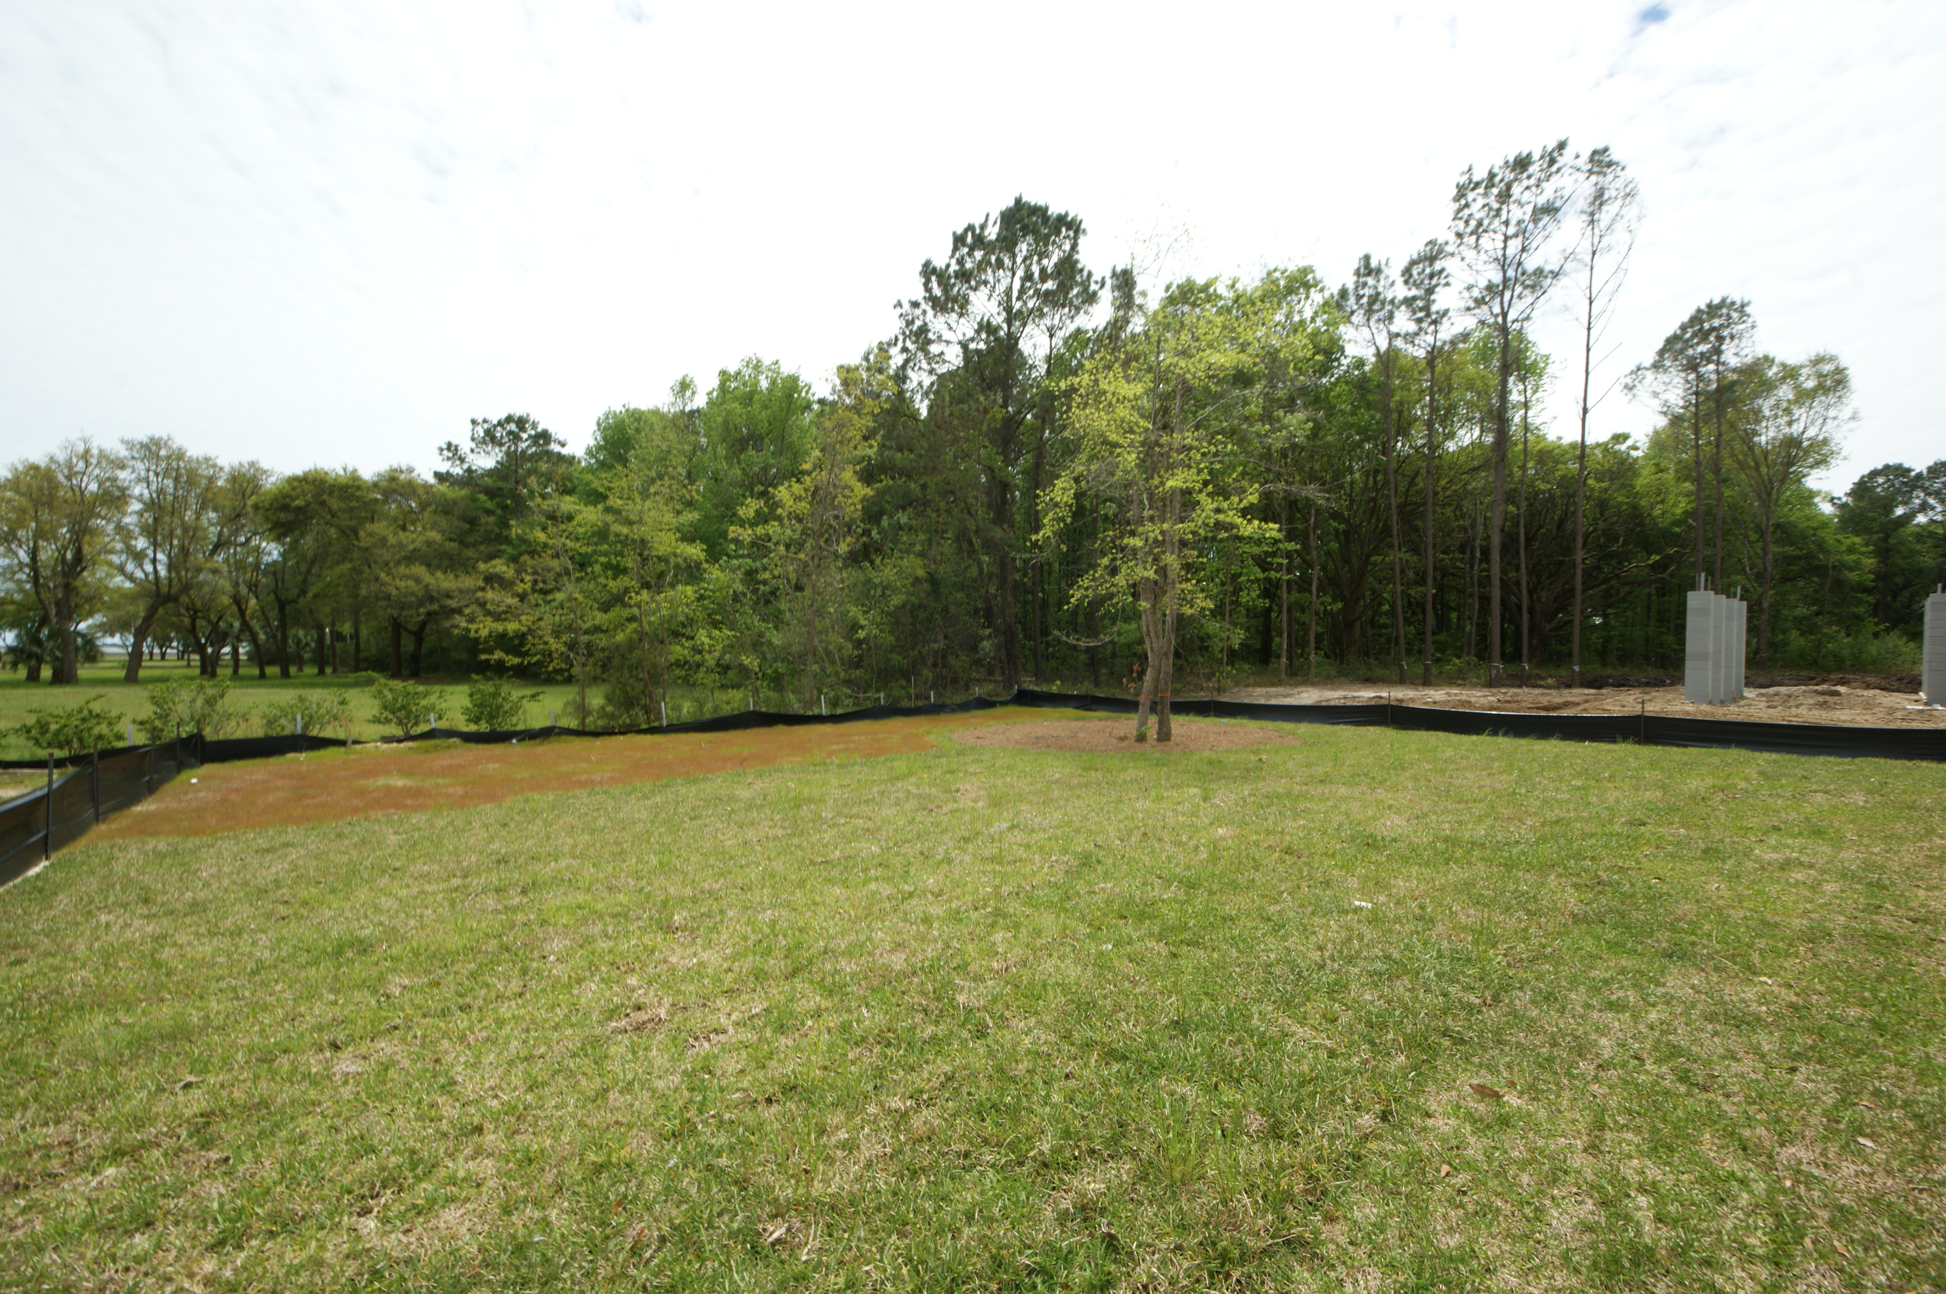
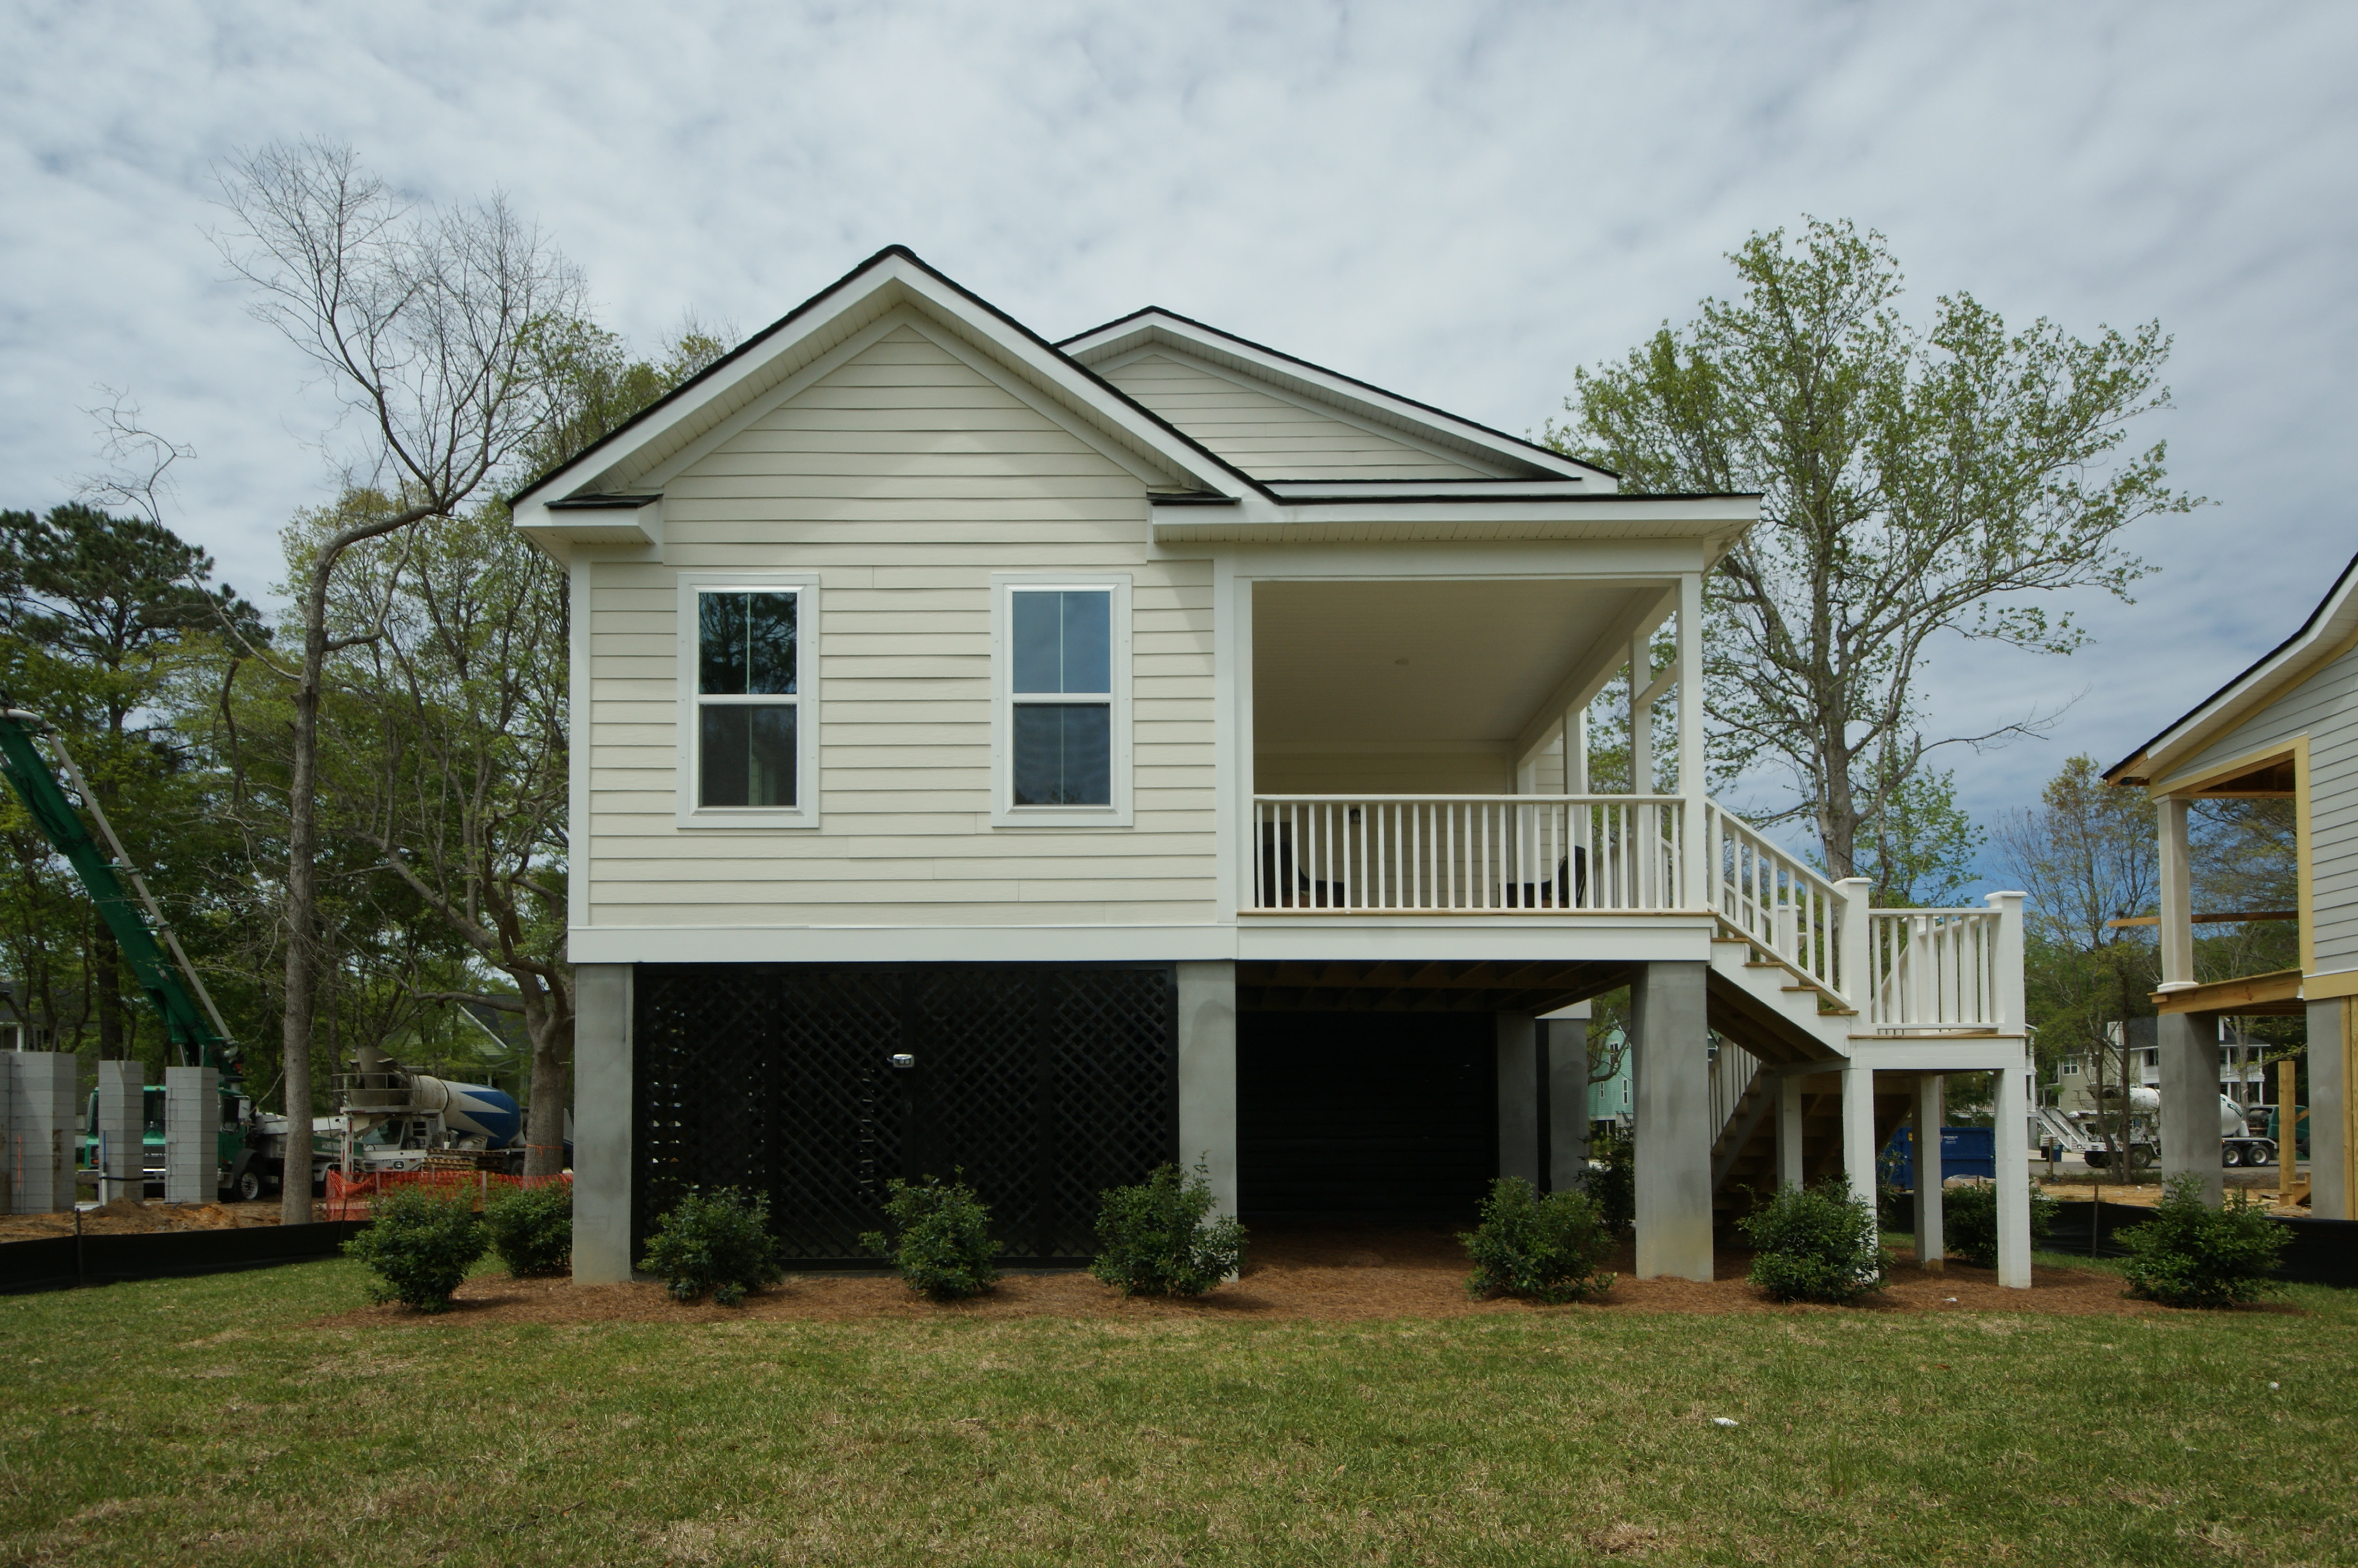


3741 Tip Lane Cottages at Copahee Mount Pleasant, SC 29466 MLS# 15027355 :: $497,100
55 and Better!
Brand New Construction
New Construction in Mount Pleasant ready now! Large, deep lots that back up to Copahee Sound! The RICHMOND floor plan is four bedrooms and four and a half bathrooms. The kitchen features 42'' inch birch cabinets with crown moulding and brushed nickel hardware, stainless steel appliances and granite countertops. Hardwood flooring is included in the downstairs main living area with a wood burning fireplace. The downstairs and owners suite shows a separate tub and shower with a double bowl vanity. Many additional features for this elevated home include cement plank siding, fully sodded landscaped yard, Sherwin Williams Historic Colors palette and 2-10 Warranty. Take advantage of country living with convenience to shopping and restaurants as well as the Mt. Pleasant Rec Dept.
Maria Woodul, ABR, CRS, SFR
Broker Associate
843.297.1836
MWoodul@carolinaone.com
www.MariaWoodul.com
Carolina One Real Estate
2713 Highway 17 North
Mt. Pleasant, SC 29466

