Slide 1
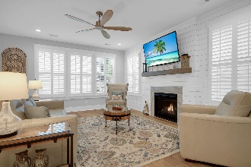
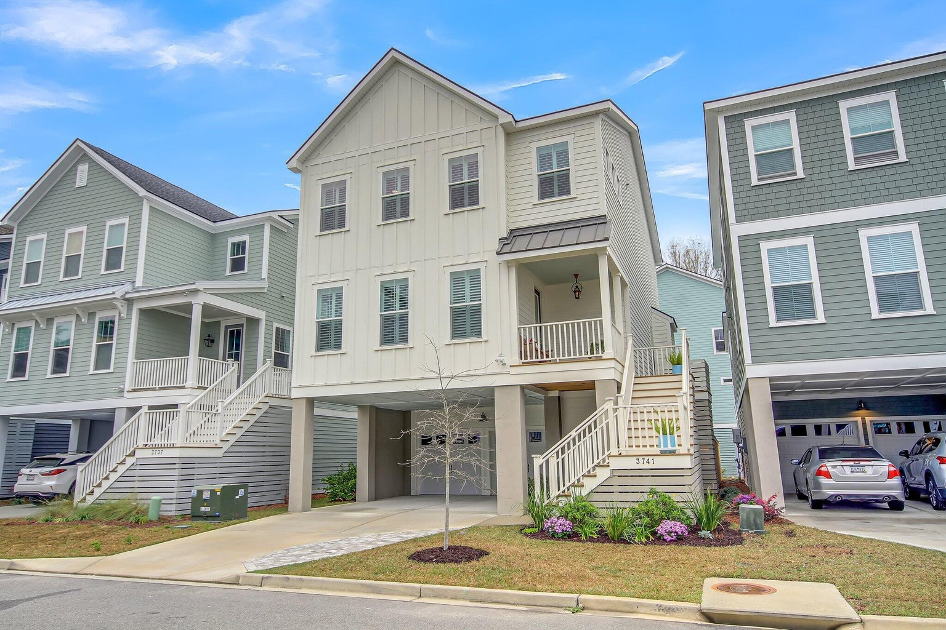
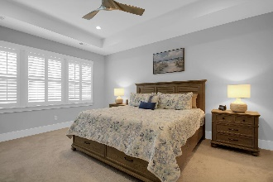
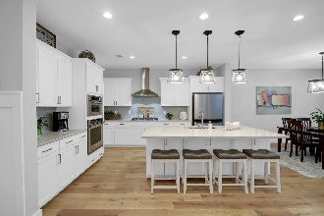
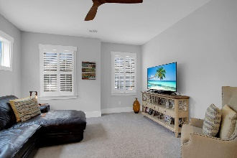
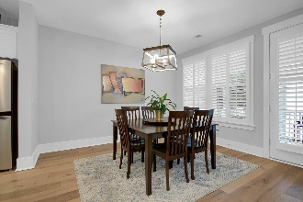
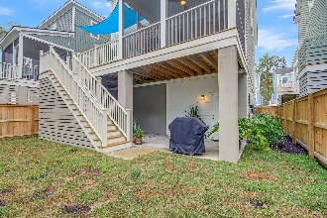
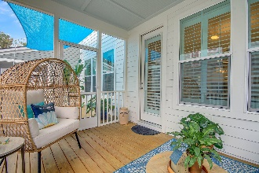
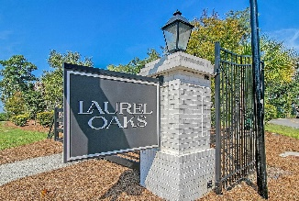
Just Hop In Your Golf Cart To Go To Dinner
3741 APIARY LANE
LAUREL OAK | JOHNS ISLAND, SC 29455 | MLS# 24006029 | $649,000
3 BEDS, 2.5 BATHS ∙ 2472 SQ. FT
Absolutely stunning home!! Raised construction, 3 car garage, 2 car carport, AND a golf cart covered parking space! Drive golf cart to grocery stores, restaurants, salons, gym, tennis courts, dog park, baseball fields, football fields, Starbucks...just about anything you'll need or want when in your new home is right down the street! Enjoy scenic walks around your neighborhood ponds and scenic walkways. Better than new home with too many upgrades to list to include fireplace, tiled tub/shower, shiplap, chef's kitchen package w gas stove, craftsman molding/trim package, grill gas line, 6ft privacy fence, extended concrete outdoor living space, widened driveway, upgraded scratch resistant hardwoods, upgraded fixtures/fans, stained stairs/porch, enclosed garage wall, and more. Must see!!
Johnny Crosby
843-270-9407
jcrosby@charlestonhomeproviders.com
Brand Name Real Estate | 4 Carriage Lane, Suite 106 | Charleston, SC 29407

