Slide 1
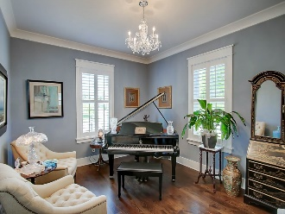
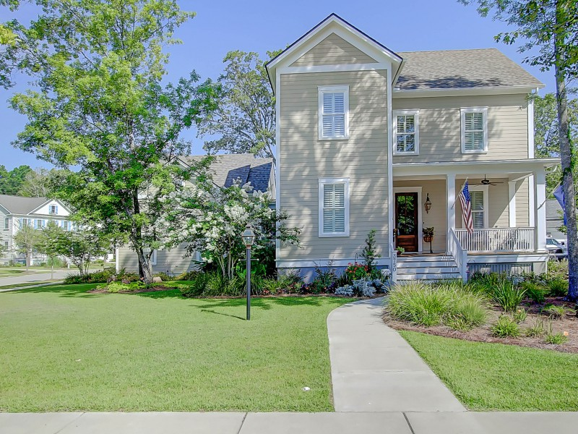
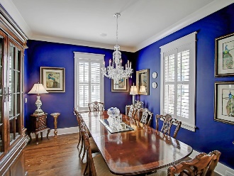
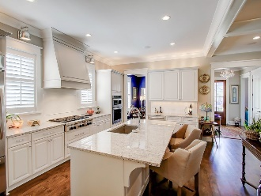
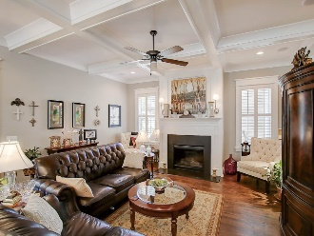
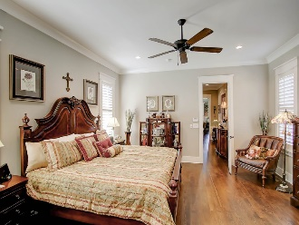
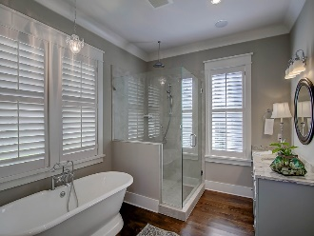
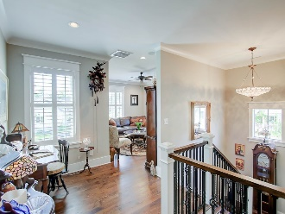
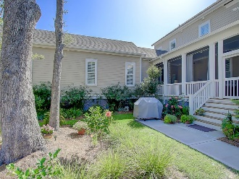

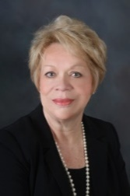
3750 Sisseton Lane
Carolina Park ~ Mount Pleasant
MLS# 16018862 ~ $772,900
Open House
Sunday, August 7th ~ 2-5
OWNERS MOTIVATED - BRING OFFERS!
Custom Built Home In Riverside At Carolina Park
WELCOME TO 3750 SISSETON LN. Immaculately maintained home, which boasts an excellent floor plan, perfect for family enjoyment and entertaining. Numerous upgrades have been added to this dramatic home, located in the exclusive CUSTOM RIVERSIDE SECTION of Carolina Park, built by Structures Building Company, an award-winning Charleston custom home builder. Convenient to downtown Historic Charleston and approx. ten mins. from IOP and Town Center, the quality of this home is obvious when one enters the elegant Foyer, which opens to a formal Dining Room on one side, and a Music Room on the other, along with the lovely staircase leading to the second floor. Centrally located Living Room with gas fireplace, has natural stone surround & hearth, and flows nicely into the Gourmet Kitchen with large island and pantry, custom built cabinetry, granite countertops and tile backsplash. Kitchen appliances include Professional Kitchen Aid appliances, six burner gas cooktop, double ovens, dishwasher, etc.
Linda Laird
REALTOR
M (843) 209-7571 | O (843) 886-8110
linda.laird@carolinaoneplus.com
www.lindalaird.com
Carolina One Real Estate
1503 Palm Blvd
Isle of Palms, SC 29451-2280

