Slide 1
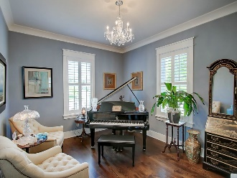
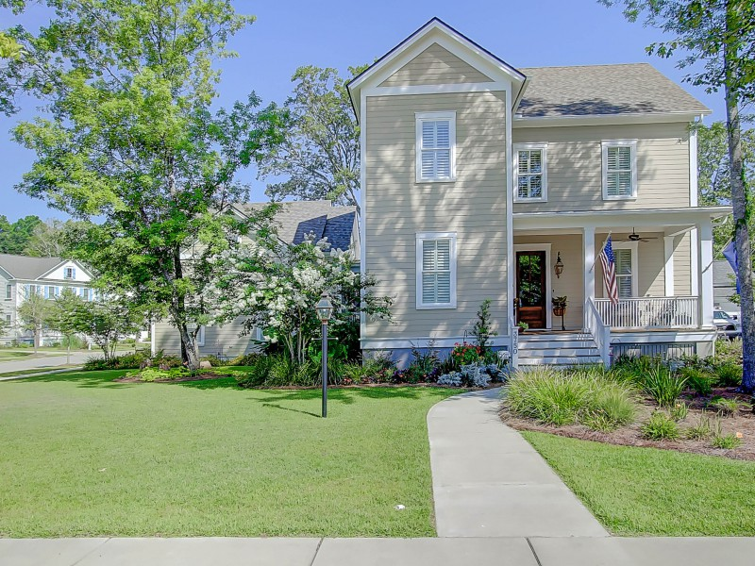
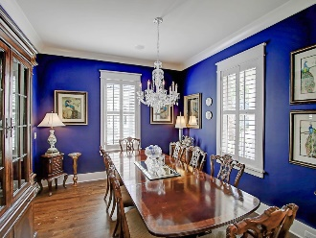
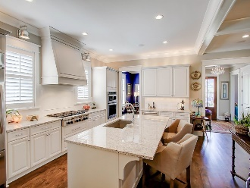
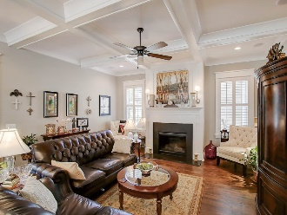
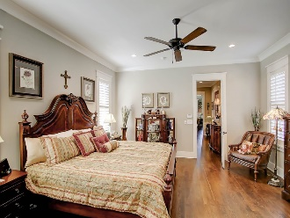
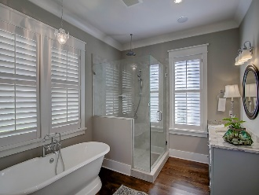
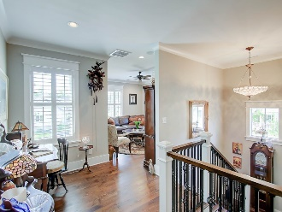
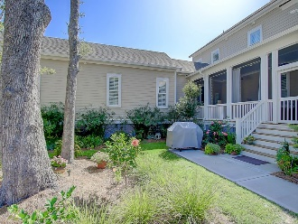

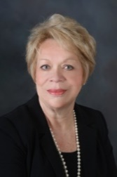
3750 Sisseton Lane Carolina Park ~ Mount Pleasant MLS# 16018862 ~ $744,900
Custom Built Home In Riverside At Carolina Park
JUST REDUCED!!! Priced to Sell…don't miss this wonderful opportunity!
This house has approx. $80k in upgrades, reflected in price. Immaculately maintained home, which boasts an excellent floor plan, including unfinished room/bath over Garage, perfect for family enjoyment and entertaining. Numerous upgrades have been added to this dramatic home, located in the exclusive CUSTOM RIVERSIDE SECTION of Carolina Park, built by Structures Building Company, an award-winning Charleston custom home builder. Convenient to downtown Historic Charleston and approx. ten mins. from IOP and Town Center, the quality of this home is obvious. Great schools and all of the amenities Carolina Park has to offer such a neighborhood Pool, Club House, Play Park, Tennis Court, & Walk/Jog Trails.
Unbeatable Value for Size, Quality and Upgrades.
Linda Laird REALTOR
M (843) 209-7571 | O (843) 886-8110
linda.laird@carolinaoneplus.com
www.lindalaird.com
Carolina One Real Estate
1503 Palm Blvd
Isle of Palms, SC 29451-2280

