Slide 1
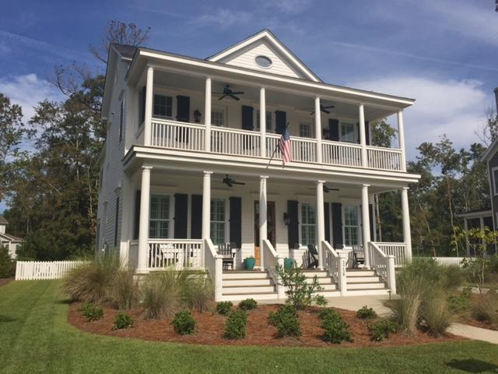
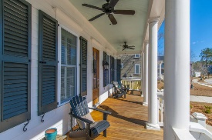
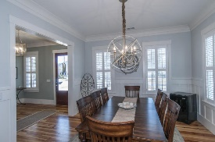
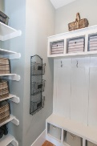
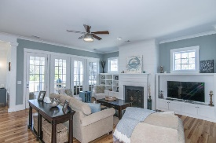
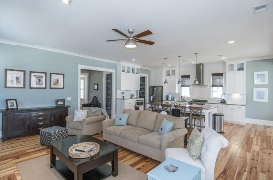
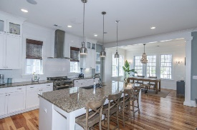
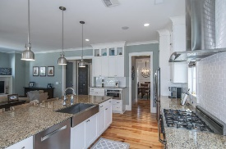
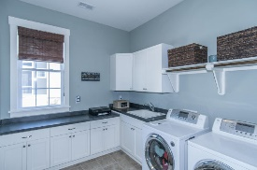
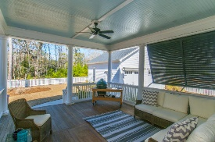
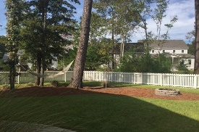


3758 Sisseton Lane Mount Pleasant ~ MLS# 16025905 ~ $730,000
New Listing Riverside Carolina Park!
Lowcountry beauty with double front porches!
$50,000 Price Reduction
Welcome home to coastal living at its finest! This custom home in the exclusive Riverside section of Carolina Park will satisfy the most discerning buyer. The beautiful double stacked front porches are just the beginning of the appeal of this home. This home also sits on a larger homesite backing up to wooded HOA space, lending privacy from behind. Why wait to build when you can move in now and benefit from all the gracious upgrades. This home is built on a crawl space with on-site finished hardwood floors. The downstairs features 10 ft ceilings, a large foyer, study or formal dining room up front, spacious laundry room with custom cabinetry and a separate drop zone with built ins and room for lots of gear. The kitchen features an over-sized island that is open to the family room. The family room has a gas fireplace and built-in shelves on each side as well as shiplap above. The kitchen also opens to an eat-in breakfast area/keeping room. Shiplap also adorns this area giving it that coastal feel. The screened porch is off the back of the home and is shielded on one side by a pair of beautiful Bahama shutters. Upstairs, you will find a loft area where the hardwoods continue along with access to the upper porch. There are also three secondary bedrooms, one of which has it's own private bath. The other two share a hall bath. Finally there is a large master suite off the back of the home with a walk-in closet and well-appointed bathroom including a garden tub, large shower, dual sinks, linen closet and a separate water closet. The detached garage dimensions are 24 x 26 feet. This gem is like new and ready for you!
Five photos of this home (when it was first built) are featured on Saussy Burbank's website. Go the www.saussyburbank.com and click galleries then interior pictures to see them.
Melodie Smith (843) 408-5067 M
melodie.smith@carolinaone.com www.melodiesmithrealestate.com

