Slide 1
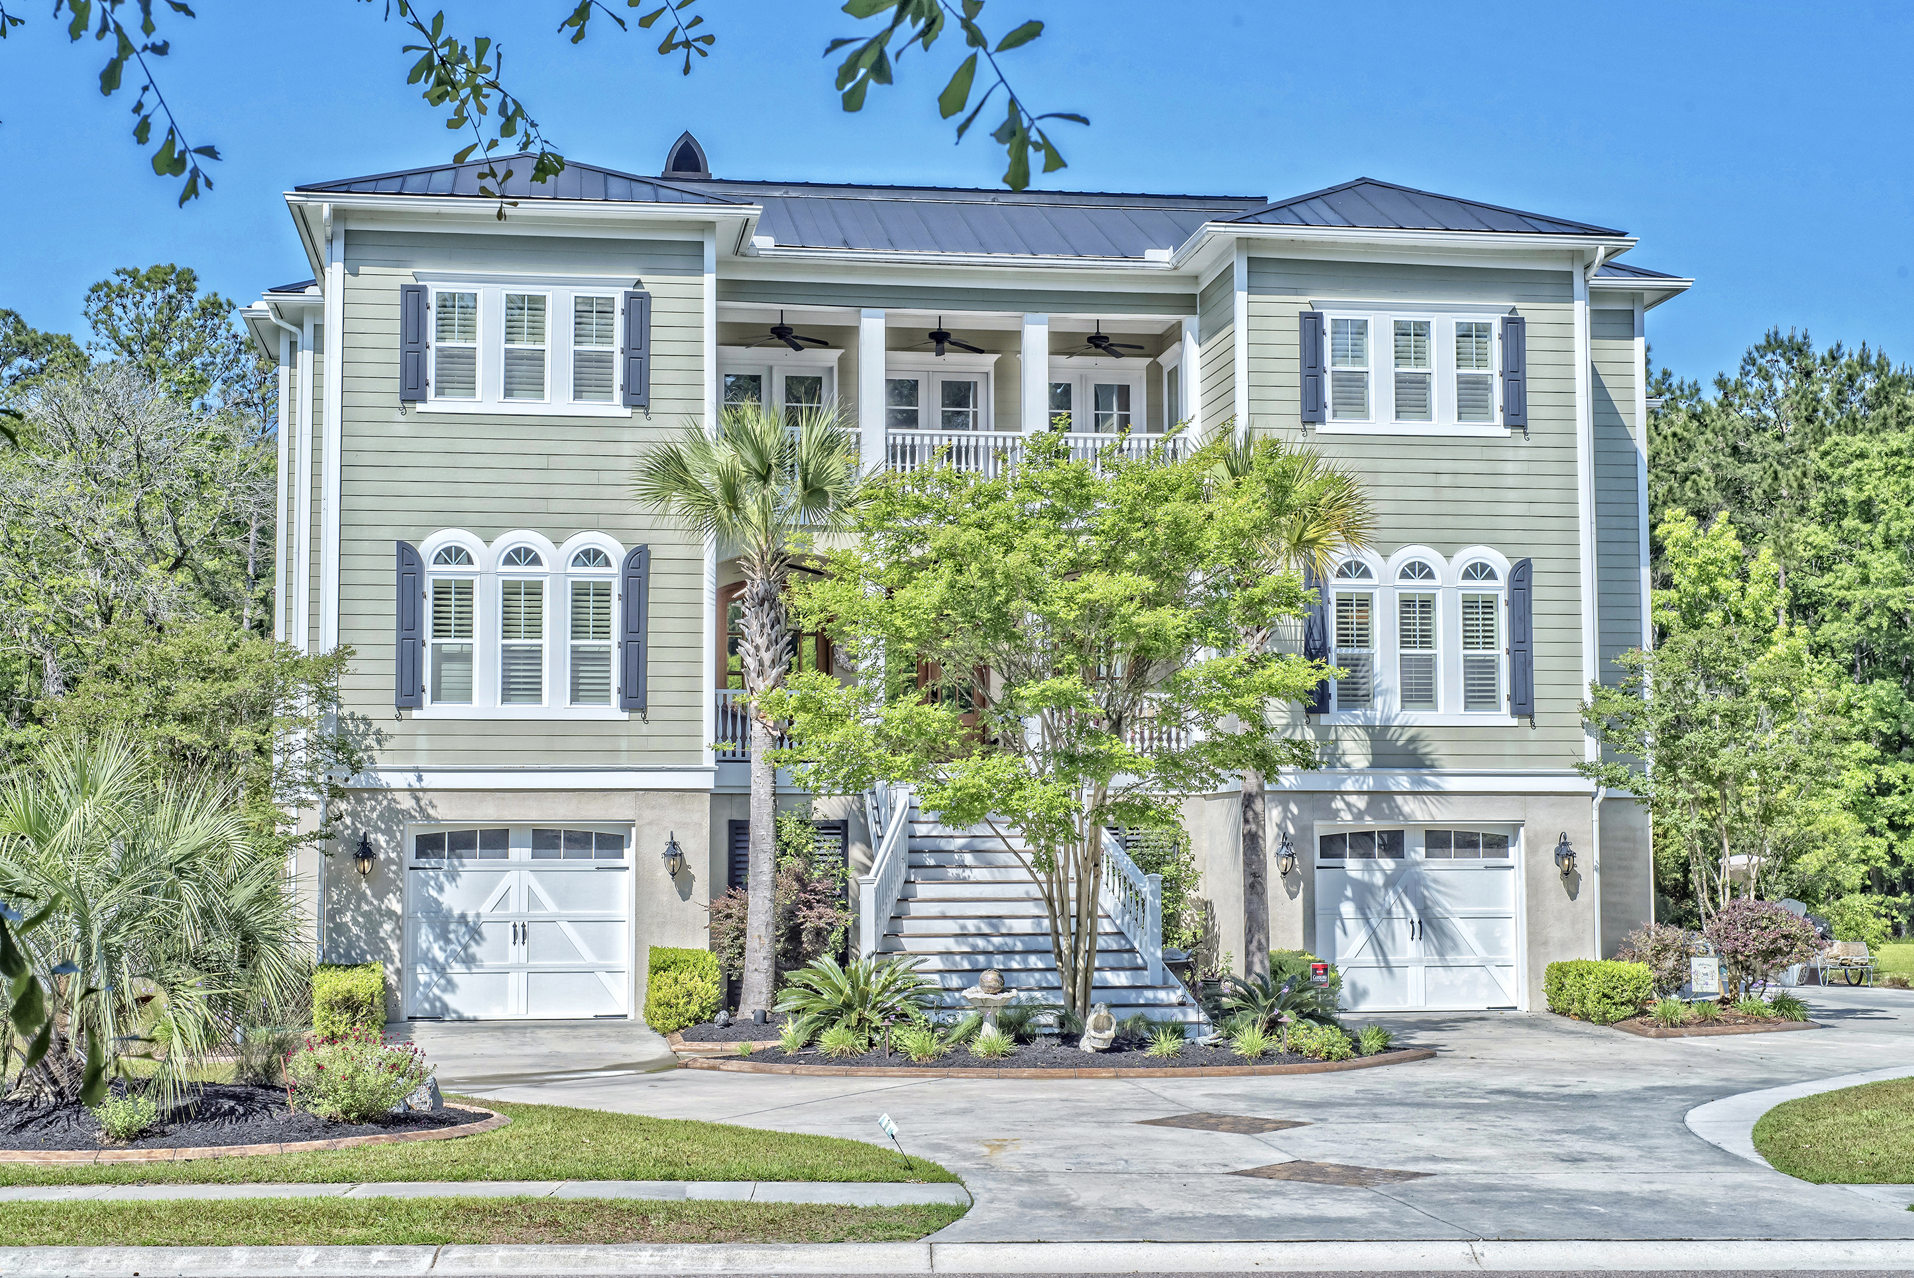
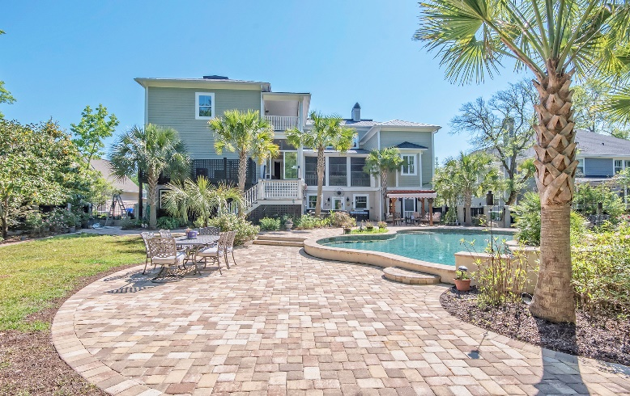
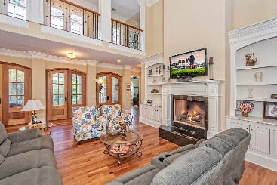
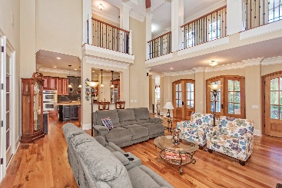
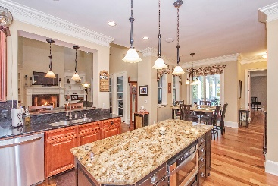
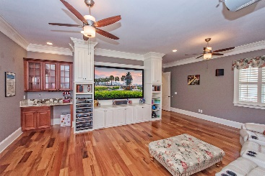
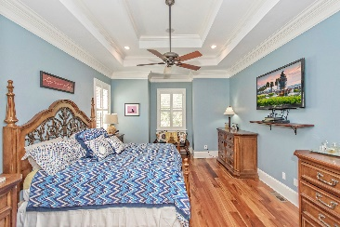
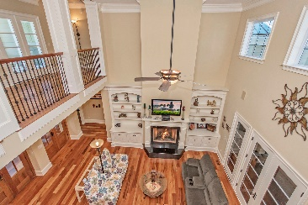
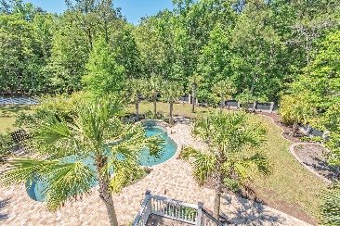
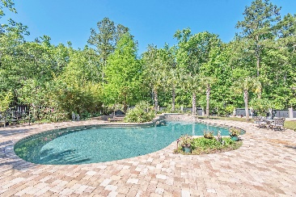


Highly Motivated Seller
One of the Best Values in Mt. Pleasant
3759 Saint Ellens Drive
Darrell Creek | Mount Pleasant, SC 29466 | MLS# 16011129 | $1,275,000
This beautiful custom built home has an additional 1190sqft of finished space on the ground level floor with all the bells and whistles that a discriminating buyer is searching for! Built with no expenses spared, this home features a heated, 25,000 gallon salt water in ground pool with water fall and professional landscaping. Solid hardwood doors and beautiful tiger wood floors are throughout the entire house, every counter top is granite and every shower is tiled setting this home apart from all the others. Pictures do not do this house justice, this home is a must see! There are 6 bedrooms, 5.5 baths, 5 porches, and a 6 car garage. The Chef's Delight Gourmet kitchen features granite counter-tops custom soft close cabinetry, a 5 burner GE Monogram gas cook top and stainless steel appliances. The kitchen overlooks the family room and has direct access to the side porch that leads to the backyard. The oversized master suite is downstairs along with an oversized ''Media room'' which includes a 100'' Sony Projection screen with full surround system. The 2 story coffered ceiling family room has an oversized gas fireplace with granite surround and hearth, built in bookcases and has direct access to the double doors that lead to the large rear screen porch overlooking the beautifully landscaped back yard that is fenced in with custom raw iron railings. Upstairs is a "Juliet" balcony and raw iron railing that overlooks the family room as well as 4 oversized bedrooms. Bedroom 2 & 3 share a Jack n' Jill that has a full floor to ceiling tile shower. Bedroom 4 has a private en-suite bathroom and a reach in closet with built ins. Bedroom 5 is a massive "second master-style bedroom" that has a 2 basin en-suite bathroom, a full linen and full walk-in clothes closet, a private balcony that overlooks backyard/pool. This bedroom also has a private sitting room with a full walk bookcase and access to a large walk-in, conditioned storage closet. The ground level is finished off and could be used as an in-law suite, maid quarters or spare bedroom. Some other items of importance are Central vacuum, central surround system with room volume controls, plantation shutters, alarm system, pre-wired 2 story stop elevator shaft, Butler Pantry, 3 season room with sliding panels, a massive walk in storage closet, beautiful outdoor landscaping and lighting, 2 Rinnai water heaters, work shop, stamped concrete curbed planting beds along with a lawn irrigation system on a separate water supply. . Spray Foam Insulation, Web trusses , a 500 gallon propane tank (buried), 2x6 Exterior Walls through the entire house (most homes have 2X4), 301/2'' foundation ( typical is 261/2''). This house sits on .8 acres on a dead end street, backs up to protected wetlands and is right down the street from Roper St. Francis hospital and the public schools. This home is a MUST SEE! Listing agent believes all information on the MLS to be correct, however, buyer should verify all information important to them.
Todd McKenna
(843) 870-8110
todd@toddmckennarealestate.com
www.toddmckennarealestate.com
Keller Williams Realty Charleston
496 Bramson Ct Ste 200
Mt. Pleasant, SC 29464

