Slide 1
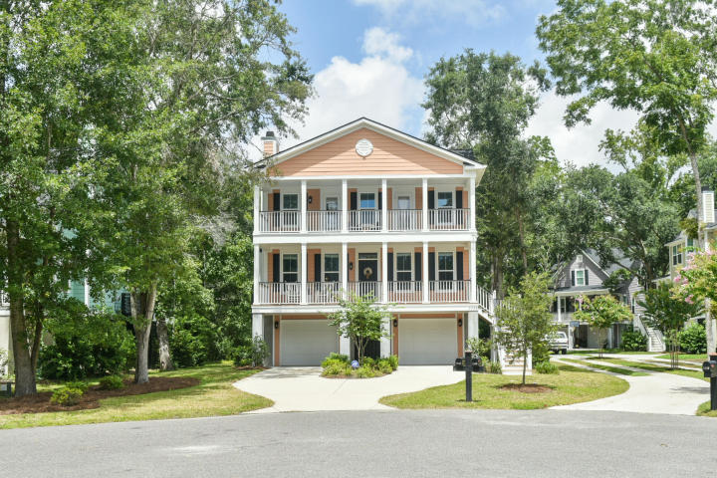
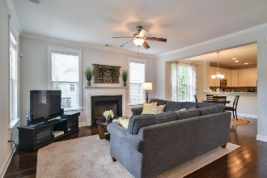
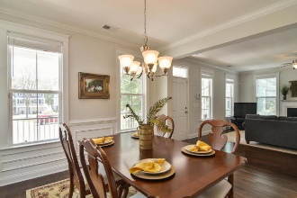
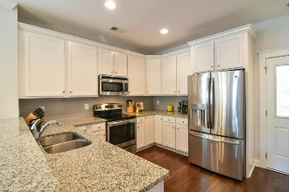
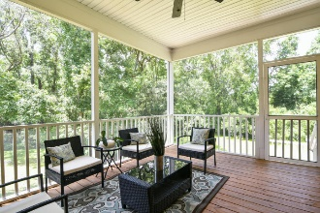
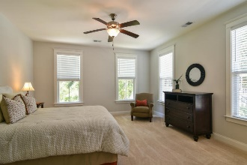
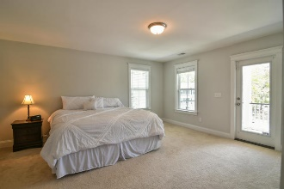
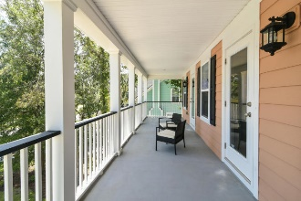
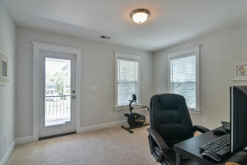
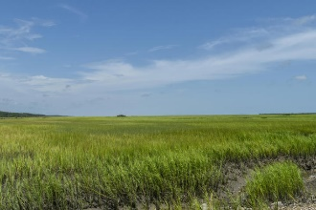


3760 Tip Lane Cottages at Copahee | Mount Pleasant, SC 29466 MLS# 17022502 | $495,900
The Only Deep Water Home On Daniel Island
Just Listed!
Open House Saturday 1pm - 4pm
Stunning 4br,4.5ba home with double front porches to catch the breezes and peekaboo views of Copahee Sound! This small development could not be more Southern! Rainbow colored homes with live oaks and marsh breezes complete with 2 front porches and a rear screened porch for sipping sweet tea and visiting with your neighbors! Each bedroom has an ensuite bath and there are true DUAL MASTERS (one on the main level and one upstairs with the other bedrooms). Beautiful kitchen with granite countertops, stainless appliances, breakfast area and separate formal dining area. Hardwood floors complete the elegant feel! If you need space and desire a newer home, this is the one for you! $4000 credit available towards buyer's closing costs and prepaids with acceptable offer and use of preferred lender. Zoned for new Carolina Park Elementary School. Gadsdenville Boat Landing is very nearby.
Helen Hudson
843-991-9875
helen.hudson@carolinaone.com
Carolina One Real Estate
2713 Highway 17 North
Mt. Pleasant, SC 29466

