Slide 1
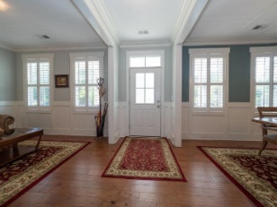
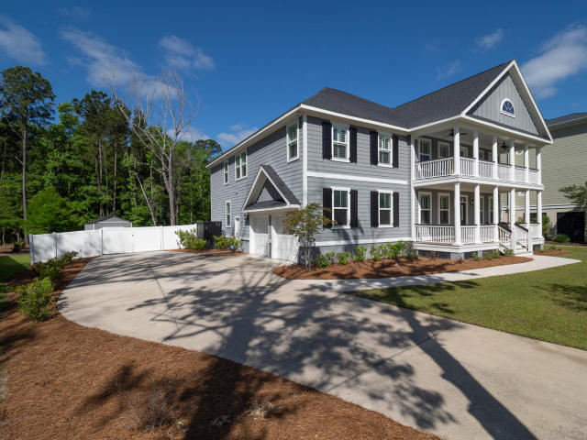
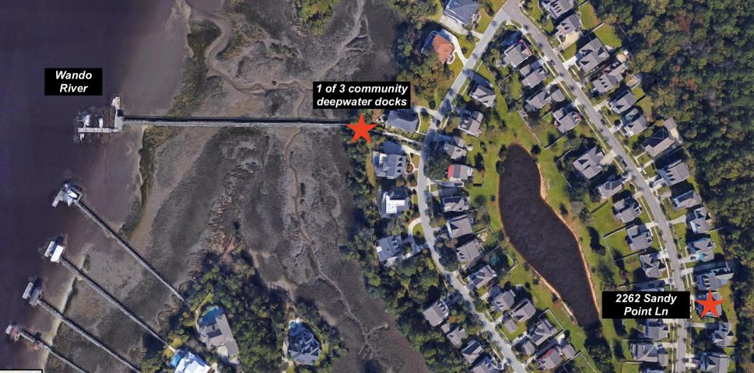
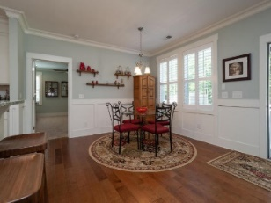
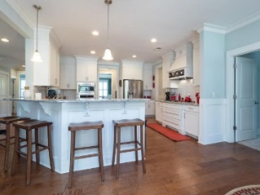
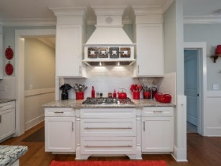
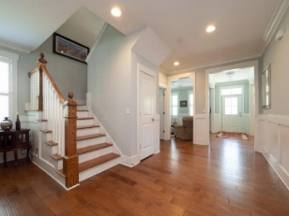
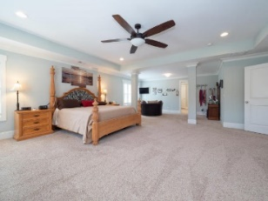
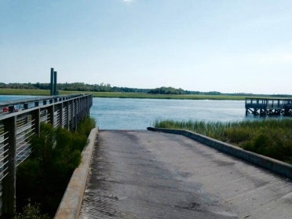
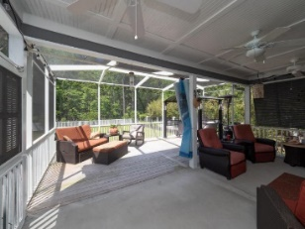
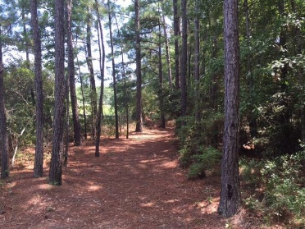
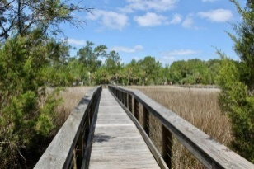
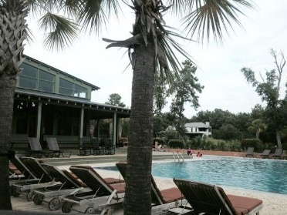


3763 Saint Ellens Drive
Mount Pleasant, SC 29466 ~ MLS# 18012874
Price Reduced to $775,000
Darrell Creek
Recently Reduced $15K
If you are looking to be in a neighborhood with a great family community feel and Wando River sunset views...then this is the place! Rivertowne on the Wando offers many amenities similar to other local neighborhoods, like pools, tennis courts, and green space...but what those others are missing is the river! With 3 community docks on deepwater Wando River, there's no shortage of crabbing, fishing, boating activity here! Another great feature, Rivertowne on the Wando is zoned for award-winning schools (including Laing, the #1 STEM middle school in the country)! And only a short distance to downtown Charleston, Isle of Palms and Sullivan's Island beaches, town recreation center/fields, medical facilities, dining and shopping, you're close to everything you need! Come see for yourself!
Recently Built Custom Home
Large Private Lot
Home Sits On Over Half An Acre
5 Bedrooms (1 Of Which Is Downstairs W/A Full Bath)
4.5 Bathrooms
22'x22' Extended Screened Porch Overlooks A Professionally Graded Backyard
Fully-fenced Backyard Has Outside Patio
Backs To Unbuildable Woods
12'x24' Shed
2-car Garage
Additional Parking Area For A Boat, Jet Skis, Trailer, Etc.
Open Floor Plan Home
Large Family Room W/Gas Fireplace And An Eat-in Dining Area
Granite Countertops
Abundant Counter Space (W/An Island)
Stainless Steel Appliances
5-burner Wolf Gas Cooktop
Built-in Wall Oven & Microwave
4 bedrooms
2.5 bathrooms
2629 sqft
Upgraded detailing such as crown molding and wainscoting in the dining room
Wood flooring throughout the entire home (including all of the bedrooms)
Contemporary ceiling fan in the family room
Decorative backsplash and pendant lighting in the kitchen
Kitchen also includes granite countertops, a full set of stainless steel appliances (including a Samsung refrigerator), solid wood cabinetry and additional storage in the full pantry
The eat-in kitchen and family room have plenty of space to entertain, but continue outside onto the large deck and brick fire pit area if you need more!
Kris Higman
(843) 810-8824
kris.higman@cbcarolinas.com
www.CharlestonHomesByKris.com
Coldwell Banker Residential Brokerage | 1127 Queensborough Blvd. 103 | Mt Pleasant, SC 29464

