Slide 1
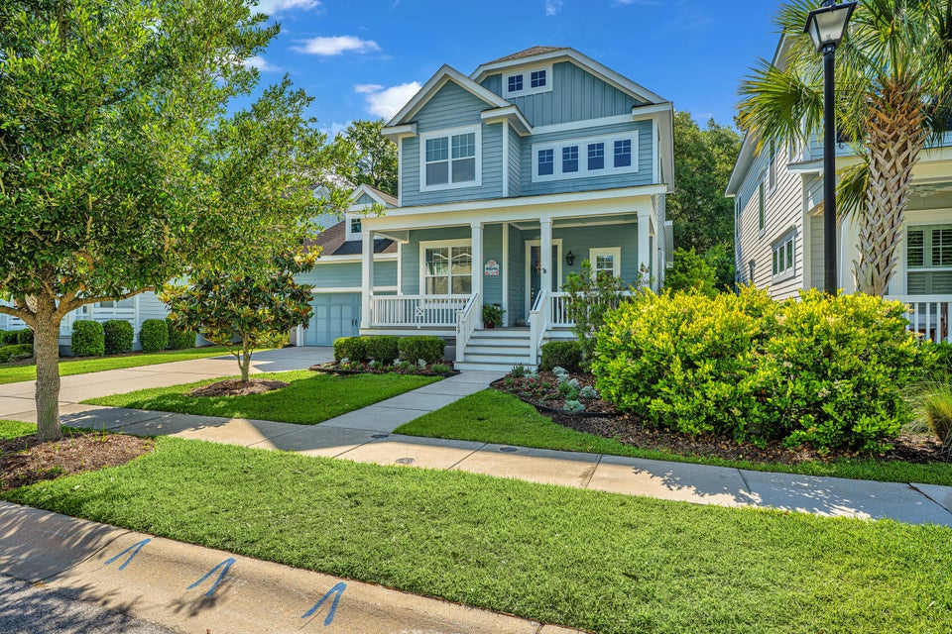
Price Improvement
3769 Maidstone Drive
Carolina Park | Mount Pleasant, SC 29466 | MLS# 25011715 | $900,000
Beautiful, well maintained move-in ready home. Open kitchen, dining area and family room with gas log fireplace. Primary bedroom downstairs with large walk-in closet. Primary bath has large walk-in shower. Office/study and 1/2 bath on first floor. Ceiling fans throughout. Screen porch on back of house overlooking fenced backyard with green space privacy beyond. Upstairs has 3 bedrooms and 2 full baths. One of the bedrooms is presently being used as an artist studio for artist owner. House has a Rinnai tankless hot water heater. Washer and Dryer convey.
Bob & Shari Alford
843-442-9215
bob@bobalford.com
www.bobalford.com
Carolina One Real Estate
195 W Coleman Blvd
Mt Pleasant, SC 29464-3495

