Slide 1

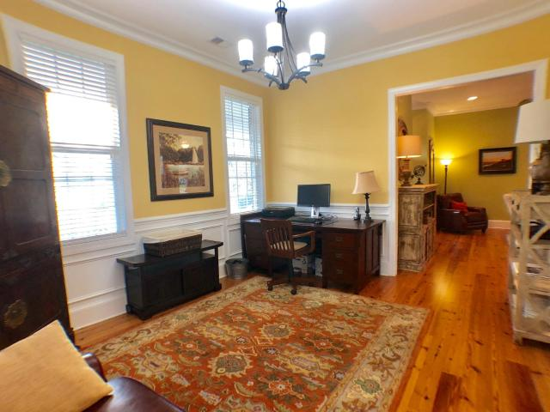
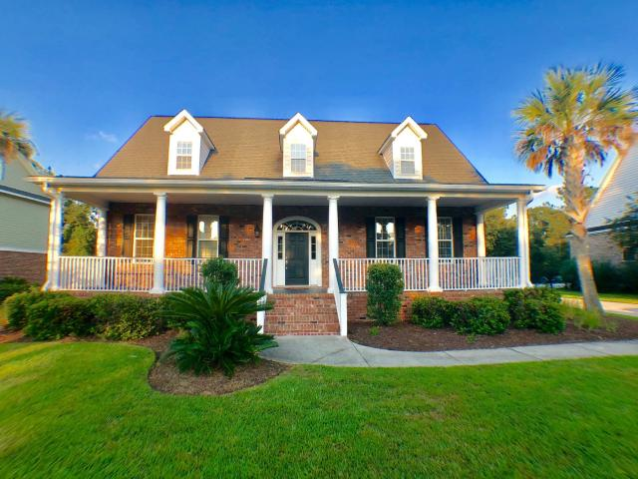
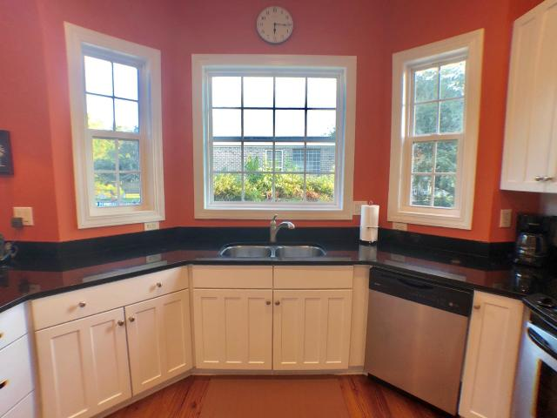
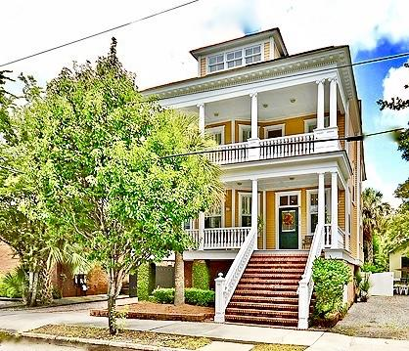
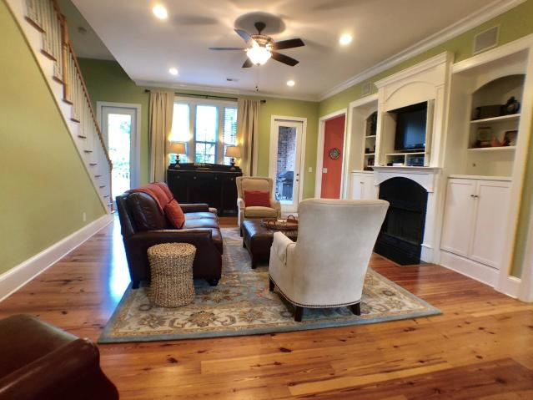
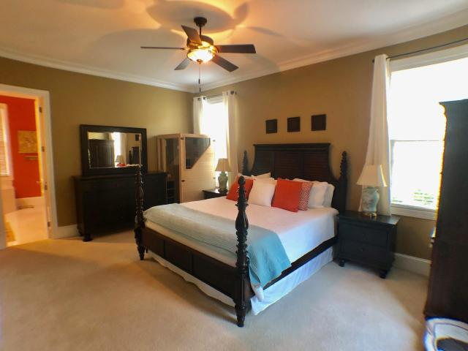
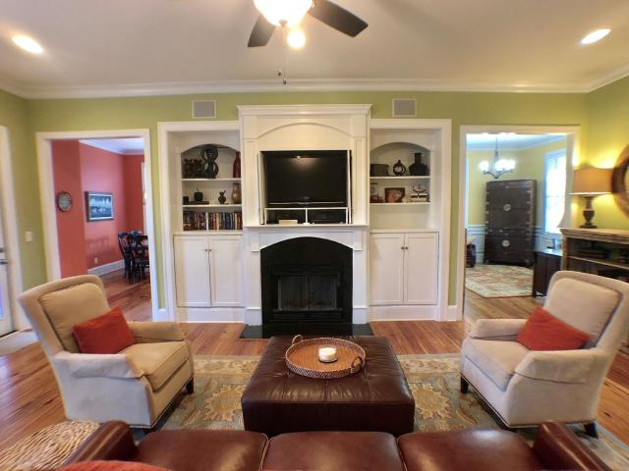
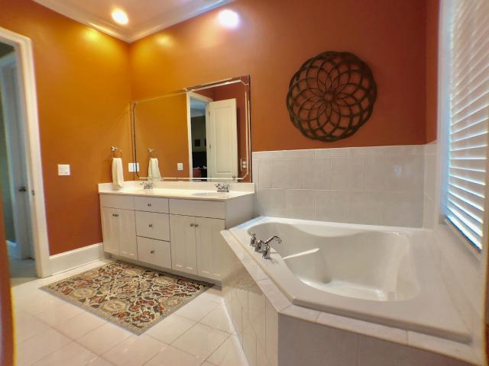
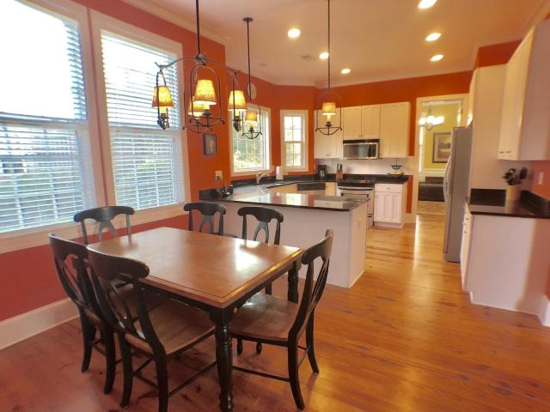
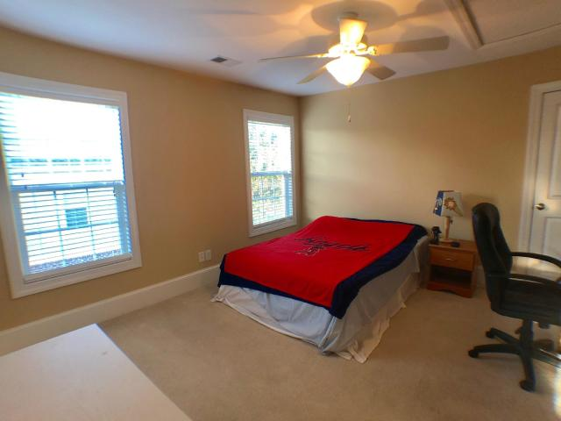
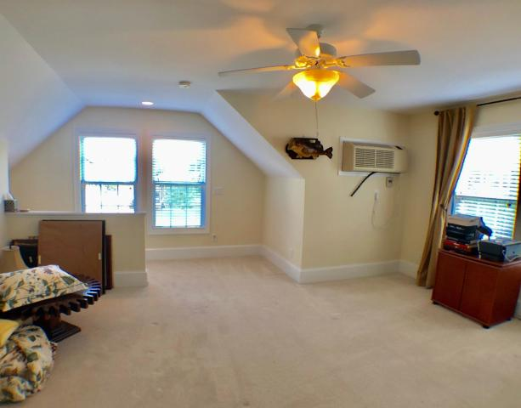
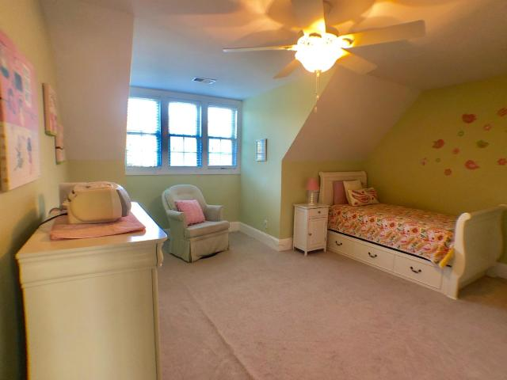
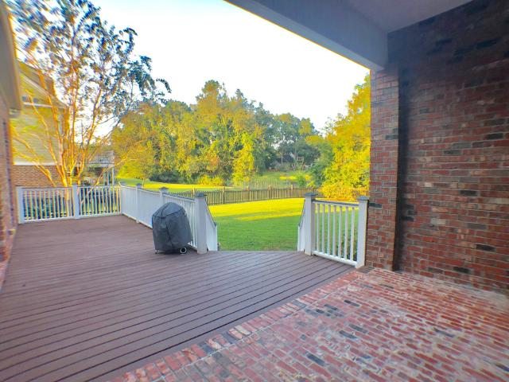
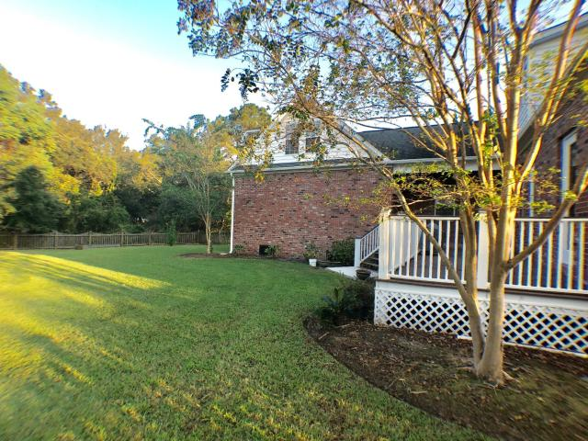
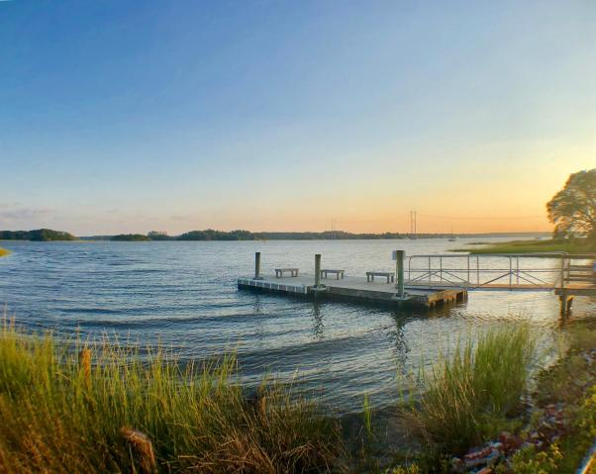


376 Meadow Breeze Lane
Sylvan Shores | Charleston, SC 29414 MLS# 18026493 | $544,500
Buy.......Build.....Begin
This gorgeous home is waiting for you!
BEAUTIFUL HOME IN THE SERENE SYLVAN SHORES NEIGHBORHOOD OFFERING LOWCOUNTRY LIVING AT IT'S BEST IS A MUST SEE!! Front porch with tile flooring and a back deck great for grilling. Bright and spacious eat-in kitchen with granite counter tops and stainless appliances. Lovely family room with custom built in book shelves and fireplace attached to the dining room and 1/2 bath all with heart pine hardwood floors is one of the many features you will love about this home. The large laundry room that also attaches to the FROG w/ full bath. The master bedroom has ample room for a large bedroom set and is downstairs with garden tub and oversized shower. 3 bedrooms upstairs and a loft perfect for kids to have their own TV room. 2 bedrooms have full baths attached. There is a nice loft area upstairs great for kids extra space den area. The neighborhood HOA allows residents to access the community dock, which residents enjoy crabbing, fishing, flotillas and happy hours. It also includes a boat ramp, tennis courts and bird sanctuary. The community gets together annually for cookouts, oyster roasts etc., parades and much more! Sylvan Shores has direct access to the West Ashley Greenway which is an 8.25 mile hiking and biking trail, is conveniently located to I-526 and has quick access to shopping, the airport, hospitals, the popular Costco and the new Whole Foods
English Oltmann Sieber
(843) 568-9165
lowcountryenglish@gmail.com
Brand Name Real Estate | 4 Carriage Lane Suite 106 | Charleston, SC 29407

