Slide 1
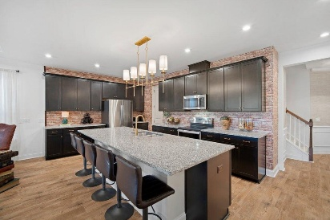
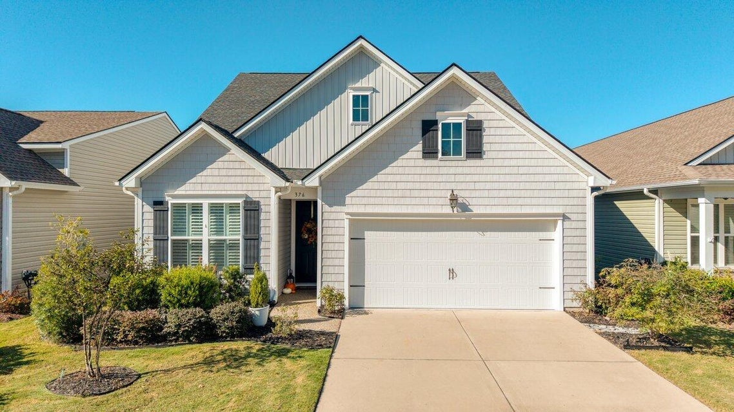
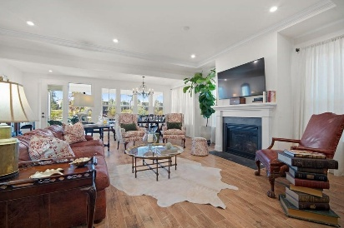

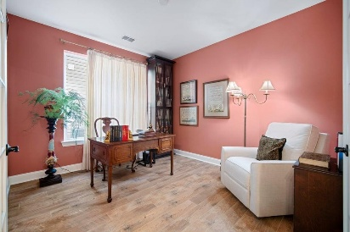
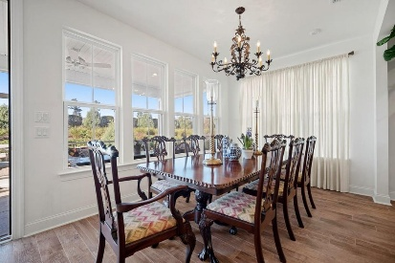
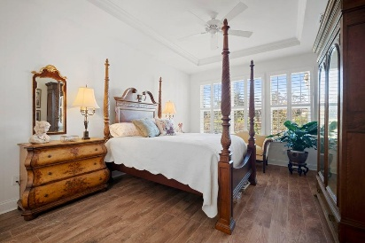

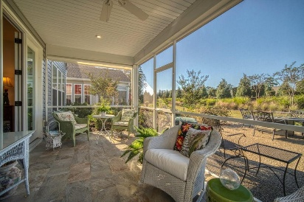
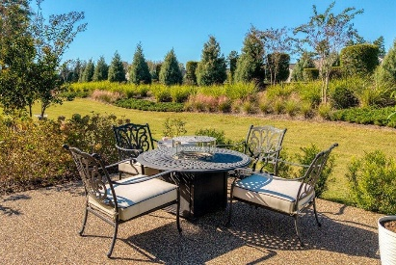
$10,000 BLACK FRIDAY PRICE DROP
IN FOUR SEASONS @ CANE BAY!!!
Co-hosting with
Lisa Wood from
Crown Home Mortgage
Offering $2500
Lender Credit
376 Seaside Trail
Cane Bay Plantation | Summerville| MLS# 25028727 | $559,900
At 376 Seaside Trail, life truly doesn't get any sweeter! This stunning Donegal Loft model offers the perfect blend of sophistication, comfort, and privacy in Summerville's premier 55+ lakeside community of Four Seasons. Featuring 3 bedrooms, 3 full bathrooms, a den/study, and a spacious loft, this home was designed for effortless entertaining and everyday enjoyment. From the moment you arrive, the upgraded landscaping, resurfaced stone-and-epoxy front entry, and ''secret-garden'' retreat set a tone of tranquility. Step inside and discover a home that has been lovingly maintained and appointed with over $30,000 in thoughtful upgrades—from designer lighting and plantation shutters to custom window treatments and luxury vinyl plank flooring throughout the main living areas.
At the front of the home, the guest wing provides a comfortable bedroom and full bath for visitors, while the flexible den/study with French doors can easily serve as a fourth bedroom or home office. The heart of the home is the bright, open-concept living area, seamlessly connecting the gourmet kitchen, living room, and dining space. The kitchen boasts an enormous granite island that seats six or more, upgraded cabinetry with pull-outs, custom lighting, a double oven, upgraded microwave and dishwasher, and a tasteful designer wallpaper accent that adds warmth and personality. A generous pantry, convenient drop zone, and two-car garage add thoughtful functionality. Relax in the living room, highlighted by tray ceilings and a gas fireplace with custom mantle, or enjoy a meal in the dining area overlooking a wall of windows, a space that can easily transition into an extended sitting or entertaining area.
The owner's suite is a private retreat, complete with tray ceilings, plantation shutters, ceiling fan, and peaceful views of the wooded berm lot. The spa-inspired ensuite bath features dual vanities, an oversized walk-in shower, and a spacious walk-in closet.
Upstairs, the loft level offers a generous second living area, perfect for guests, hobbies, or movie nights. Along with the living area, is a large third bedroom and another full bath. Outdoor living takes center stage here. Step onto your full-length tiled screened porch, complete with ceiling fan and roll-down shades. Beyond, a large stone and epoxy patio offers multiple gathering zones for dining al fresco or relaxing by the outdoor fireplace under the stars. The mature landscaping ensures ultimate privacy, visited only by chirping birds and the occasional bunny. Bonus inclusions make this home truly turnkey: outdoor fireplace and chairs, barstools, sectional in the loft, refrigerator, washer, and dryer all convey at no additional cost.
In Four Seasons you will never be bored, as this is the only Active Adult Community in the area that is built around a 300-acre lake with its own private boat dock. Other amazing amenities include an indoor and outdoor pool, fitness center, ballroom, dog park, bocce, pickleball, tennis courts, a kayak launch and so much more! There is also a packed monthly events calendar and Full-time Lifestyle Director. Once you move to the Four Seasons, you will never want to leave.
This is more than a home, it's the lifestyle you've been waiting for. Beautifully maintained, richly upgraded, and perfectly situated, 376 Seaside Trail offers everything today's discerning 55+ Buyer could desire, a serene, luxurious retreat in the heart of Four Seasons.
House Tour | Amenity Tour
Elissa Campbell
843-853-1433 | elissa.campbell@agentownedrealty.com
AgentOwned Realty Preferred Group | 824 Johnnie Dodds Blvd | Mt Pleasant, SC 29464

