Slide 1

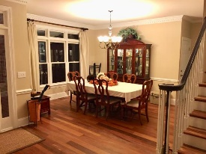
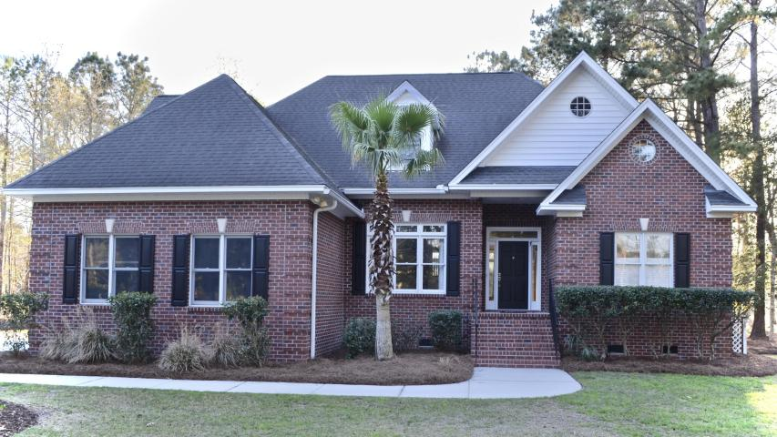
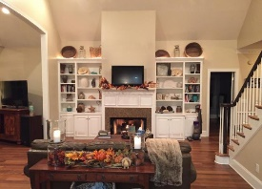
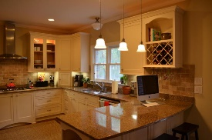
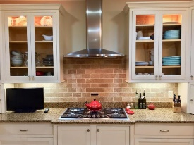
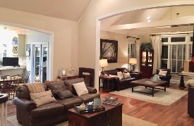
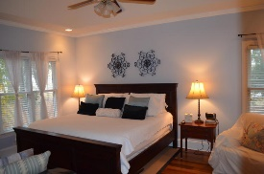
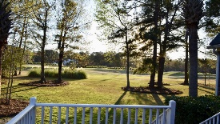
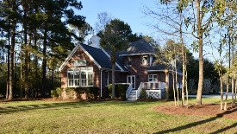
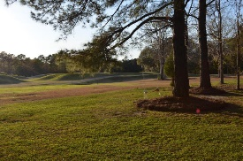

On The Golf Course of Dunes West!! Amazing Price
3775 Colonel Vanderhorst Circle
Dunes West ~ Mount Pleasant, SC 29466
MLS# 17006755 ~ $709,900
Welcome to this beautiful, updated home on the golf course! From the moment you drive up, you will notice this home has lots of space for you to get away from it all. It is situated near the 5th tee box of Dunes West Golf Course. The large 1.27 acre lot boasts mature Palmetto and oak trees. In the evening you will enjoy some of the most beautiful sunsets over the golf course while a family of deer graze in your backyard. Inside this beautiful home you will find 4 bedrooms and 3 1/2 baths that boasts an open floor plan with great natural light. Updated in 2010, this home consists of beautiful Brazilian Teak Hardwoods throughout the first floor; a large Dining Room with Dentil Crown Moulding; the open kitchen is an entertainers dream with updated stainless steel appliances including, a Thermador 5 burner gas range, Thermador oven and Thermador dishwasher. The newer custom cabinets have space for everything from large cooking appliances to the little extras. Off of the kitchen you will find a large pantry, french doors that open to the back deck and overlook the beautiful large backyard. The open floor plan allows you to enjoy your gas fireplace, mantle and custom built-in bookshelves. Located off of the Living Room you will find the large Family Room that opens to a wall of windows for even more natural light. The large Master Suite is located on the first floor, with a trey ceiling and views of the backyard. The Master Bath has a frameless glass shower with Rainshower head and a separate large soaking tub along with his and her sinks. You will also find a separate water closet as well as his and her walk-in closets. Upstairs you will find a second master with walk-in closet, large bathroom and separate nursery, study, or she shack/man cave. The other two bedrooms are nice sized as well and share the third bathroom. You will find plenty of attic and storage space along with an oversized two-car garage. 2 separate HVAC units were replaced in 2009 and 2010 with all new ductwork, air handlers, etc. The exterior has been well maintained with gutters, new sprinkler system, irrigation, new French drains throughout property, mature landscaping and beautiful trees. Dunes West is a gated neighborhood (attendant always on duty) and offers its residents access to Club amenities such as three pools, a waterslide, golf course membership, crabbing dock, boat ramp, multiple tennis courts, exercise facility and boat storage that are all available for an additional fee. Owner is licensed Realtor.
Wendy Deitsch
O - (843) 491-1445
M - (843) 270-0433
wendy@lifetreeliving.com
LifeTree Real Estate, LLC
3094 Hwy 17 North
Mt. Pleasant, SC 29466
www.lifetreerealestate.com

