Slide 1

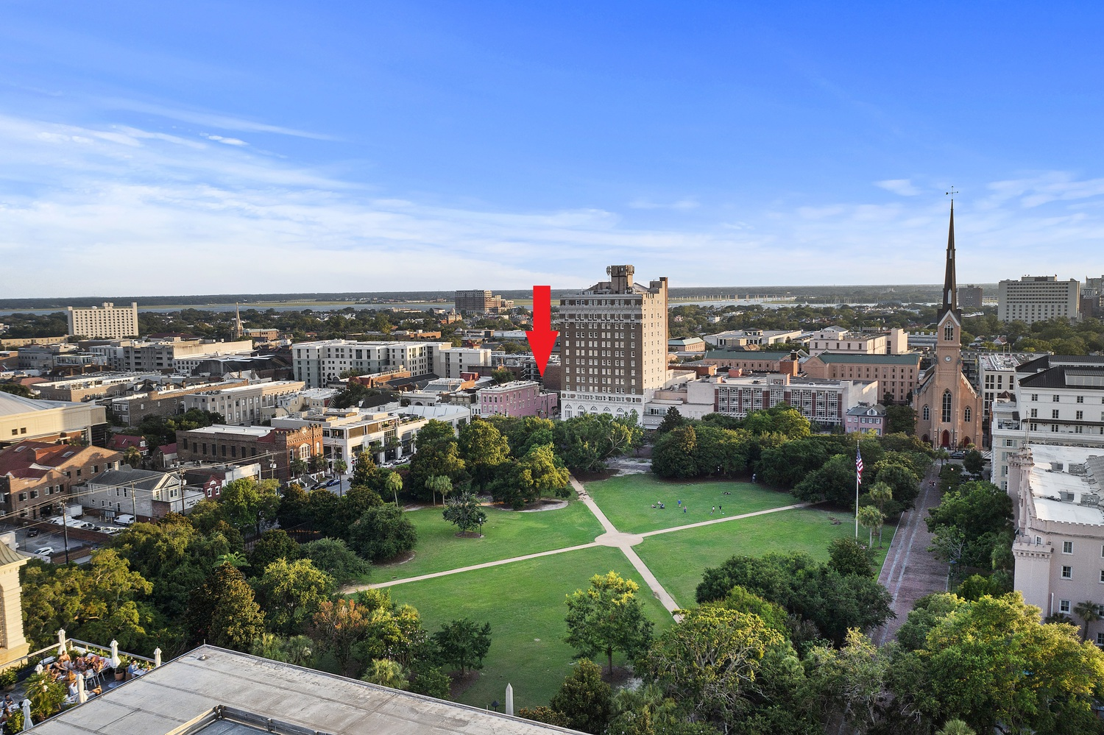
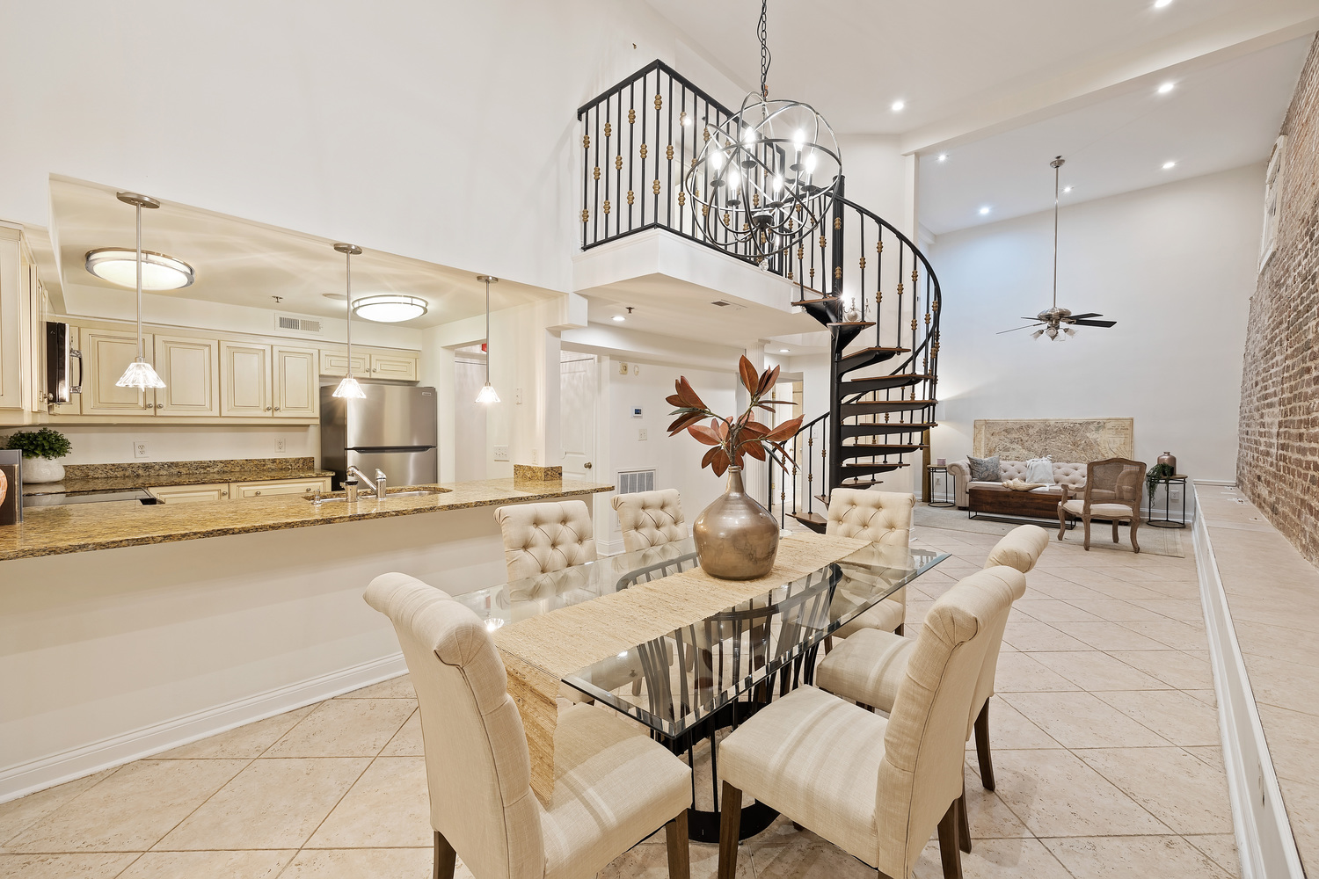
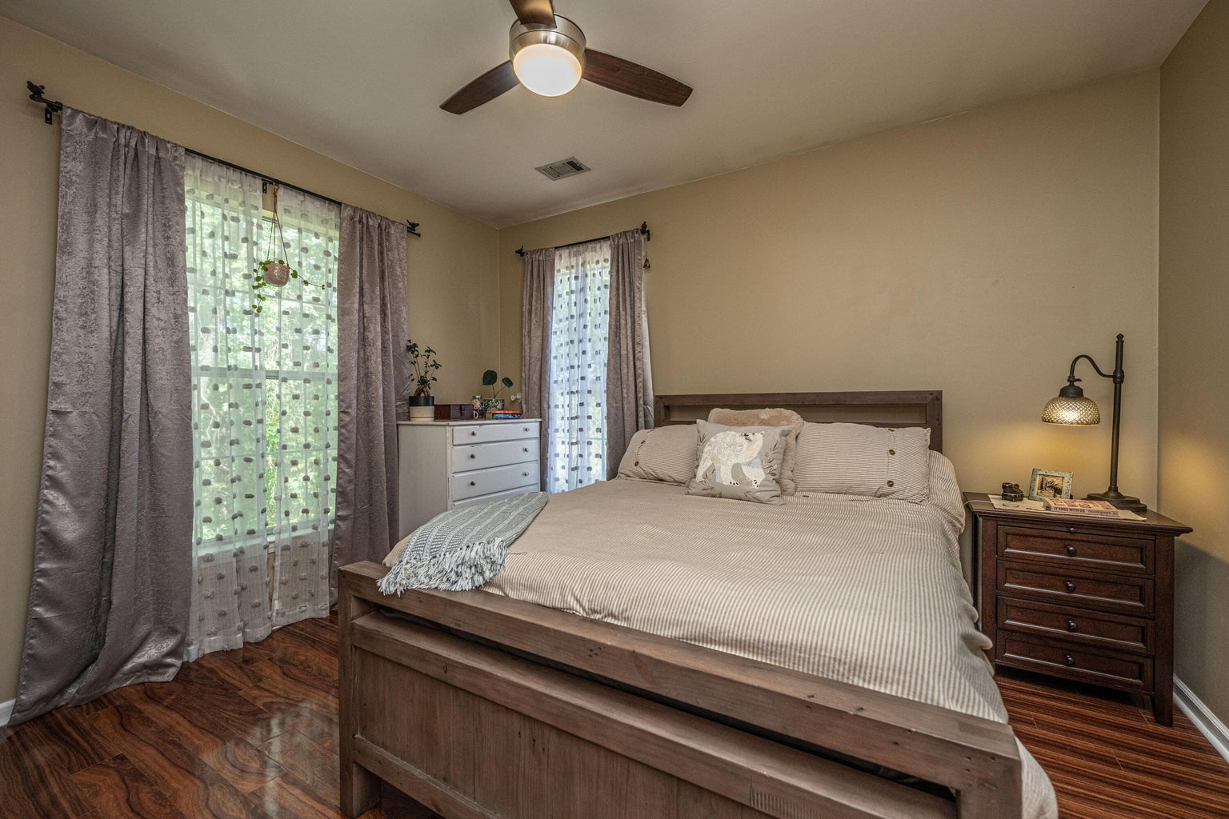
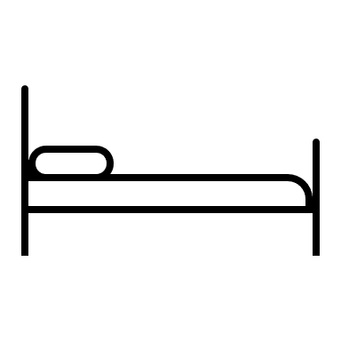


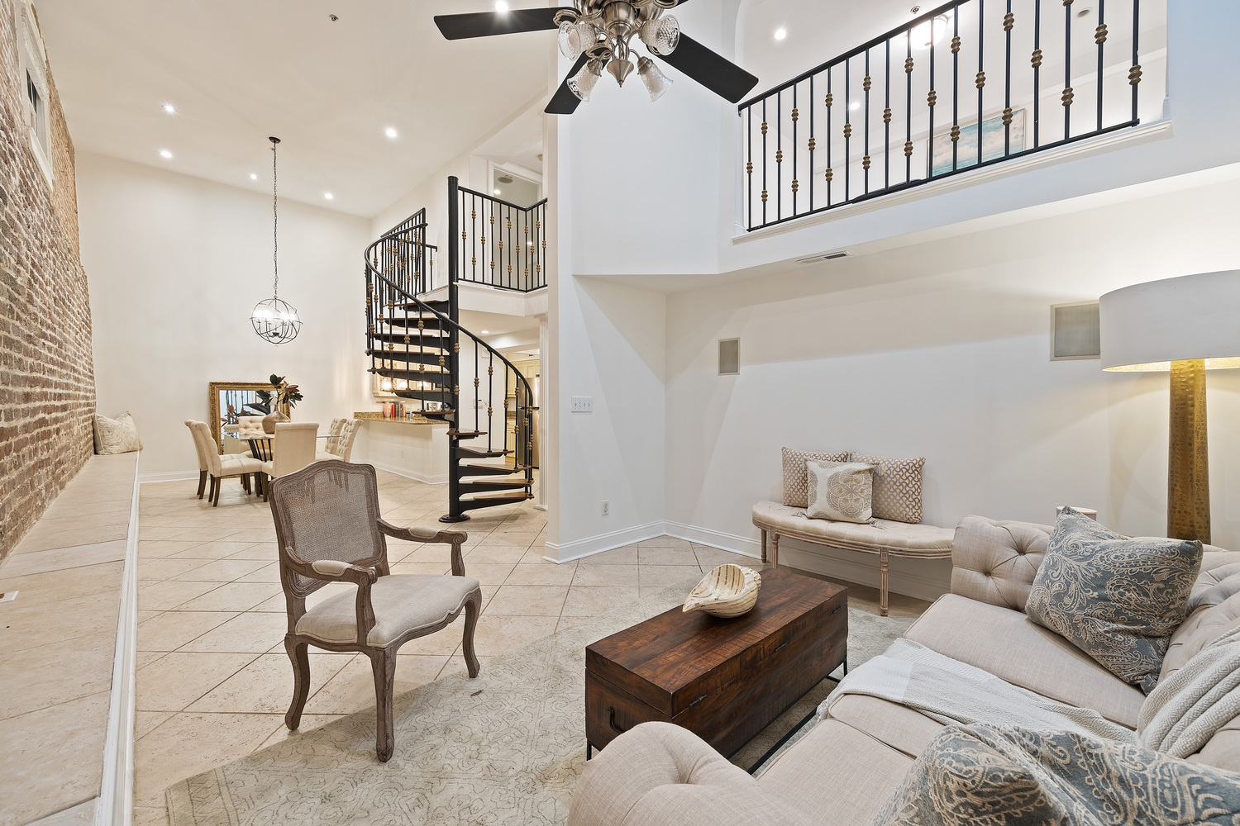
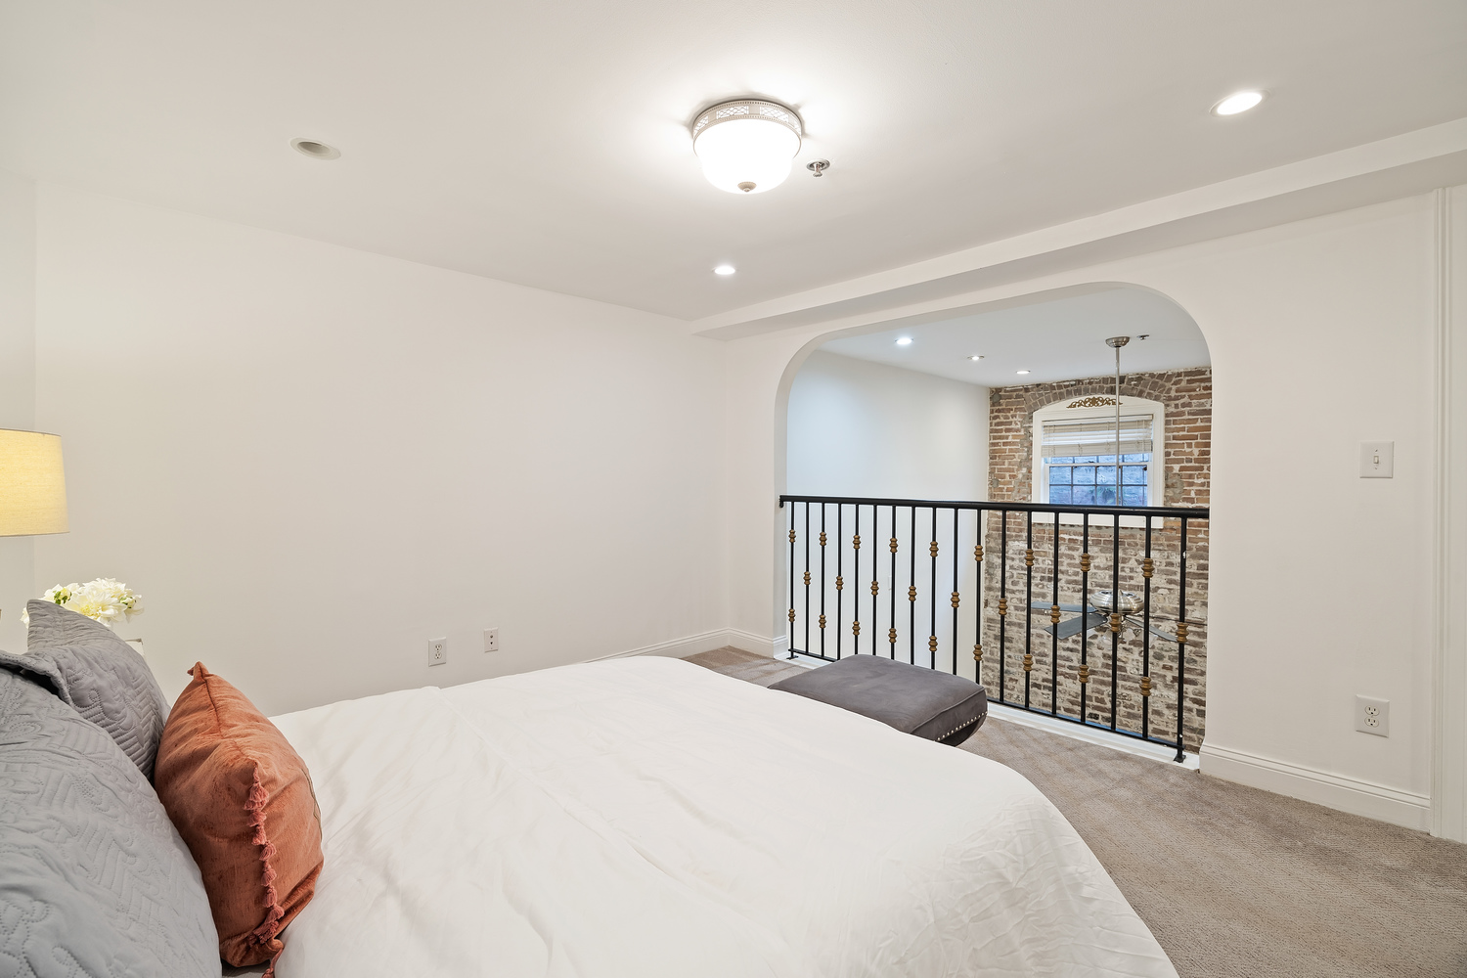
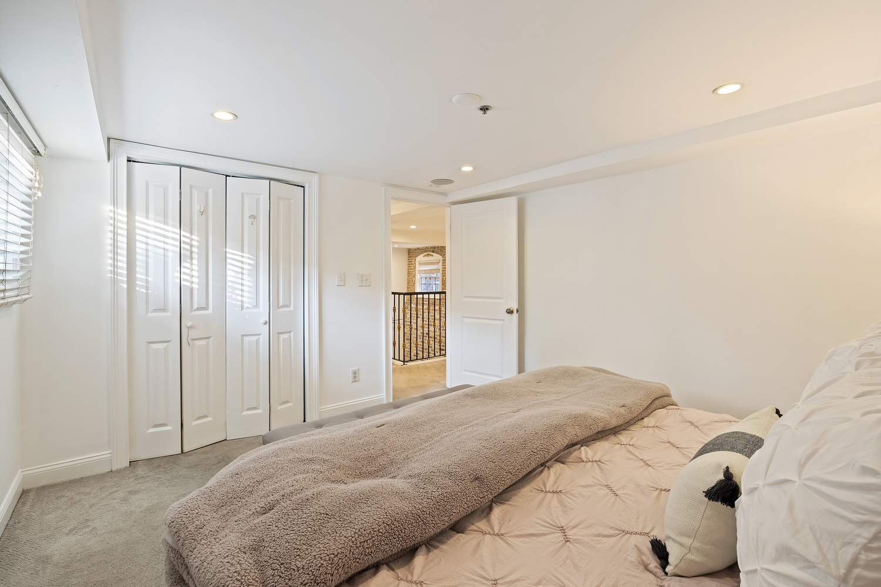
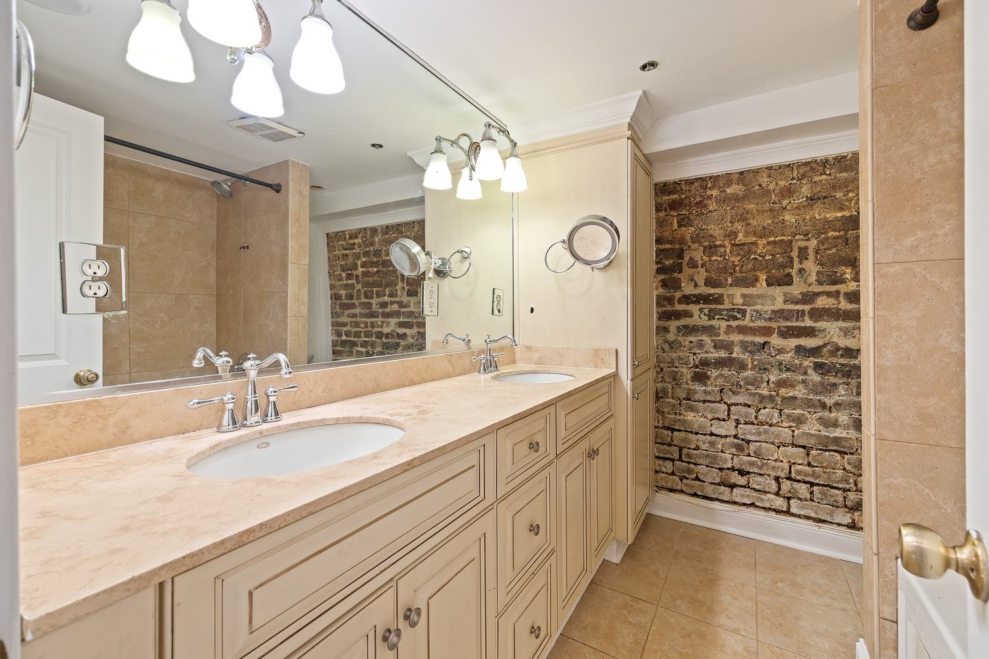


Price Improvement
377 King Street 102
Charleston, SC 29401 | MLS# 23015977 | Now Offering at $699,000
Welcome to this charming and centrally located condo in the heart of historic Charleston. Situated at the corner of King St and Calhoun St, enjoy the convenience of being within walking distance to the prestigious College of Charleston, Marion Square, renowned restaurants, boutique shopping, and much more.
As you step into this meticulously maintained condo, you'll immediately notice the fresh paint, beautifully exposed brick walls, and high ceilings that create a warm and inviting ambiance. The open layout seamlessly connects the living, dining, and kitchen areas, making it ideal for everyday living. The kitchen boasts new appliances installed in 2021, ensuring a modern and efficient culinary experience. The addition of a new washer and dryer in 2022 adds to the convenience of modern living. The HVAC system and hot water heater were both replaced in 2019, providing optimal comfort throughout the seasons. Recent upgrades by the HOA include a new roof in 2021, providing peace of mind and added value.
Included with the condo is a separately deeded parking space, a highly sought-after feature in downtown Charleston.
4
3
1,844
Liza Gandis 843-926-8656
liza.gandis@carolinaone.com
Carolina One Real Estate 191 Rutledge Ave
Charleston, SC 29403

