Slide 1

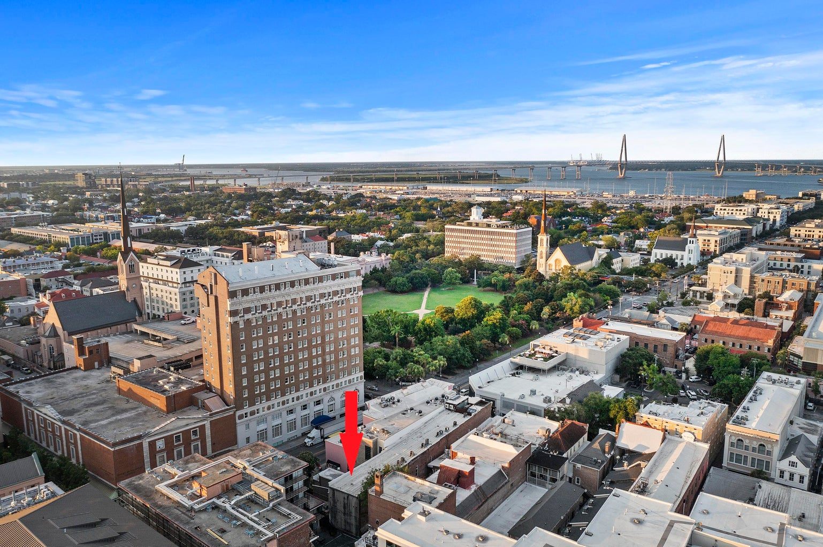
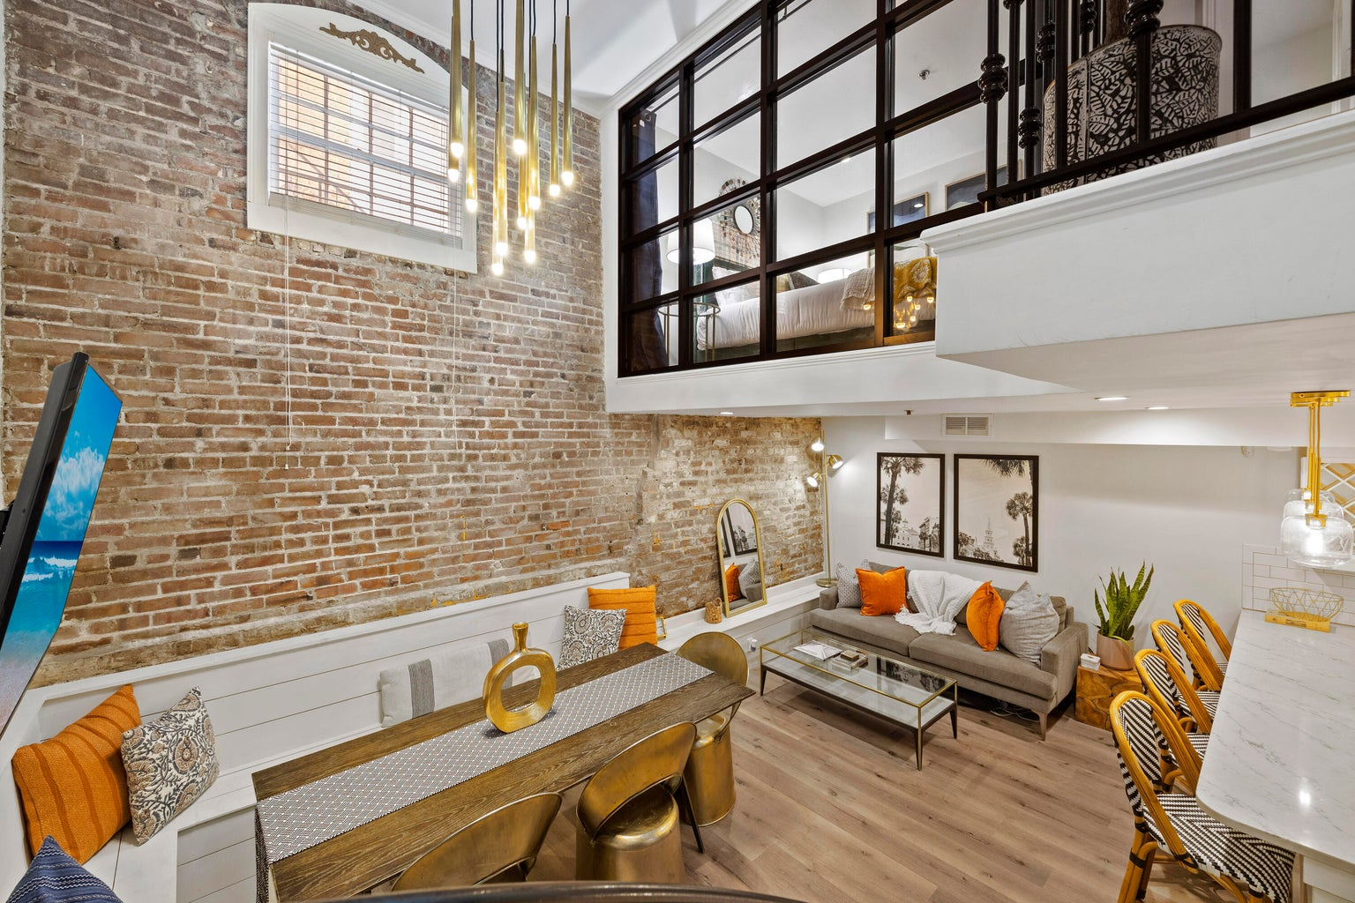
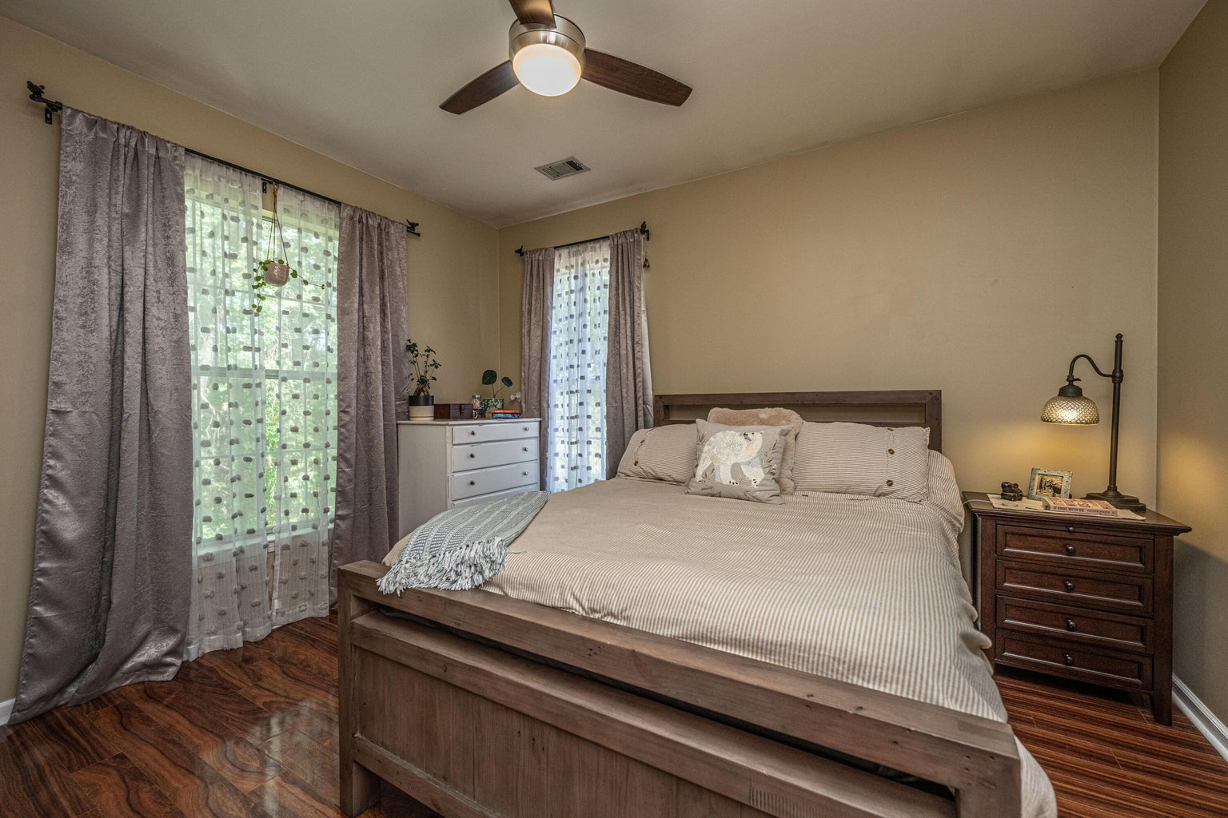
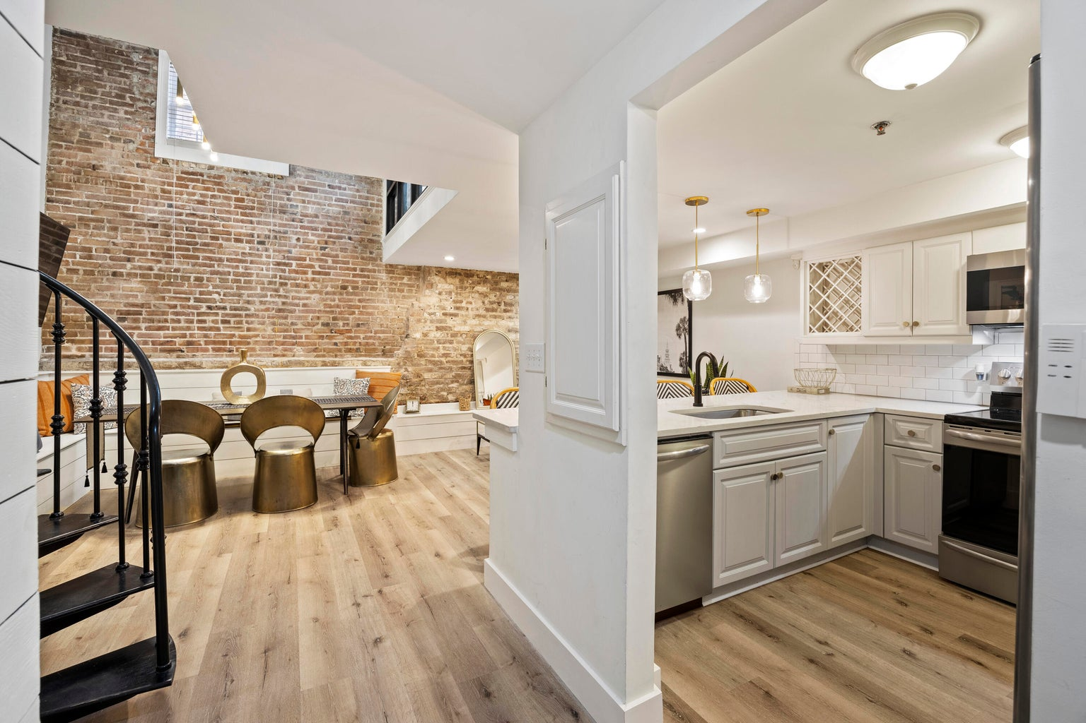
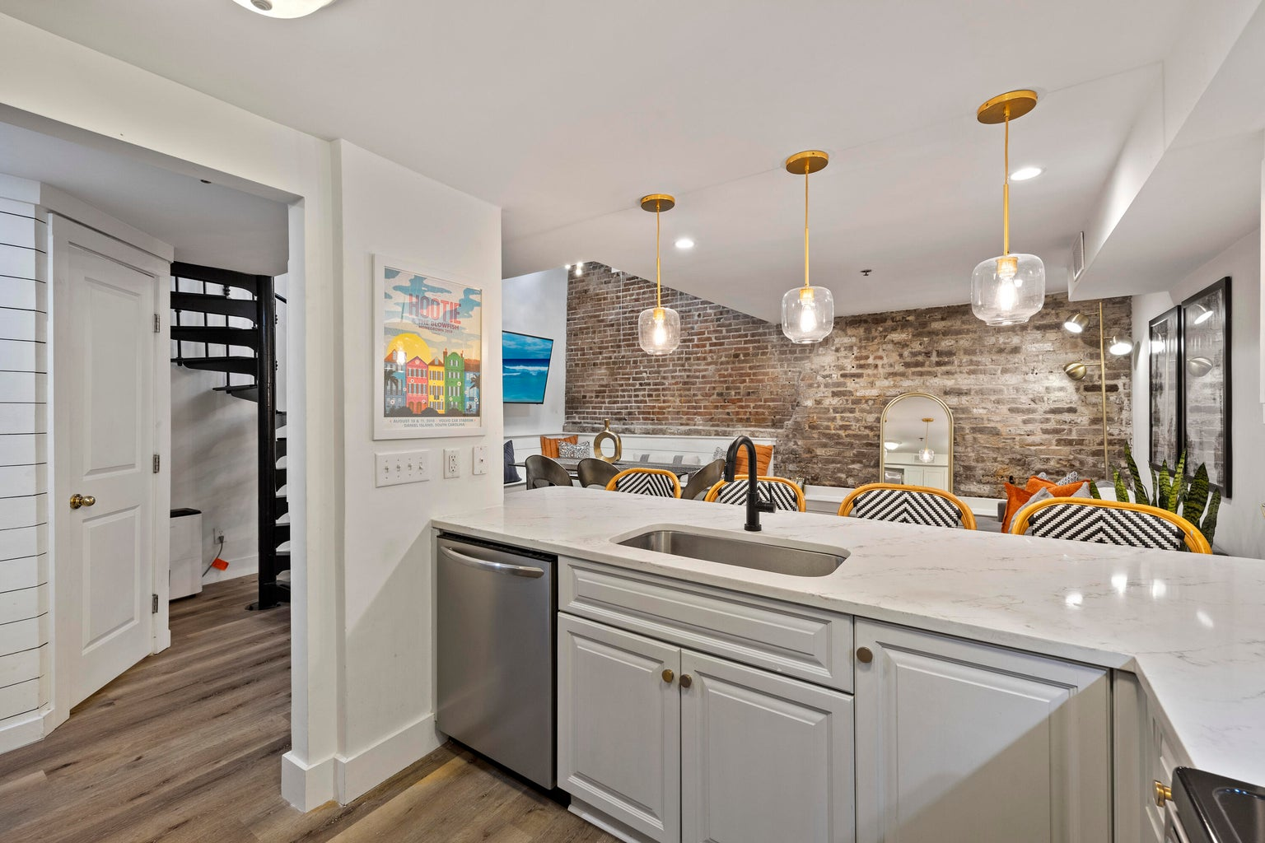
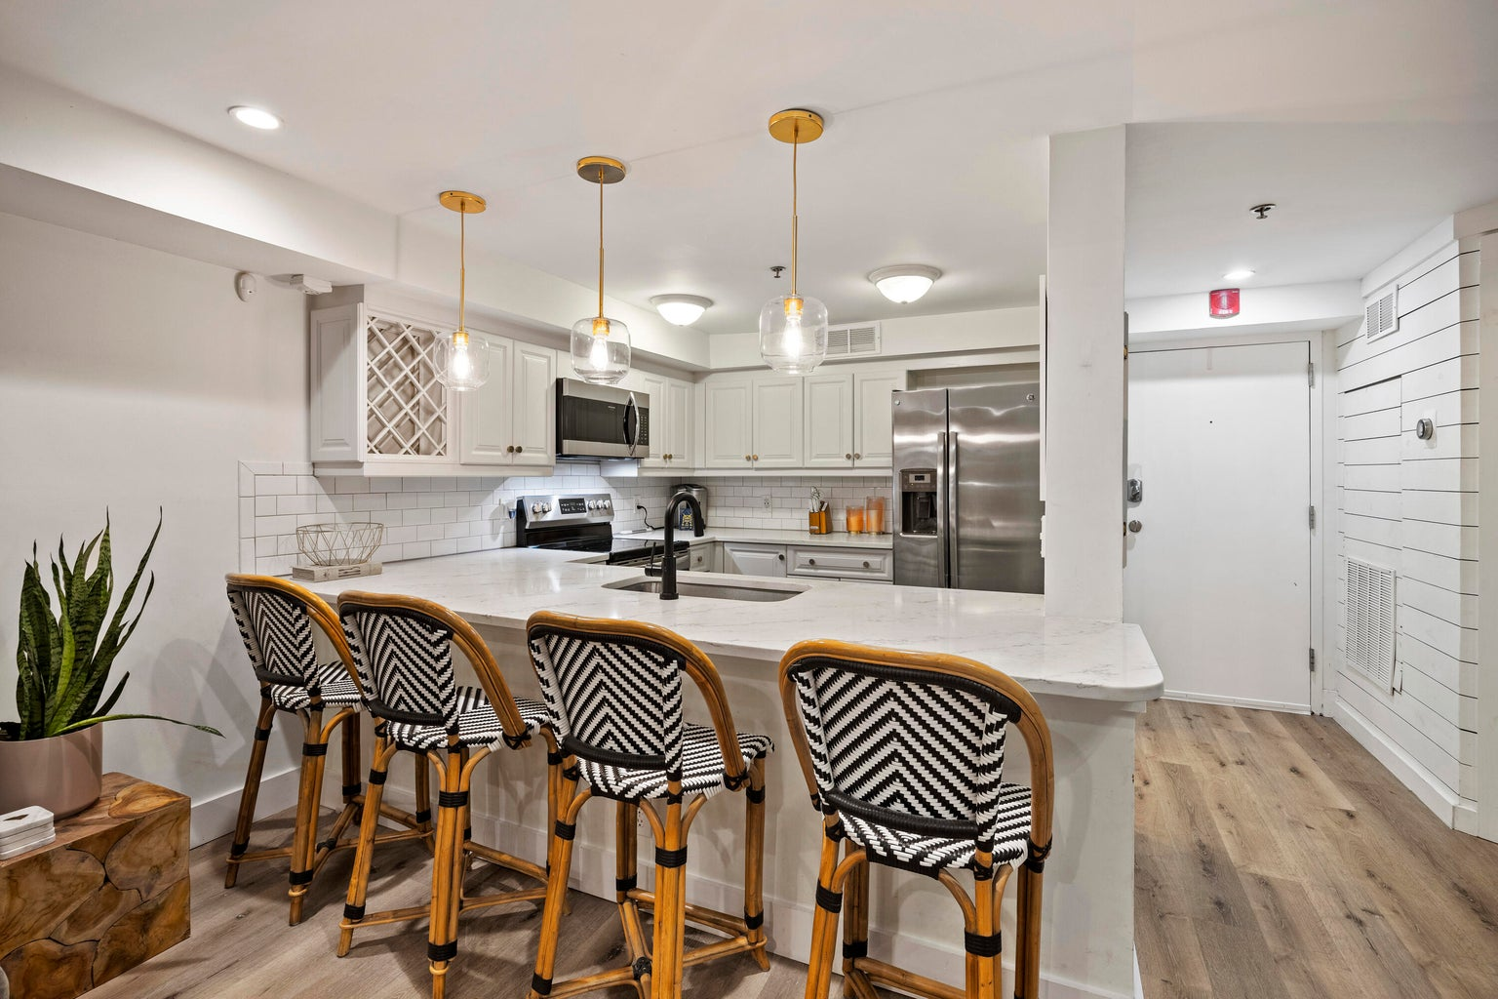
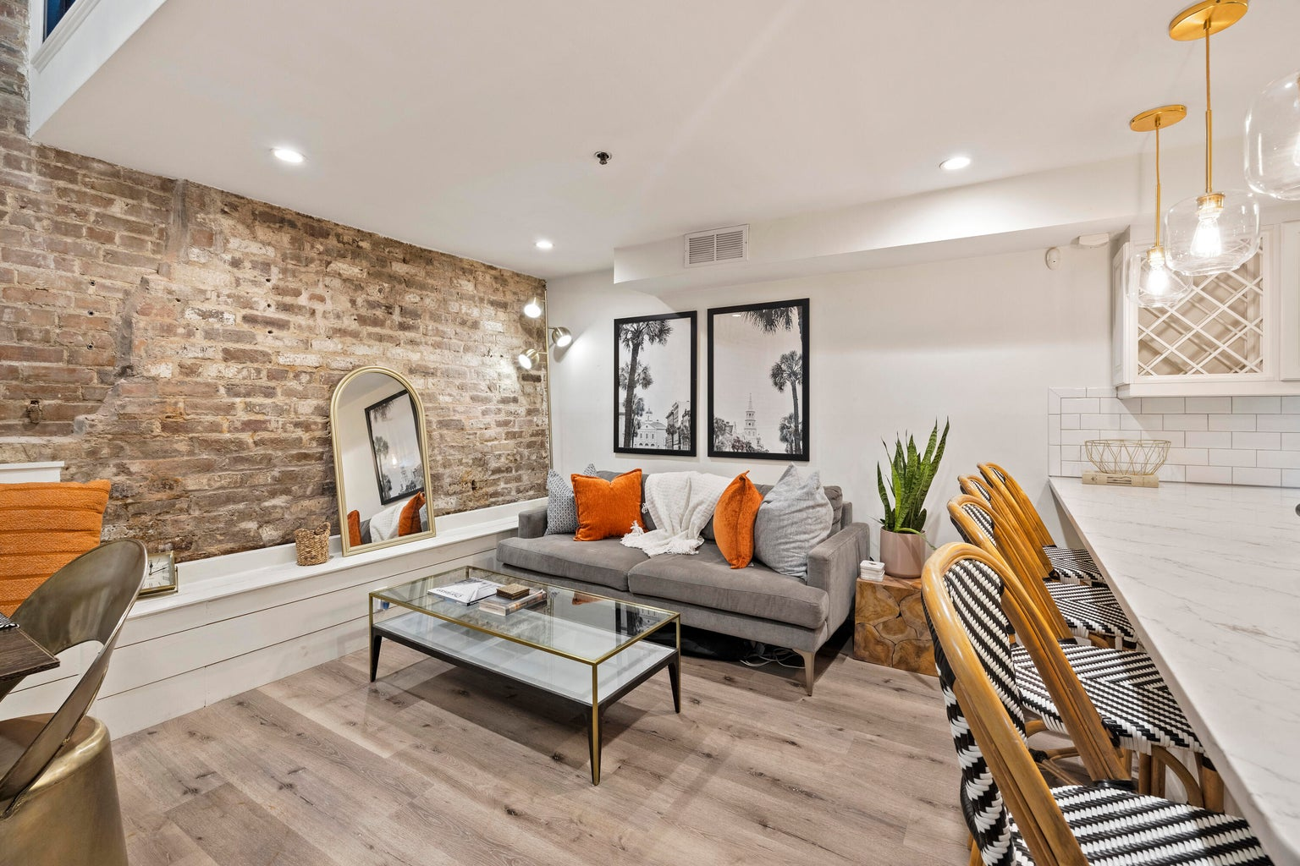
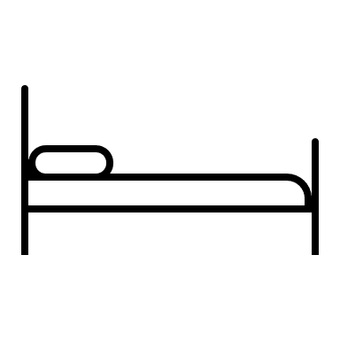


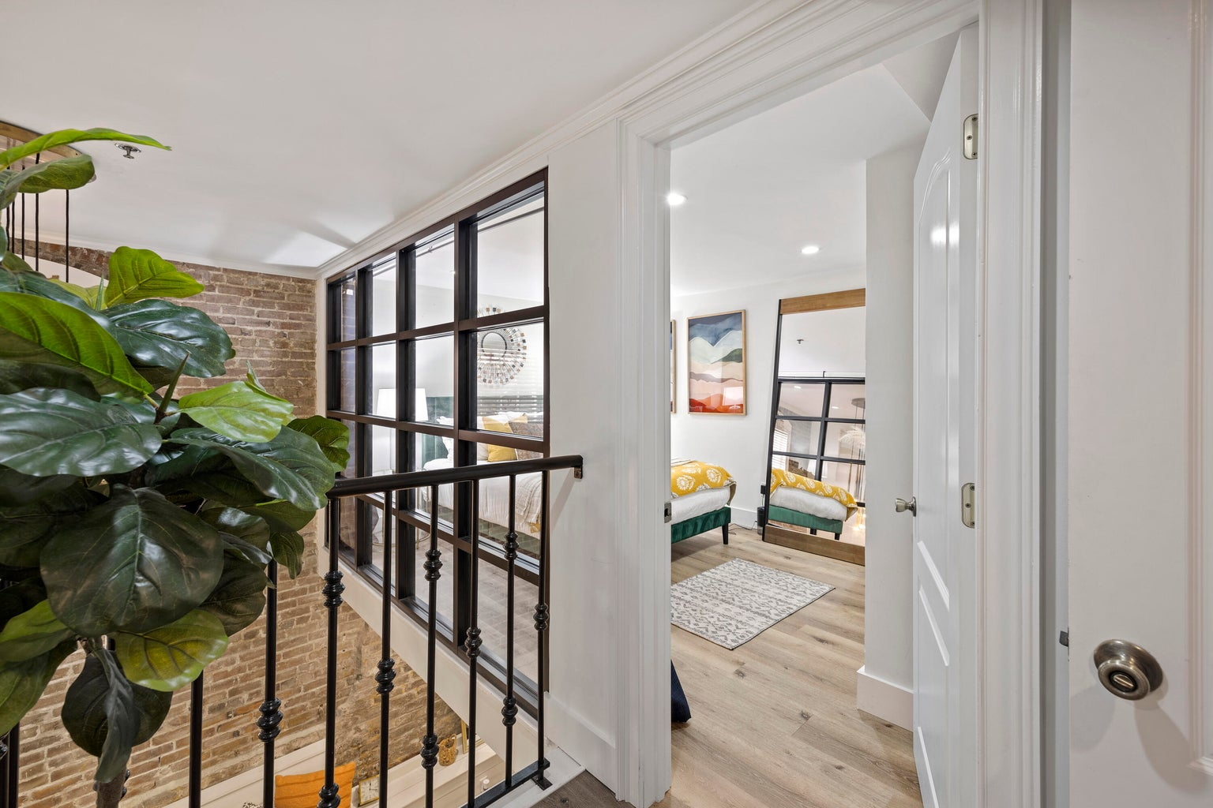
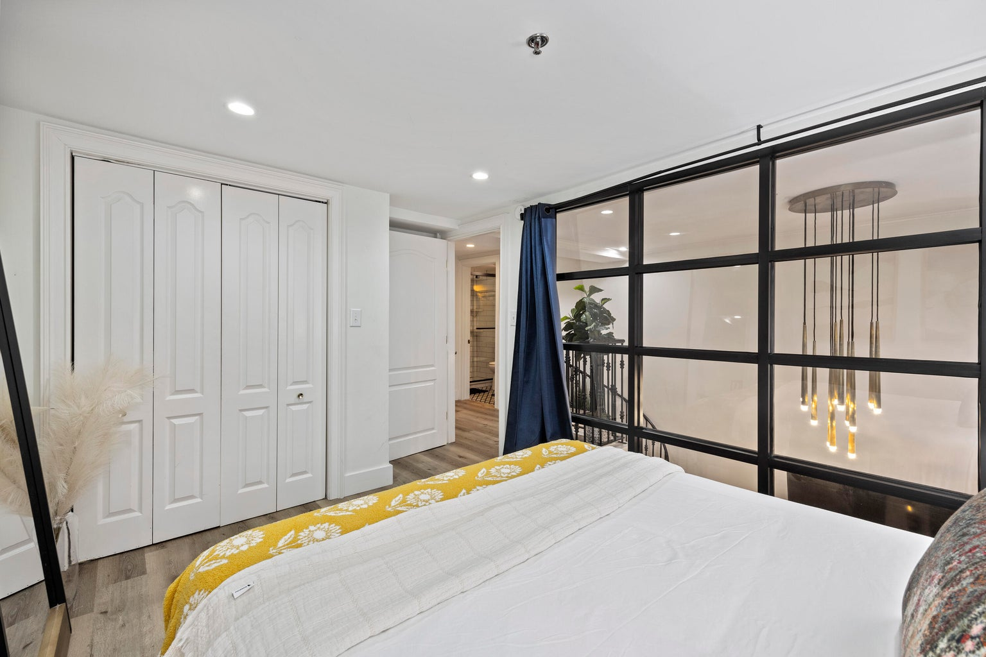
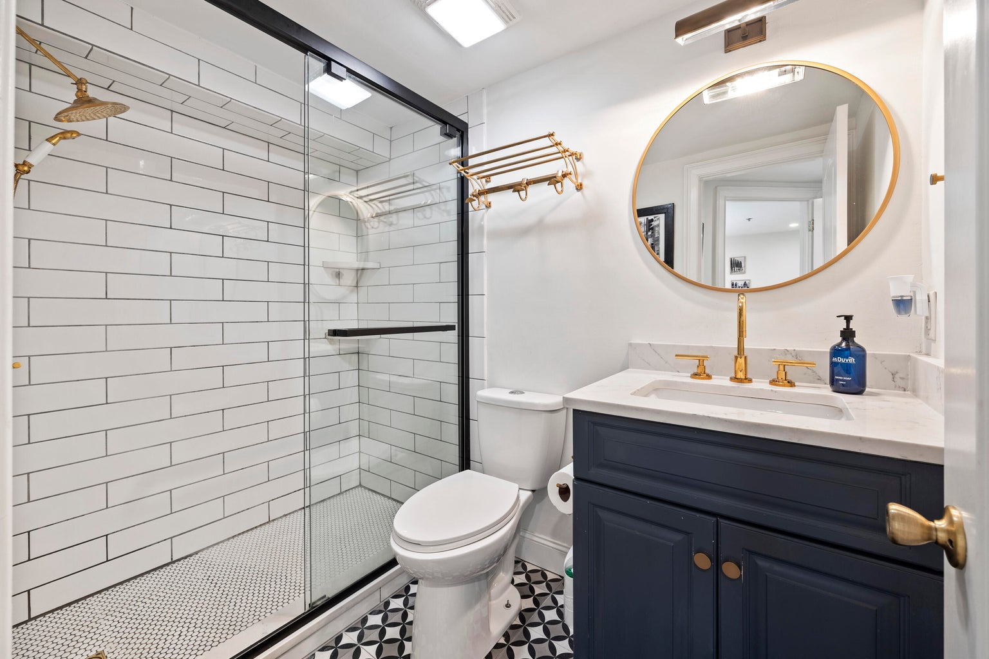
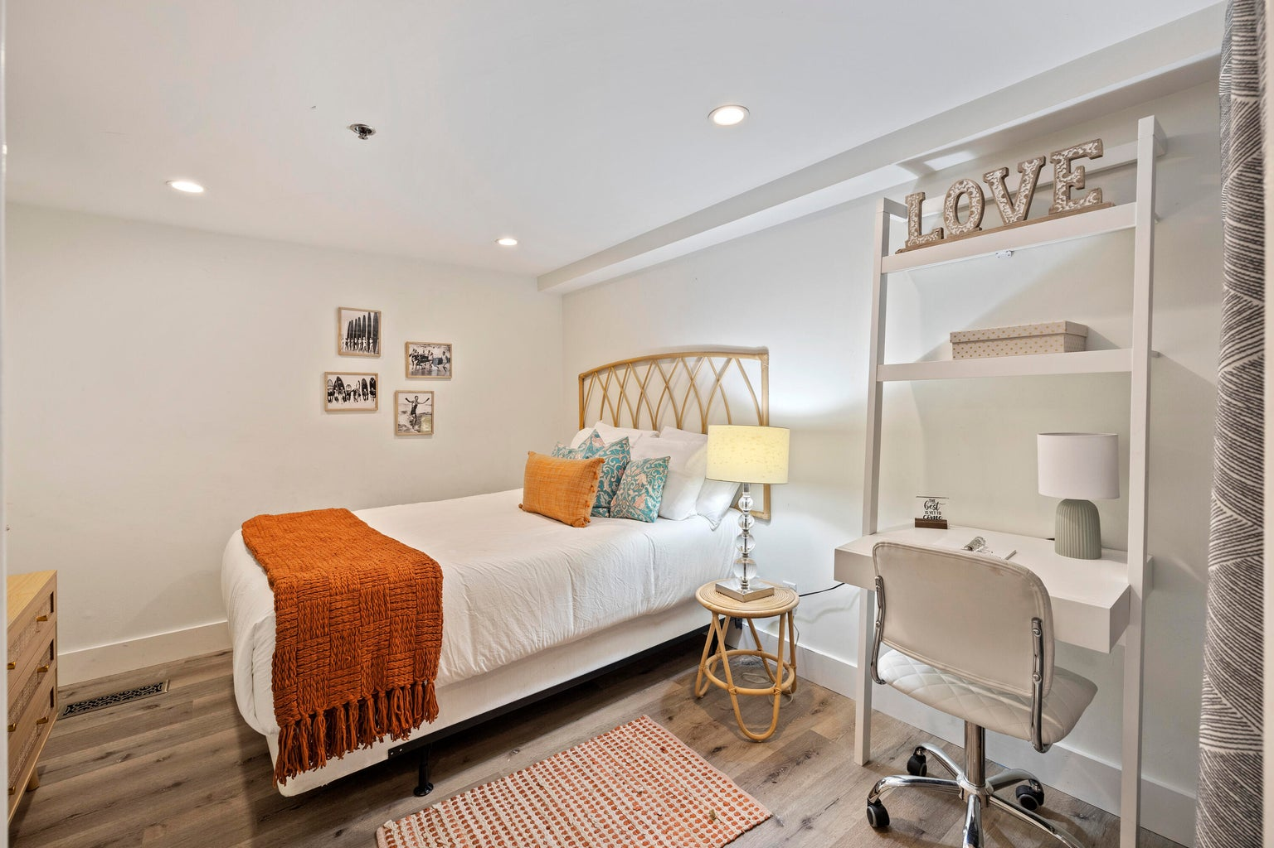


2 Bedroom, 1.5 Bath Condo in Downtown
377 King Street 103
Charleston, SC 29401 | MLS# 23021114 | $600,000
4
3
1,844
Embrace the best of downtown Charleston living in this charming, fully furnished two-story condo. Its prime location places you in the heart of Charleston's food and shopping scene, the College of Charleston, Marion Square and so much more. This thoughtfully designed residence boasts exposed brick walls, shiplap accents, and custom built-in seating, all complemented by sleek, contemporary finishes. The open-concept living area is an absolute showstopper with its captivating spiral staircase, creating an urban-chic ambiance. The fully equipped kitchen, adorned with stainless steel appliances and granite countertops, is a testament to modern culinary excellence. Luxury vinyl plank flooring graces the space, while decorative tile accents and updated bathrooms complete this beautiful home.
VIDEO TOUR
Liza Gandis
843-926-8656
liza.gandis@carolinaone.com
Carolina One Real Estate
191 Rutledge Ave
Charleston, SC 29403

