Slide 1
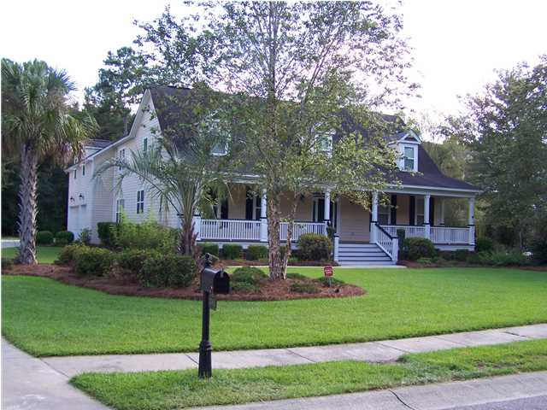
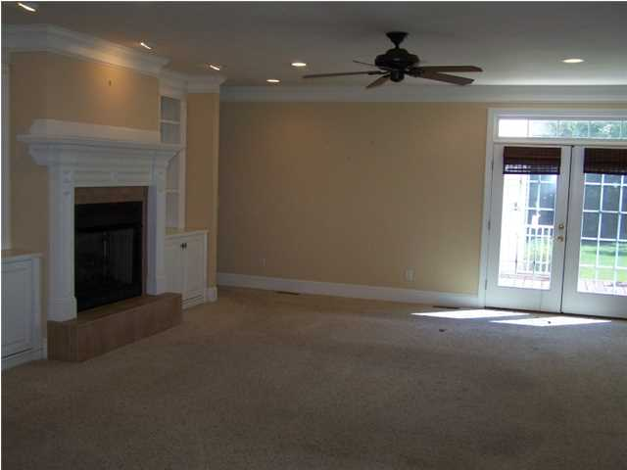
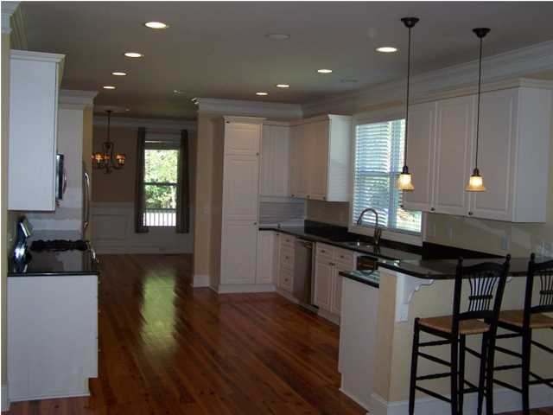
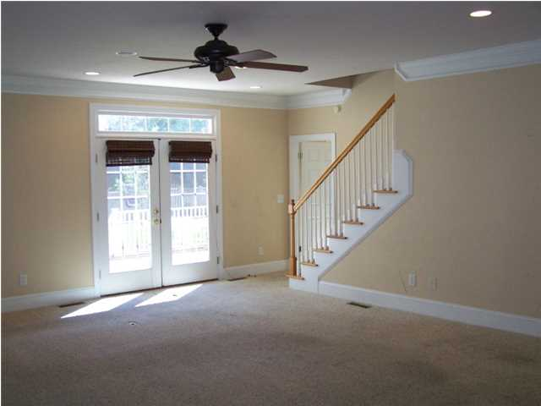
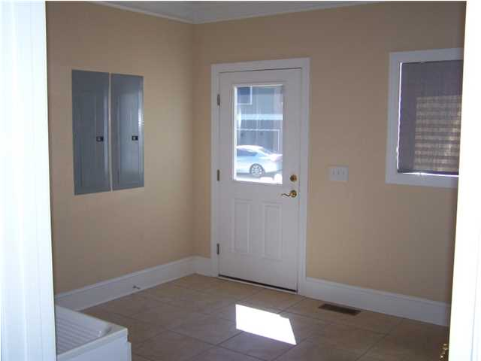
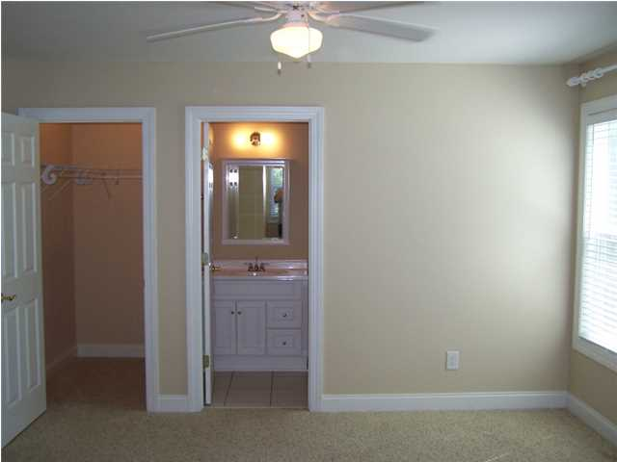
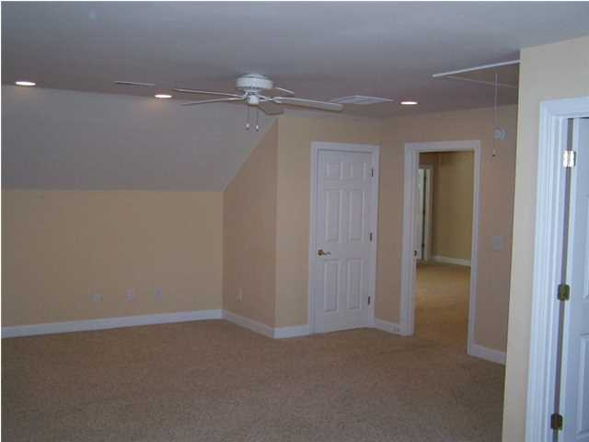
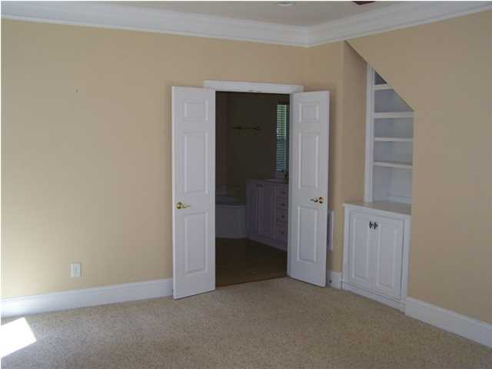
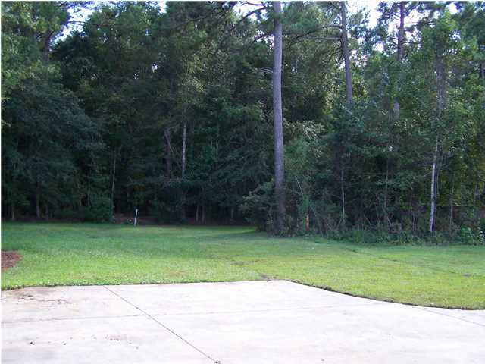
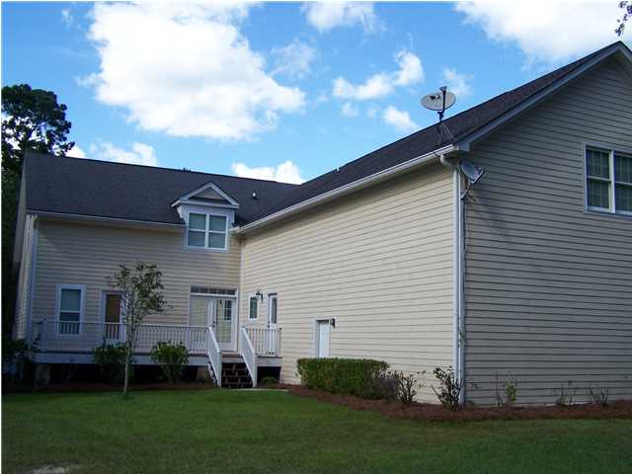
Price Reduced!
3783 Saint Ellens Dr
Mount Pleasant
$540,000
MLS# 1423091
4 Bed | 4½ Bath | 4,392 sf
The large front porch welcomes you to this quaint southern home situated near the end of a cul-de-sac. This home boasts of approximately 4,400 square feet and offers 4 large bedrooms each with their own full bath. There are beautiful heart pine floors, granite counter tops, and stainless steel appliances including a gas range. One of the many inviting features of this home is the bonus/game room with a built in bar for entertaining. There are ample storage areas throughout the home, as well as a large 3 car garage. Motivated Seller.
Thomas Hartnett, Jr
Hartnett Realty Co., Inc.
134 Meeting St, Chas, SC 29401
tom@hartnettrealty.com
(843) 723-7222 Office | (843) 270-2915 Mobile

