Slide 1
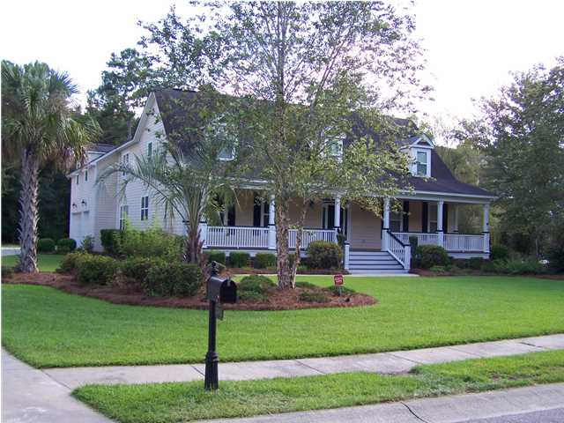
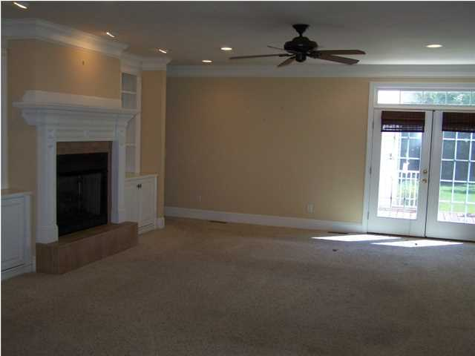
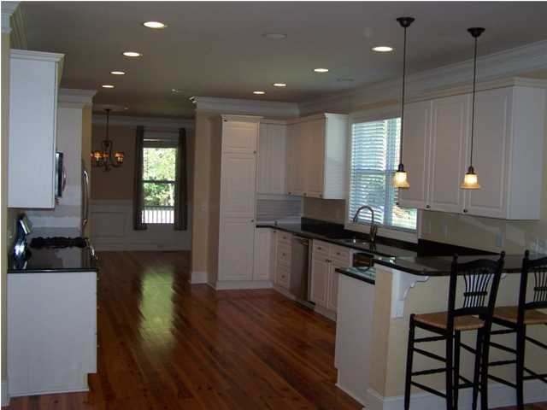
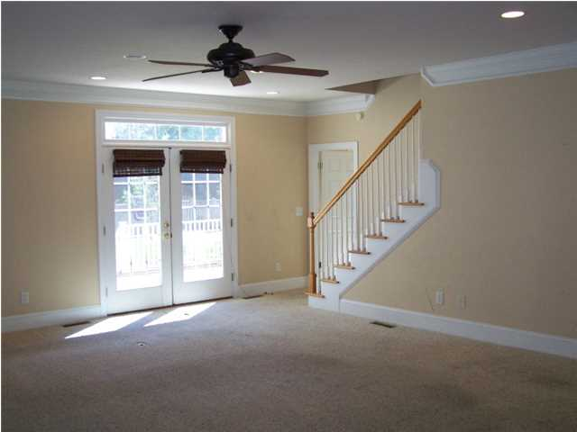
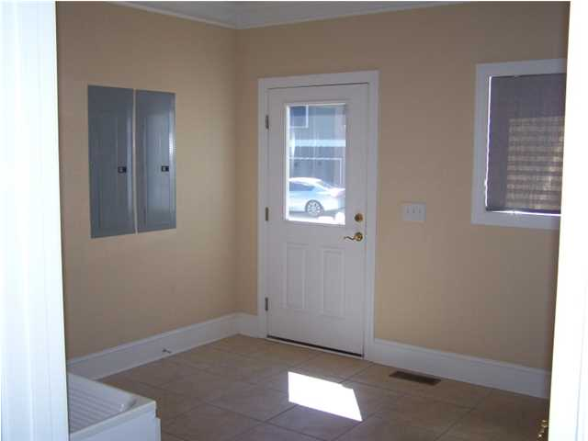
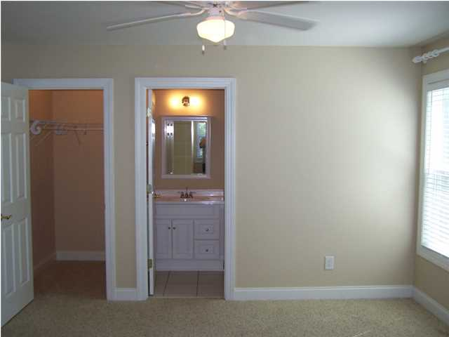
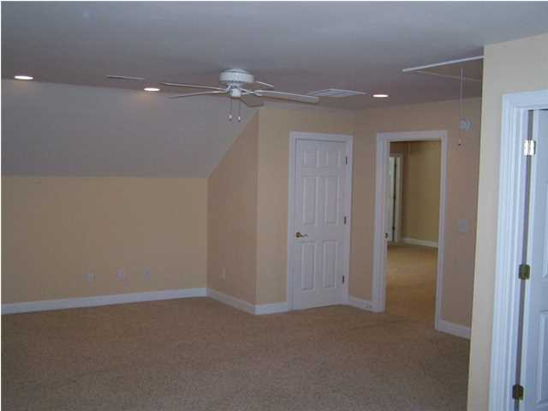
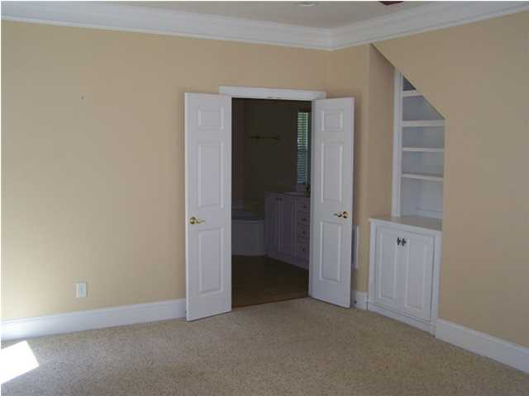
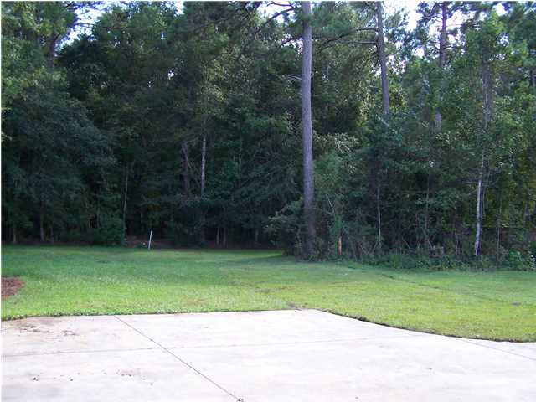
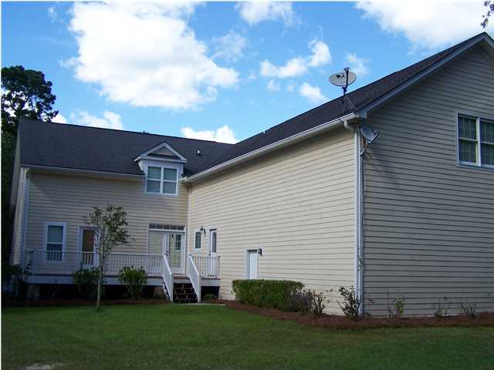
Major Price Reduction!
3783 Saint Ellens Dr
Mount Pleasant
$560,000
MLS# 1423091
4 Bed | 4½ Bath | 4,392 sf
Seller now offering a $10,000 allowance toward new carpeting and cosmetics with an acceptable offer to close before December 1st.
The large front porch welcomes you to this quaint southern home situated near the end of a cul-de-sac. This home boasts of approximately 4,400 square feet and offers 4 large bedrooms each with their own full bath. There are beautiful heart pine floors, granite counter tops, and stainless steel appliances including a gas range. One of the many inviting features of this home is the bonus/game room with a built in bar for entertaining. There are ample storage areas throughout the home, as well as a large 3 car garage. Motivated Seller.
Thomas Hartnett, Jr
Hartnett Realty Co., Inc.
134 Meeting St, Chas, SC 29401
tom@hartnettrealty.com
(843) 723-7222 Office | (843) 270-2915 Mobile

