Slide 1
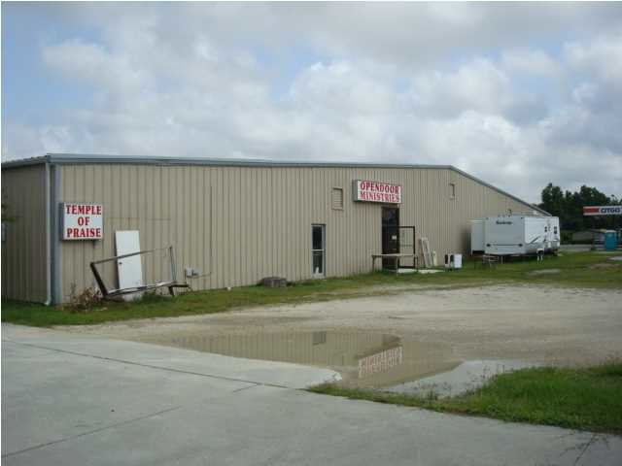
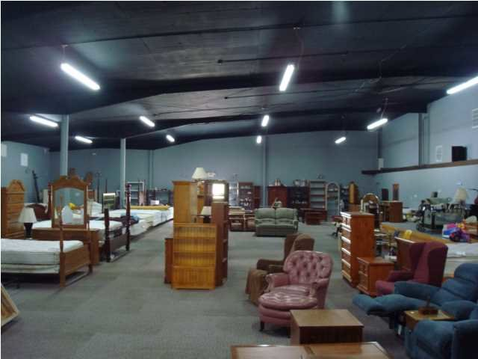
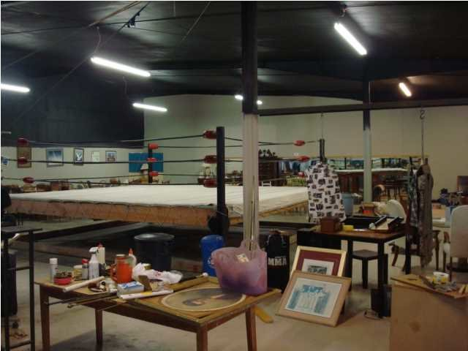
OPPORTUNITY ZONE
ST STEPHEN | $20/SF | 32,000SF
$40,000
Price Reduction!
Commercial / Fronts HWY 52
3784 Byrnes Dr | $650,000 | CMLS# 30474654
Property fronts on Hwy 52 in the town limits of St. Stephen...Only about 35 minutes from I-26 and Summerville or the same to I-95. Commercial/Industrial Warehouse. This property has had a portion used as a church, office, storage and sale of furniture and other household goods. Owner will sell. Lease...Lease/Purchase and even hold owner financing...Its okay to be creative. Seller upgraded roof...Insulated the roof and created many...Many concrete parking spaces. Additional land to be built upon...3 total acres zoned commercial...Less than 1 hour drive from Boeing!!!!
Rick Willis
843-327-3017 Rick@RickWillis.com The Group, LLC

