Slide 1
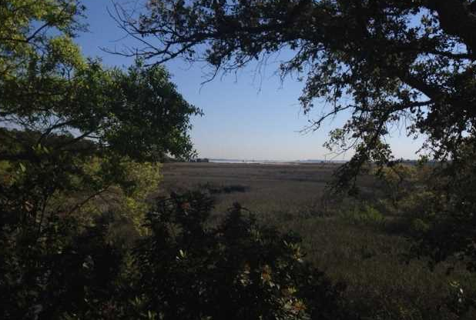
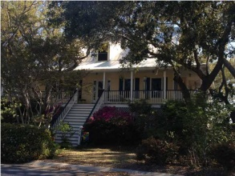
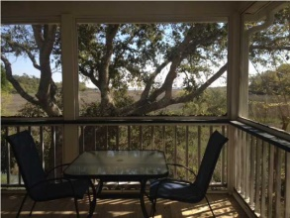
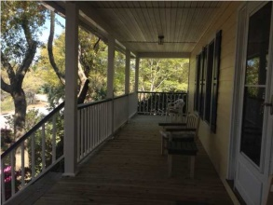
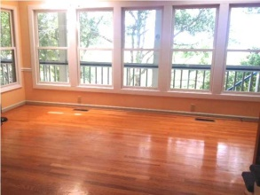
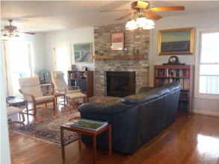
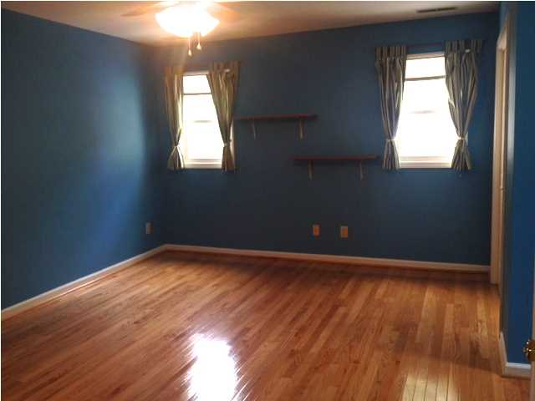
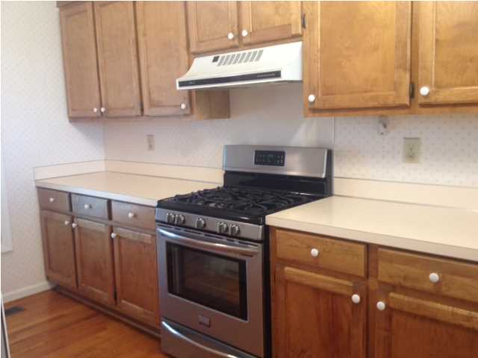
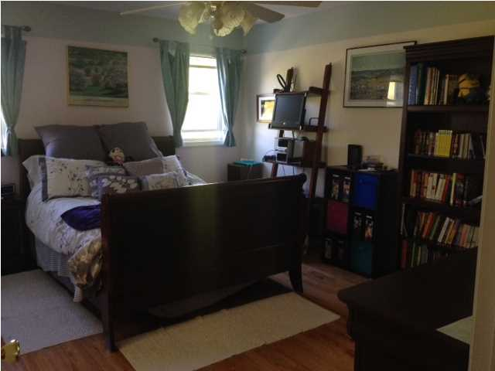
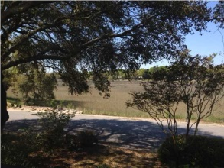
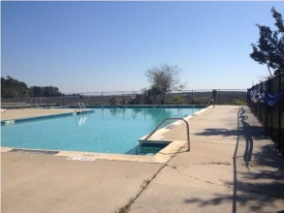
Open House
Wed, Aug. 27th ~ 11:30a-1:30p
378 Sweetgrass Creek Rd
James Island, SC
MLS# 1409911
Recently Reduced to $585,000!
Summer has come to an end! Kids are back in school!
Time to "Get back to work!“
Join me for a quick bite to eat while checking out this beautiful view… owner retired and moved "up north".
House is vacant and easy to show to potential clients.
Come preview it on the 27th.
Please RSVP to
Angie Chakeris
843-270-3700
angiechakeris@msn.com
Hewitt & Hewitt | PO Box 492 | Charleston, SC 29402

