Slide 1
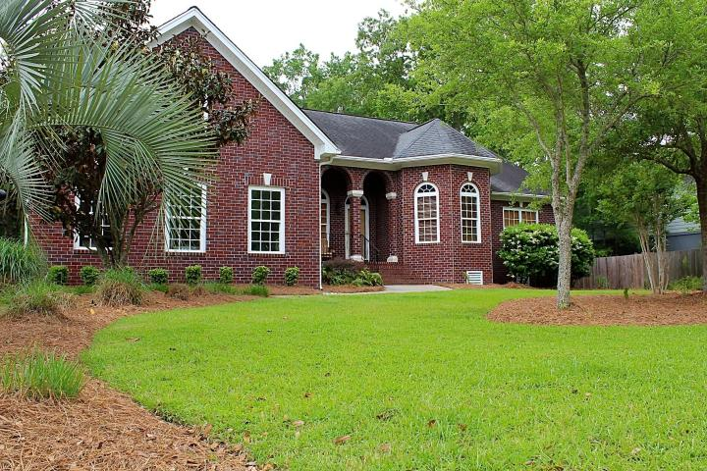
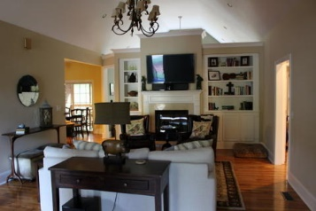
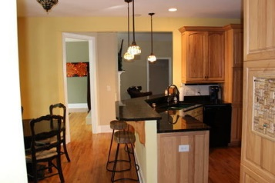
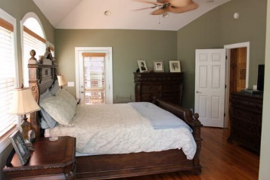
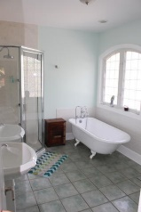
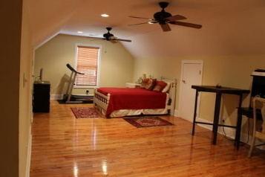
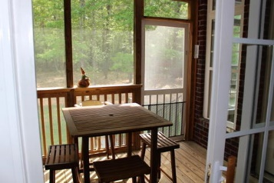
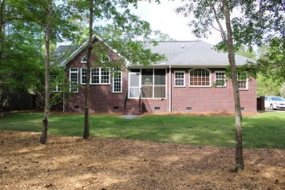
Price Reduced
3791 Saint Ellens Drive
Darrell Creek
Mount Pleasant, SC 29466
MLS# 15009390
Reduced to $529,000
You may have found the needle in the haystack. Where else will you find another custom-built, one-level, all brick home situated on a large naturally wooded lot at the end of a quiet cul de sac. This unique combination makes maintenance a breeze and allows you to relax and enjoy Lowcountry living in one of Mount Pleasant's most desirable neighborhoods. Upon entering, you're welcomed into the living room by oak hardwood floors (which you'll find throughout the home), built in shelves, cathedral ceilings, and a double-sided gas log fireplace. Behind pocket doors, you'll find a study/den that's perfect for a home office. The living room peeks into the eat-in kitchen where the family gourmet will love the granite counters, custom hickory cabinetry, gas stove/oven, and convenient access to the screened porch for outdoor family meals. The screened porch also opens to the master and sunroom - open the doors and enjoy the songbirds while lounging in the sunroom or relaxing in bed. The master suite is spacious and features a walk-in closet with efficient built-ins, traditional cast iron clawfoot tub, casement windows, and waterfall shower. Two other main floor bedrooms also have walk in closets with built-ins and share a full bath. Over the garage there's a large guest suite with full bath. Three car garage means you have room for all your toys! Bring your boat too, because the low cost HOA lets you keep it right there at home! Come see this home and you'll love its rare combination of ease and sophistication. Call to view today!
Thomas Hartnett, Jr
Hartnett Realty Co., Inc. | 134 Meeting St, Chas, SC 29401
tom@hartnettrealty.com | (843) 723-7222 Office | (843) 270-2915 Mobile

