Slide 1
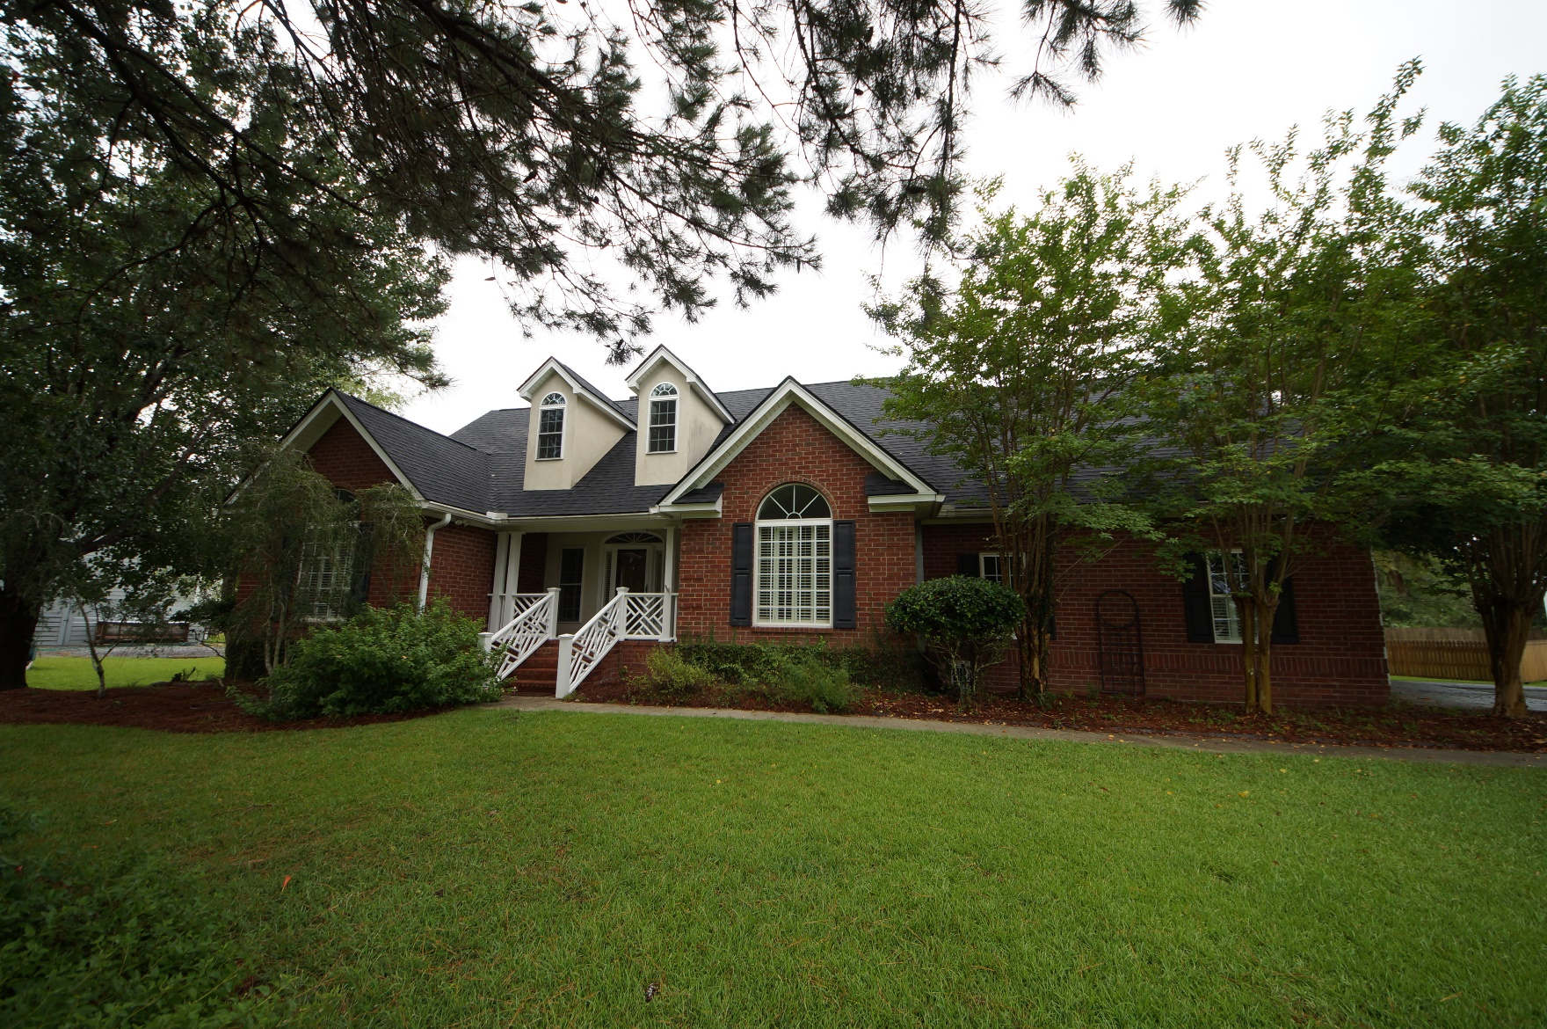
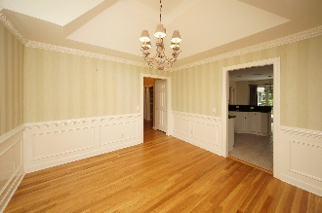
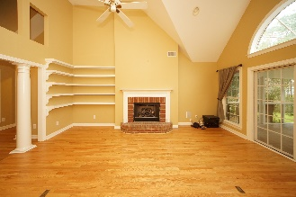
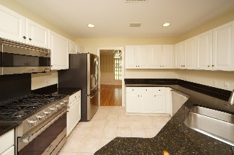
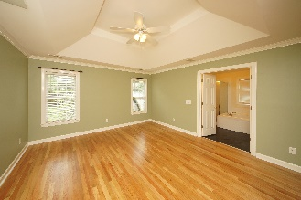
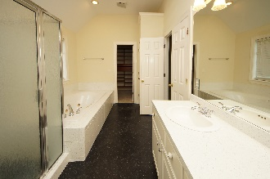
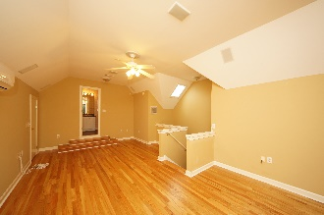
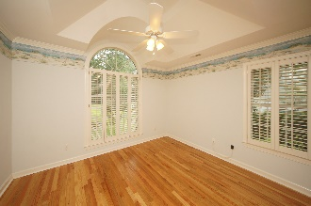
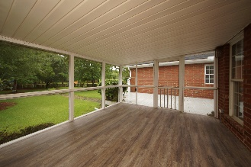
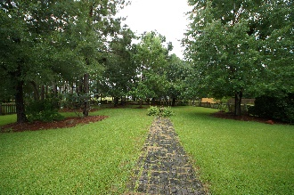
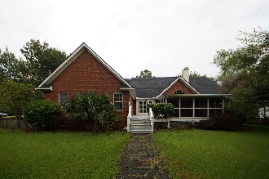

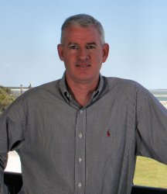
379 Commonwealth Road Darrell Creek :: Mt Pleasant :: MLS# 18004950 :: $475,000
Move Right In
Move Right In
Fantastic brick home with all living space on one level plus a bonus room over garage (4th BR) . All wood floors throughout, updated kitchen with granite and stainless appliances. Large family room with fireplace that opens to screened porch and deck area to extend the gathering space. Separate dining room with pass through to kitchen. Two car garage beautiful yard. Roof is brand new as well as newer HVAC.
Clay Cunningham
O (843) 886-8110
M (843) 345-4647
clay@carolinaone.com
www.claysre.com
Carolina One Real Estate
1503 Palm Blvd Ste
Isle of Palms, SC 29451

