Slide 1
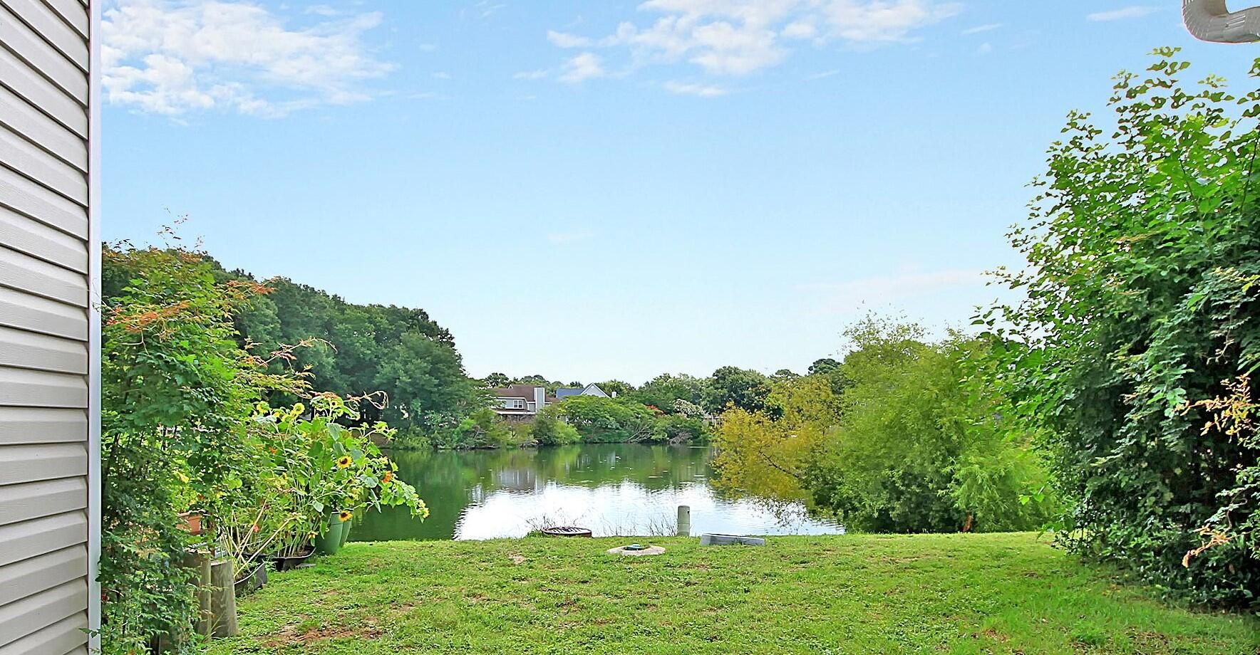

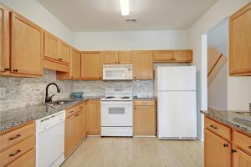
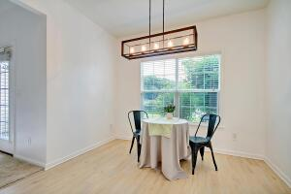
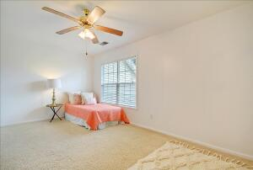
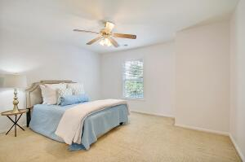
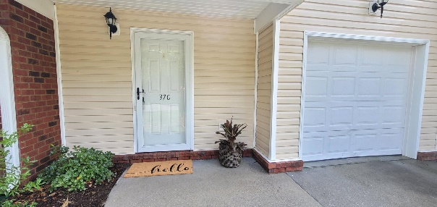
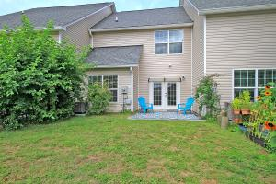
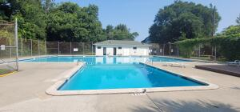



New Price
Minutes To Downtown With A Quiet Pond View
37 Rivers Point C
Rivers Point Row | Charleston, SC 29412 | MLS# 21020094 | $295,000
This property checks all of the boxes! Conveniently located less than 10 minutes from downtown Charleston or Folly Beach, you are a short Uber ride from anywhere you want to go! This two story unit overlooks a quiet pond and has an attached one-car garage. Upon entering, you will notice the soaring ceiling and light filled foyer. Hardwood floors lead to the family room featuring brand new carpet. The spacious kitchen flows into the dining area for easy entertaining. Upstairs you will find dual master bedrooms, both with en-suite bathrooms and a large laundry room with space for extra storage. Spend less time sitting in traffic and more enjoying the great local restaurants, the neighborhood pool or watching the ducks gather by the pond from your private patio. This one will not last!
Whitley Boyd
(843) 324-4761
wboyd@theexchangeco.com
www.theexchangeco.com
The Exchange Company, LLC | 49 Calhoun St | Charleston, SC 29401

