Slide 1
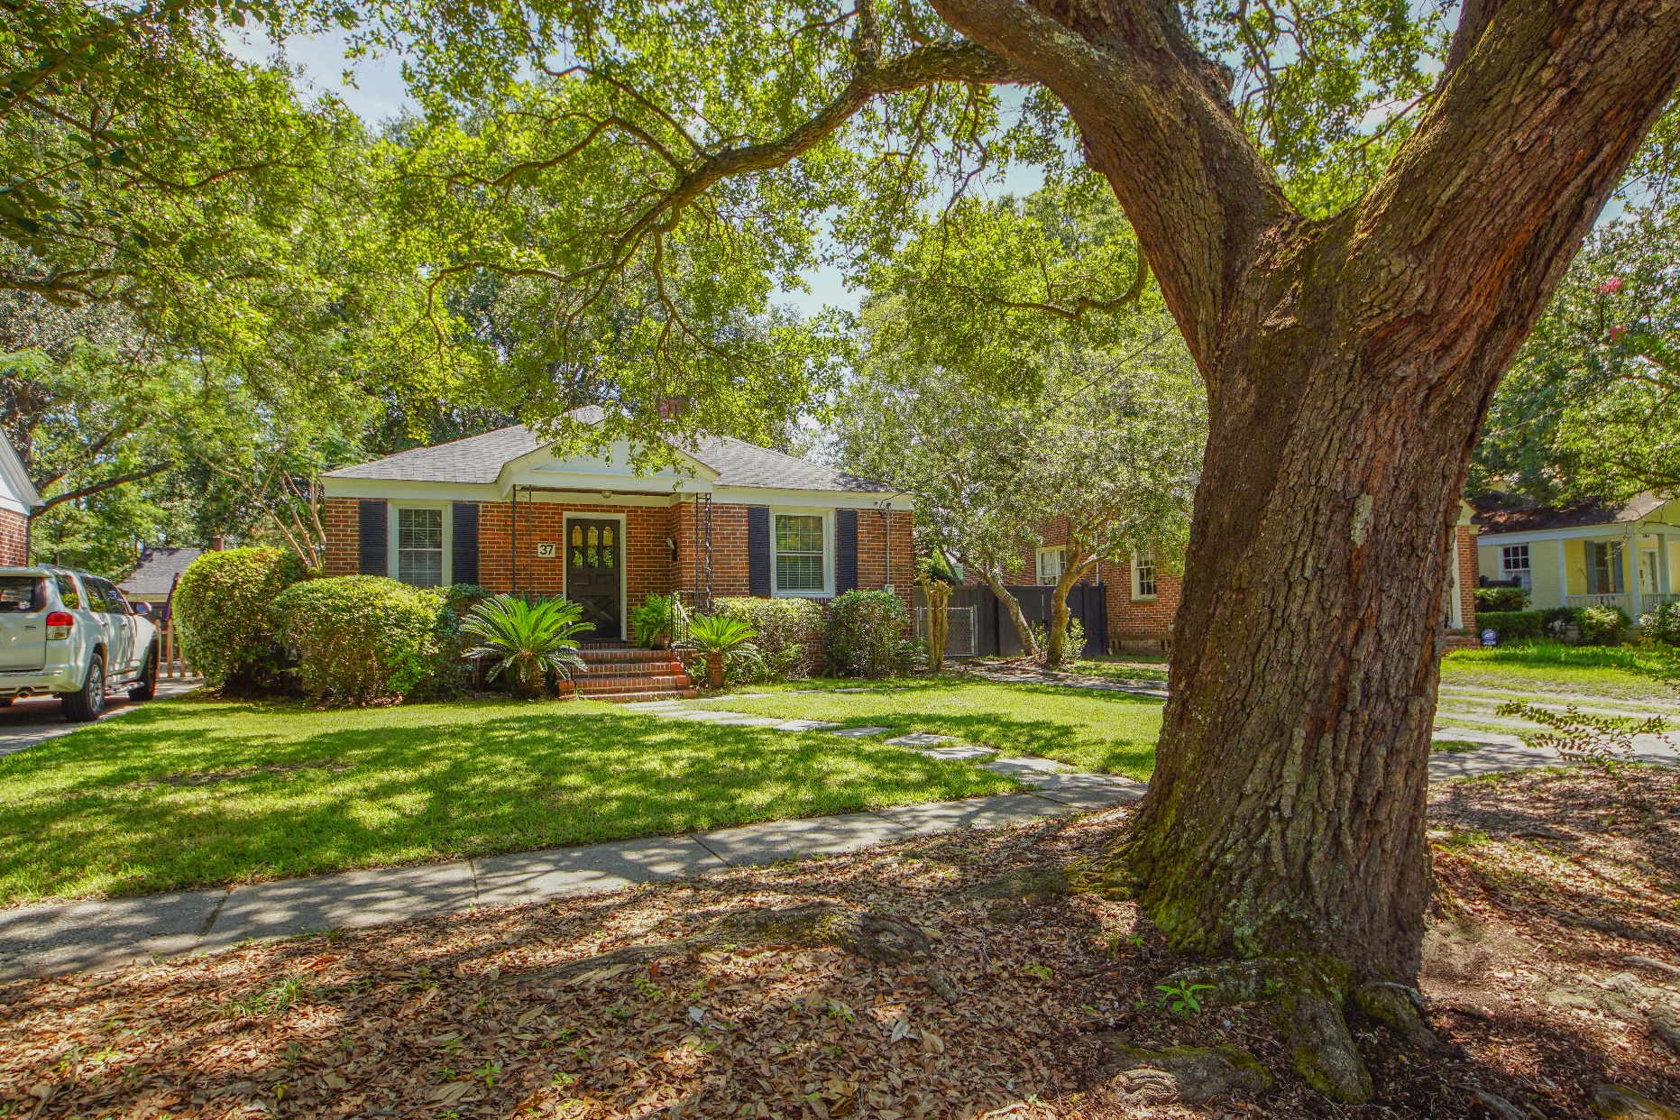
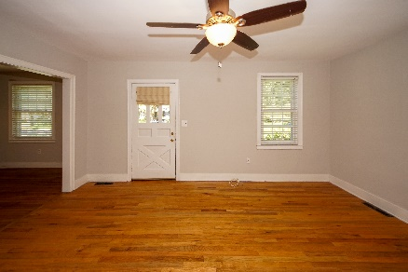
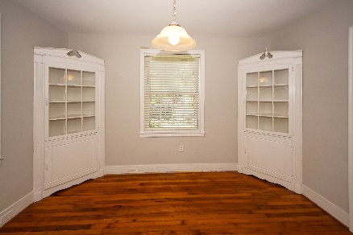
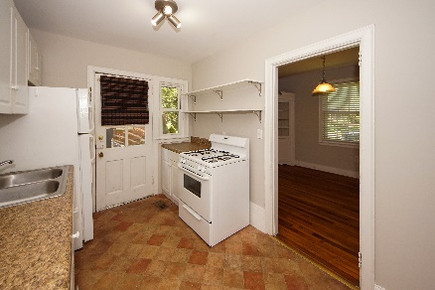
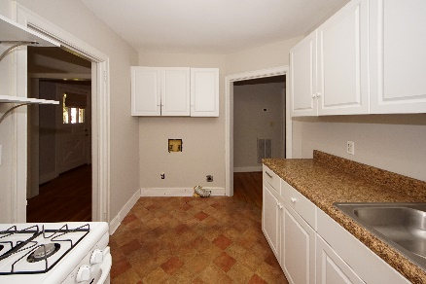
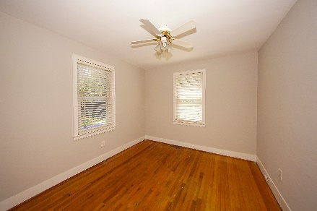
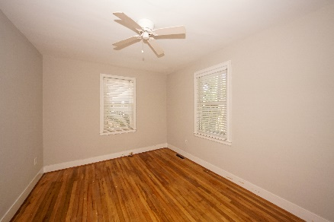
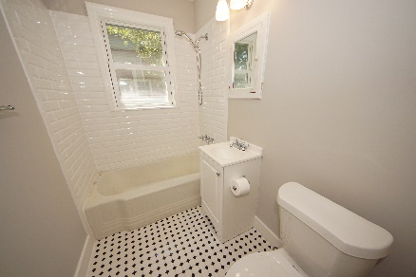
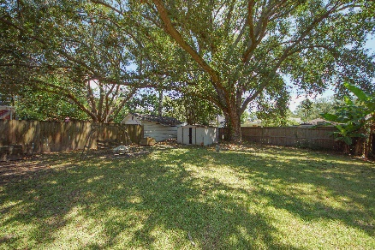


$1000 Buyer's Agent Bonus!
If Ratified By September 15th And Goes To Closing
37 Colleton Drive
Byrnes Down | Charleston, SC 29407 | MLS# 19021717 | $360,000
BYRNES DOWN!!!! Adorable and authentic....perfect place to live in West Ashley.... just minutes to Downtown, South Windermere, Avondale, dining, shopping and best of all.....just steps to the West Ashley Greenway! Much of the original charm of this home remains with some needed updates made recently.
Original hardwood throughout the majority of the house. Newly remodeled bathroom still with the mid-Century appeal. The Dining Room has built-in corner cupboards that add to that charm. Replaced windows within the last several years. Nice size back yard to enjoy. Come see this home today!
Susan Weeks
(843) 813-0495
susanweeksdesign@gmail.com
www.agentownedrealty.com
AgentOwned Charleston Group
902 Savannah Hwy
Charleston, SC 29407-7802

