Slide 1
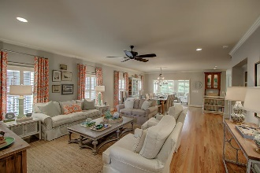
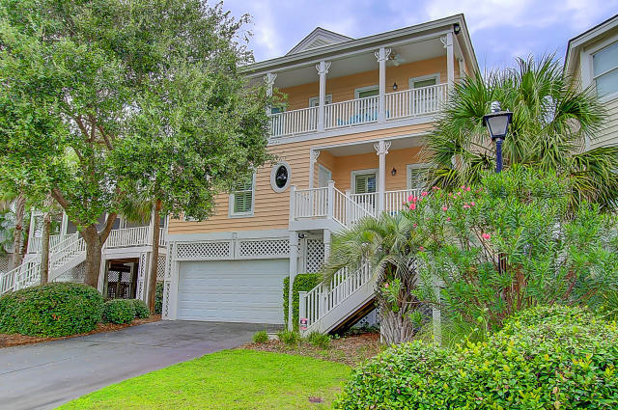
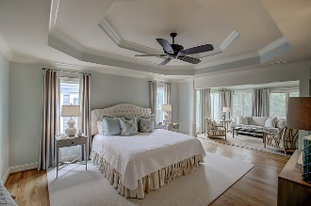
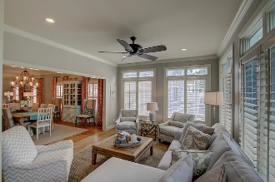
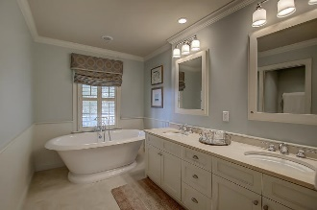
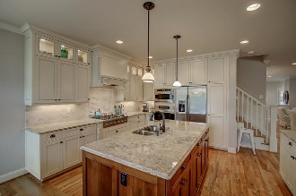
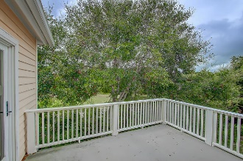


37 Pelican Reach Wild Dunes Isle of Palms MLS# 16025116 $1,199,000
Just Listed!!
Exquisite Custom Home One Block from Beach
Stunning Custom Wild Dunes home built by Hank Pritchard just one block from the beach! The interior design of this home will meet all buyers’ needs. The open floor plan expanding from the living room through to the large dining room, comfortable sunroom and gourmet kitchen is an amazing space for family gatherings and entertaining. The craftsmanship of this home is spectacular with hardwood floors, plantation shutters and additional window coverings, crown moldings, and elegant finishes and furnishings. Enjoying the art of cooking and entertaining in this fabulous gourmet kitchen would be an understatement. The spacious island and additional bar seating area is perfect for prep and serving. Gleaming granite counter tops and stunning back splash make a great presentation in this kitchen as well as the Thermador 6 burner gas stove top and other high end appliances. There is a propane gas hookup for grilling outside of the kitchen area. On the main level is a guest suite and upstairs is the master that will impress any buyer. This very large master bedroom with trey ceiling and amazing sitting room and private deck is a dream. The master bath is luxurious with free standing soaking tub, tiled shower, dual vanities and great storage. Upstairs you will find 2 more guest rooms with private baths making a total of 3 en suite guest rooms throughout the home plus the full master suite. This home overlooks the 6th hole of the Wild Dunes Links Course. Sitting on the front porch you will see peeks of the Atlantic Ocean. This home has a Rinnai tank-less water heater, a three stop elevator, security system, central vacuum and a spacious garage with extra shower and dressing room space. 37 Pelican Reach is in the middle of Wild Dunes Resort Style of Living offering a beachfront gated community with 2 golf courses, tennis courts, bike paths, owners' private beach house, a marina and several dining options. This subdivision of Pelican Bay has its own private pool just across the road. This home has never been on a rental program and is in meticulous condition. Furnishings are negotiable with this home making it a perfect Oceanside retreat that is truly move-in ready.
Darlene Smith Office - (843) 886-8110
Mobile - (843) 696-7824
darlenesmith@carolinaone.com
DarleneSmithTeam.com
Carolina One Real Estate
1503 Palm Blvd Ste
Isle of Palms, SC 29451

