Slide 1
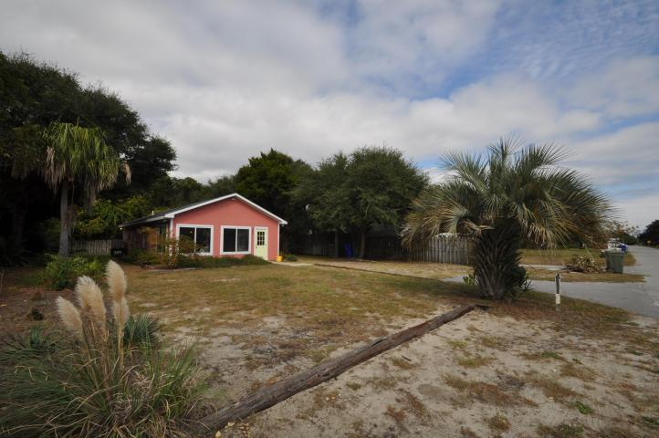
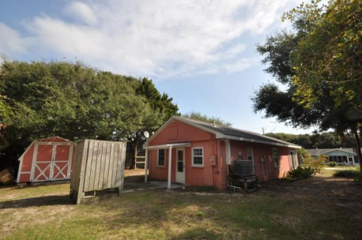
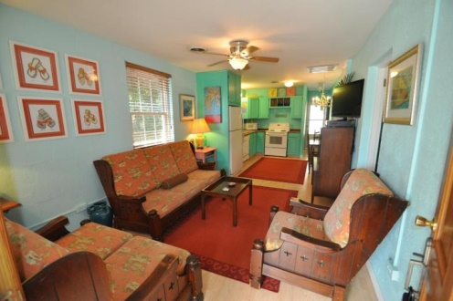
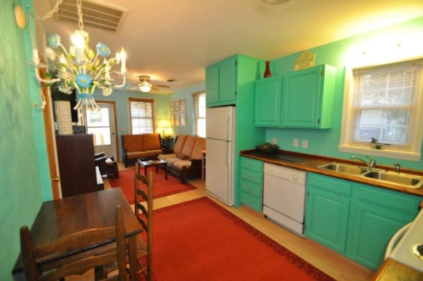
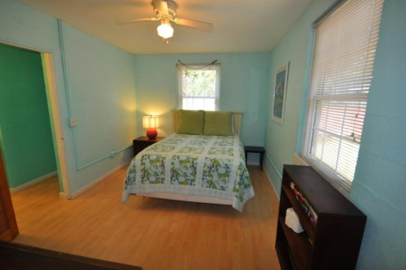
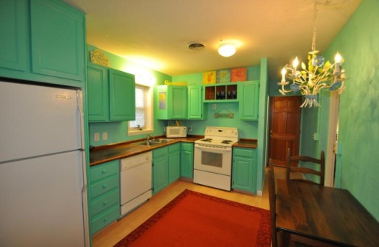
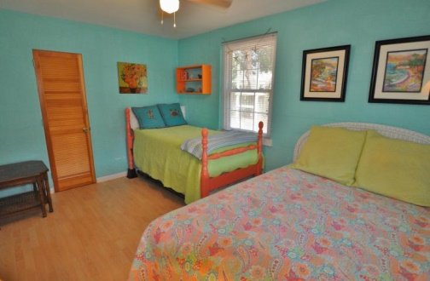
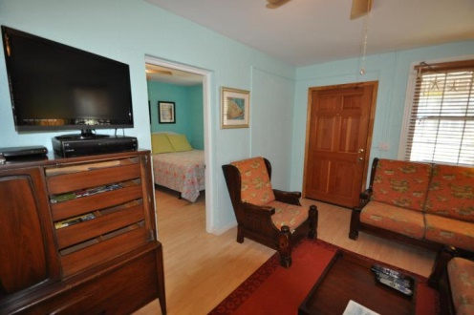
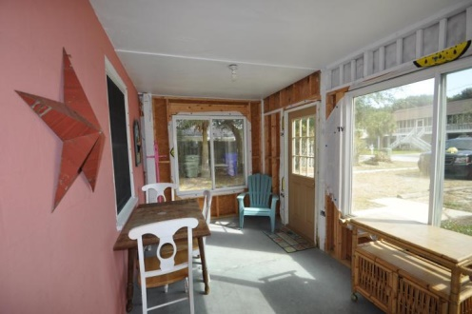
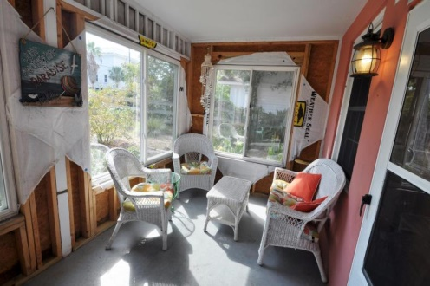

Price Reduced!
Open House Saturday
2:30-5:30
3805 Cameron Blvd ~ Isle of Palms ~ MLS# 14028895 ~ $444,900
Charming Bungalow Near The Beach! This home is your opportunity to own your own home on the prestigious and beautiful Isle of Palms. This lovely bungalow is situated a mere 1 block from the beach. The large lot is landscaped with pampas grass and mature palmettos and provides additional space for a potential add-on build. Enviable location aside, the home has been lovingly renovated with a bright, airy atmosphere and has a proven rental record. It has 2 bedrooms and 1 full bath. The open floor plan feels more substantial than its 682 square feet, and you will immediately notice the efficient use of the space. As you enter the home you will be immediately impressed with the laminate floors that run throughout the home. The mellow warmth of the Living Room draws you in. This is the ideal space to wind down after a day at the beach or to entertain friends. The Living Room flows directly into the inviting eat-in Kitchen which has been well designed to optimize space with plenty of cabinetry for storage and organization. It has rustic butcher block countertops so you'll have ample room for food prep. The open access allows you to mix with the family while preparing dinner. If you'd prefer to relax and throw a few steaks on the grill you can do so in the shade of the large backyard. The enclosed front porch with large windows was made for rocking chairs or a classic hammock and offers additional dining space. You've found your own personal island retreat. The bedrooms are good sized and the bathroom features custom ceramic tile and a shower. There's additional storage and laundry facilities in the large outdoor backyard storage shed, as well as an enclosed outdoor shower. This large lot offers ample off street parking for you, your guest and/or renters and boat storage. It's a short drive to Mt. Pleasant, Sullivan's Island and historic Downtown Charleston. This unique home won't last long, so be sure to book your appointment today!
Call or Email for details: Jordan Elleby (843) 819-9229 Jordan@MattONeillTeam.com

