Slide 1
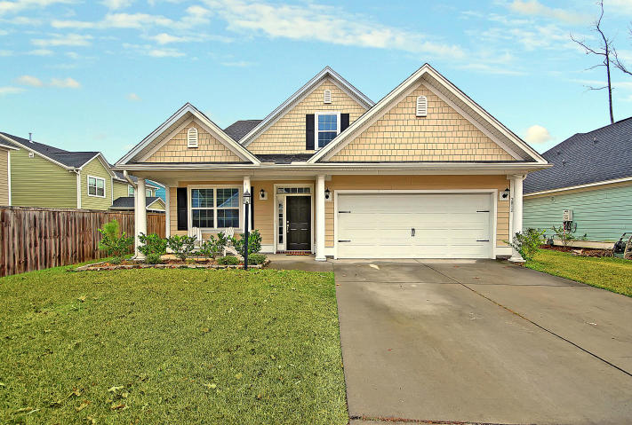
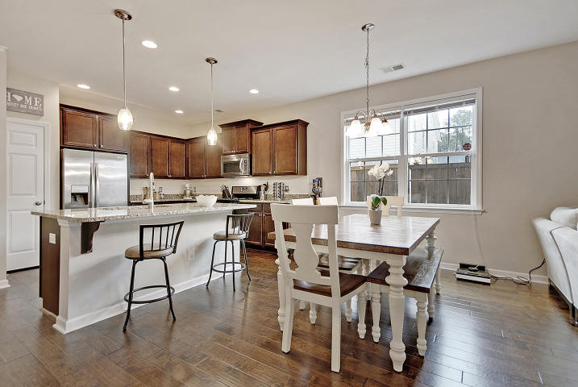
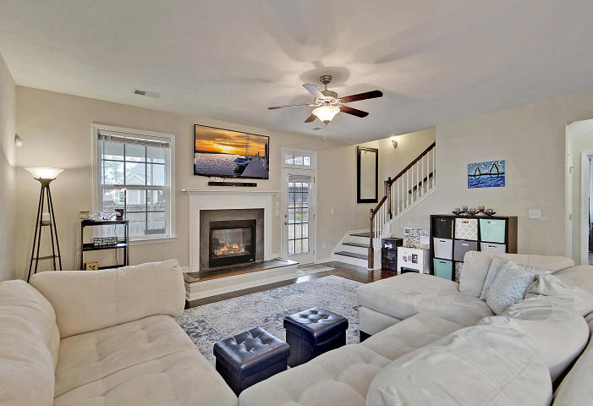
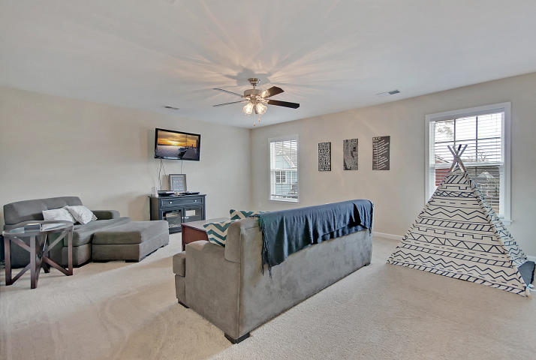
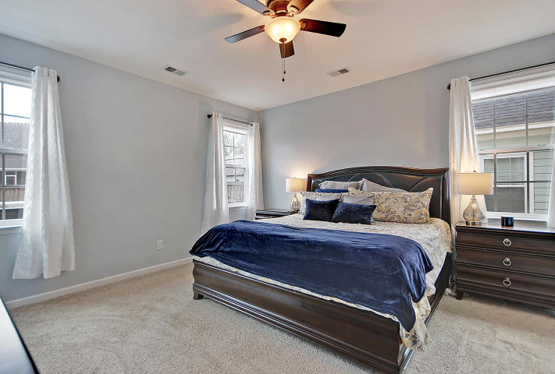
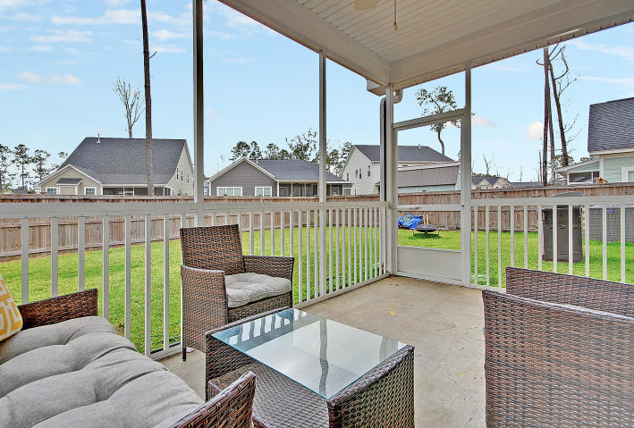
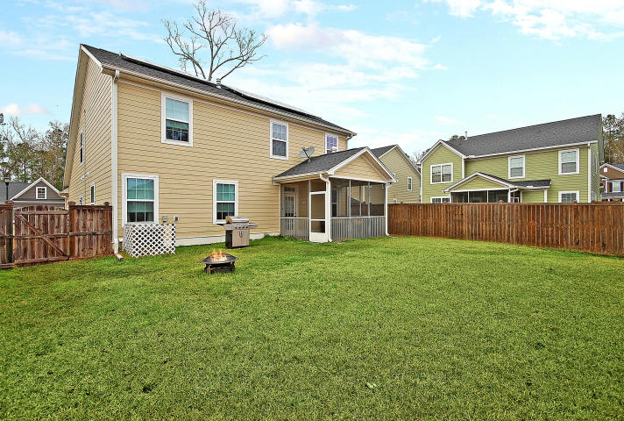
Move-in Ready in Great Location
Price Reduced!
3812 Bonnecrest Lane
Indigo Palms ~ North Charleston ~ MLS# 19000255 ~ $319,500
Conveniently located in North Charleston's Indigo Palms community, this Crescent-built home offers a spacious, two level floorplan with an amazing first floor master suite. The first level boasts beautiful hardwood floors, French doors leading to the office in the front of home, an open concept layout with an island in the eat-in kitchen and a fireplace in the living room. The owner's retreat features a huge en-suite bath with dual vanity, walk-in shower, garden tub and HUGE walk-in closet. Upstairs is a large loft area and amazing storage off one of the bedrooms that could easily be converted to another living space. A front porch, screened-in porch and fenced-in backyard make for great outdoor living spaces. When it heats up outside, take advantage of the sparkling community pool!
Additional features include:
Kitchen has granite counters, stainless steel appliances and tile backsplash
2 Car attached garage
Energy efficient home, HERS rated
Solar panels
Conveniently located to shopping, dining and 26
Three bedrooms have custom shades
Book your showing today!
Susanna Lee susanna@mattoneillteam.com 843-870-9960

