Slide 1
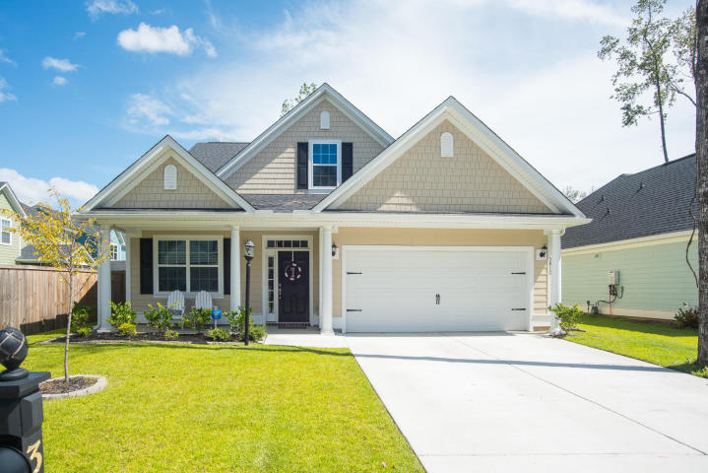
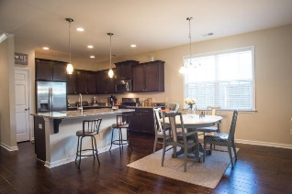
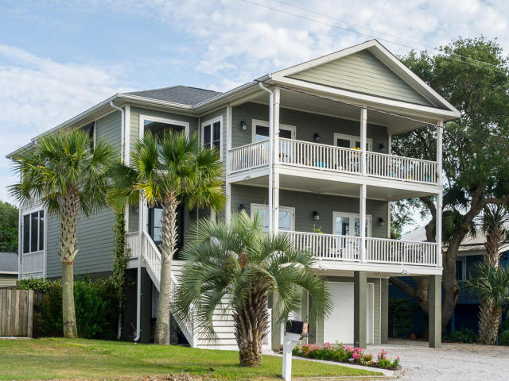
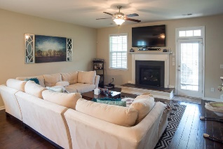
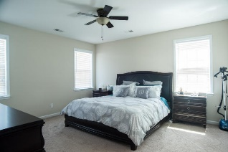
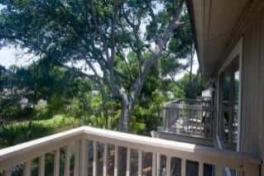
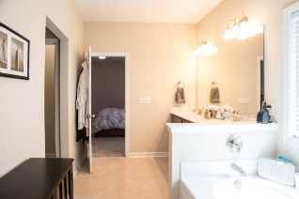
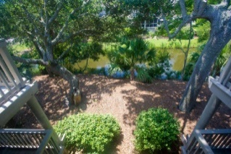
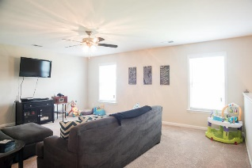
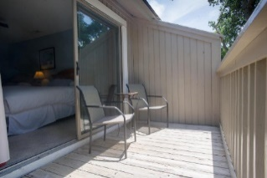
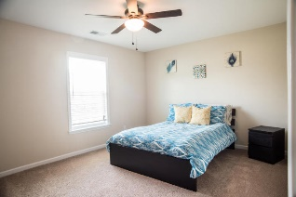
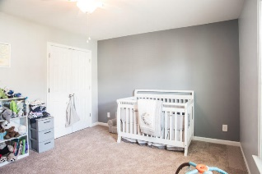
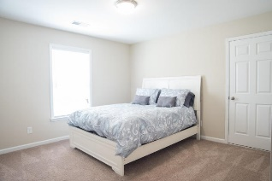
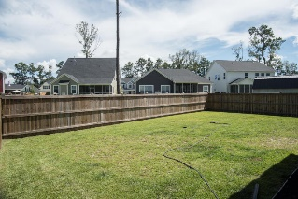


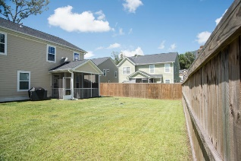
3812 Bonnecrest Lane
Indigo Palms ~ North Charleston
MLS# 16021935 ~ $290,000
New Bright & Shiny Listing!
Look No Further! This home practically sparkles and is ready for a new family!
This squeaky clean home has 4 huge bedrooms and 2 and half baths with a wonderful second family room on the second floor which would make the perfect play room or man cave. This Cassidy floor plan is one of Crescent builders most popular plans. With upgrades galore you will truly feel like you are living in luxury for under $300K. Located in a wonderful school district this home has it all. Upon entry into the wide foyer you have a flex room that could be a dining room, office or a den. The open floor plan has a large kitchen with tons of counter space and an island with granite counter tops. There is a breakfast area just off of the kitchen and opens onto the massive family room that includes a gas fireplace. The master bedroom is downstairs and boasts a lovely full bath with double sinks that includes a garden tub and a separate shower, and the closet is...well...its almost a room of its own....its huge! There is a lovely screened in porch off of the back and a nice full front porch off of the front of the house for that true southern living feel. The yard is fully fenced with a privacy fence for extra comfort. Oh and lets not forget all of the energy efficient features of the home which includes a Carrier PURON 13 Seer HVAC system, R15 insulation, a tankless water heater, LOW E windows, radiant barrier in the attic, and an 80% efficiency gas furnace!
Carey Nikonchuk
(843) 276-1701 M
cnikonchuk@gmail.com
www.palmettoproperty.net

