Slide 1
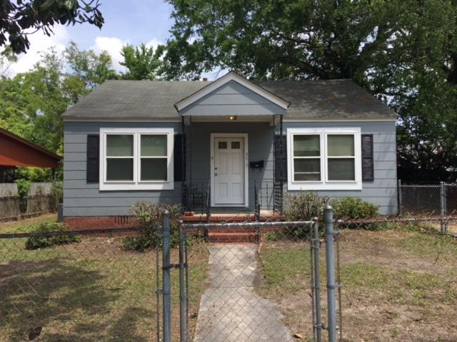
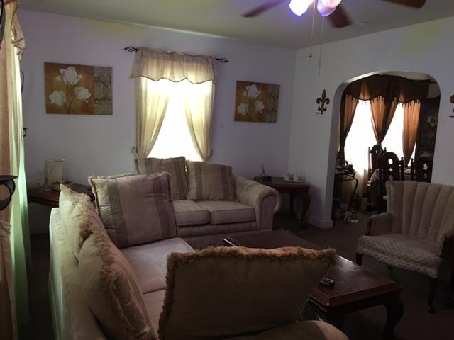
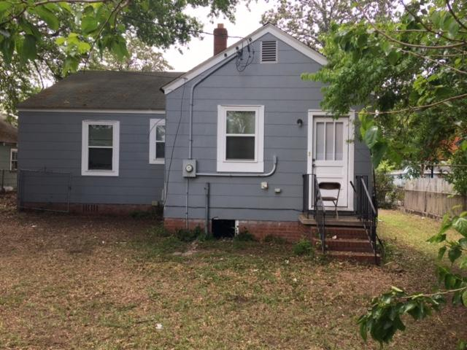
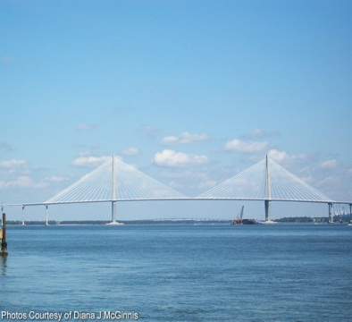
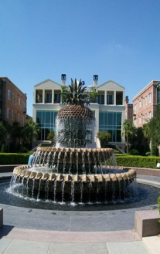
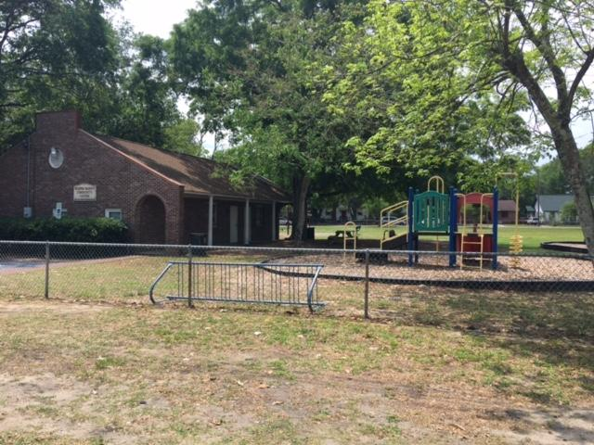
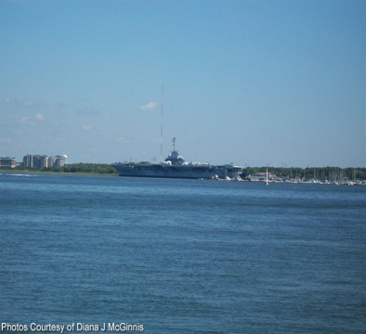


OPEN HOUSE
Sunday April 23
2:00-5:00
$450,000
$450,000
3812 Hottinger Avenue
Whipper Barony · North Charleston · MLS# 17011357 · $107,000
Kelly Rozier
(843) 209-3129
meghankellyteam@agentownedrealty.com
Come check this home out! Great Investment or Starter Home. Great location minutes away from Downtown Charleston, Park Circle and Shopping. Well maintained 2 Bedroom 1 Bath shingle sided home that was recently painted on the exterior and had insulated windows installed. This home features a living room, dining room, and large kitchen. Currently carpet over hardwood and vinyl in the kitchen and bathroom. Home is completely fenced in with a storage shed in the back that conveys. Currently occupied by long term tenant that would like to stay. Zoned X for flood zone which is minimal risk. Termite Bond in place. Don't miss out on this great opportunity. Showing by appointment only, please do not disturb tenant. Associated Licensee is daughter-in-law of seller.
AgentOwned Charleston Group
902 Savannah Hwy
Charleston, SC 29407
Real Estate ● Mortgage
Insurance ● Business Brokerage

