Slide 1
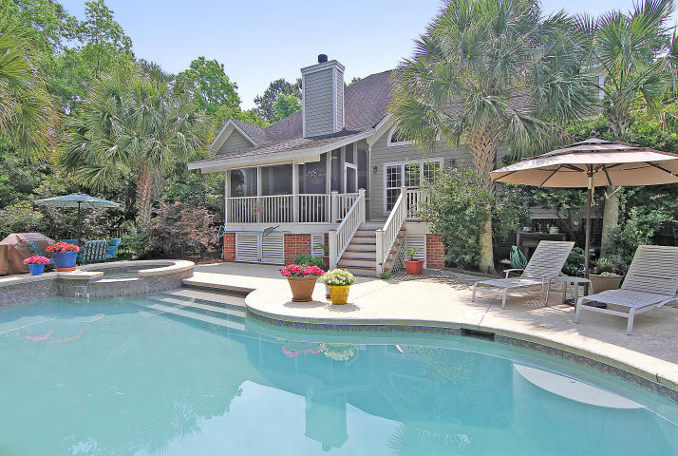
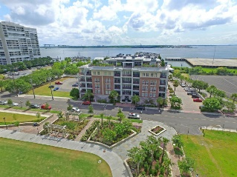
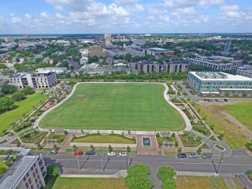
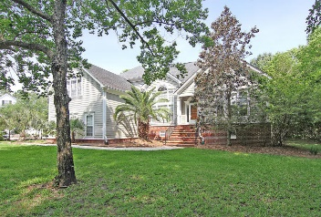
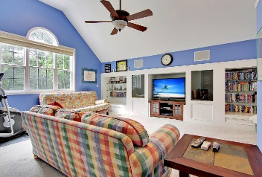
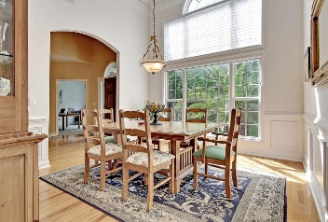
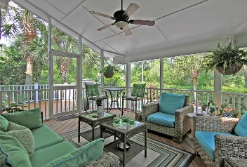
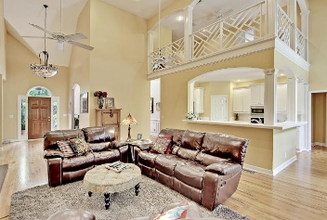
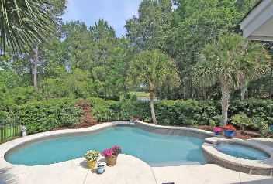
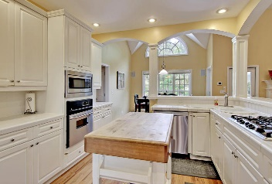
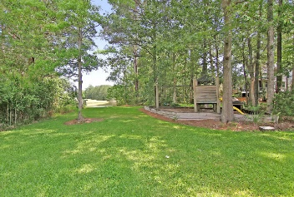
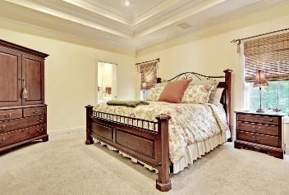
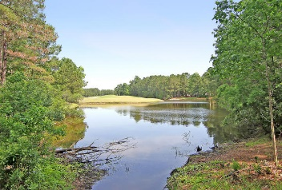
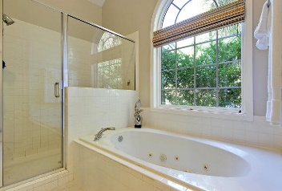
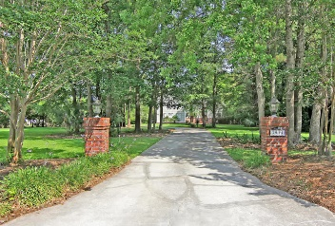

Price Reduced!
Price Reduced!
3814 Colonel Vanderhorst Circle
Dunes West ~ Mount Pleasant ~ MLS# 16013081 ~ $679,900
Gated community of Dunes West offers 5 Bedroom home with Salt-Water Pool Oasis overlooking the water and 4th golf hole. Brick entry columns welcome you to the long driveway & huge front yard of this custom home. Inside are hardwood floors & many palladian windows that allow the natural light to pour into this open floor plan. The two story dining room features wainscotting and dentil crown molding & the two story living room boasts a wood burning fireplace & access to the screened-in porch. From here you can look out to the water & golf course or enjoy the views from the deck or in-ground pool & spa. The second level of this home has a spacious loft area and a massive FROG with built-ins & a full bath. This is a fantastic home and location in the gated, golf community of Dune's West!
Additional features include:
FROG can be used as a 6th bedroom
First floor master has a tray ceiling, sitting area with built-in desk and master bath with dual vanity, walk-in closet, walk-in shower with bench and jacuzzi tub
An office is located across from the dining room
The kitchen has tile counter tops, a breakfast bar, a gas range and SS appliances
Pool area is fenced in and there is a large play set and rear yard behind it
Book your showing today!
Book your showing today!
Matt O’Neill matt@mattoneillteam.com 843-532-4220

