Slide 1
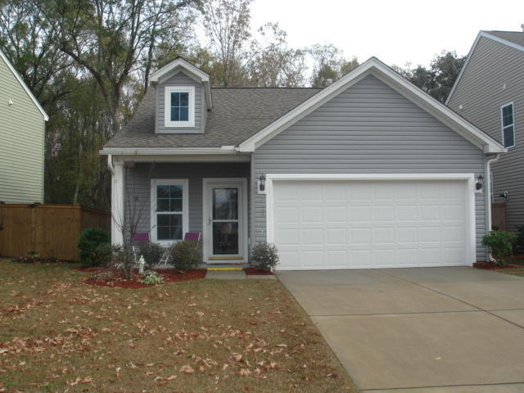
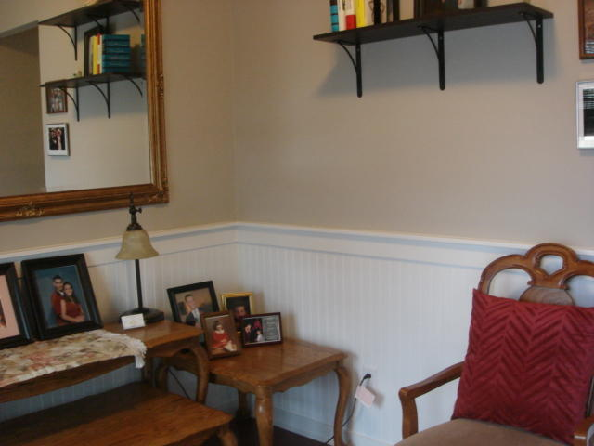
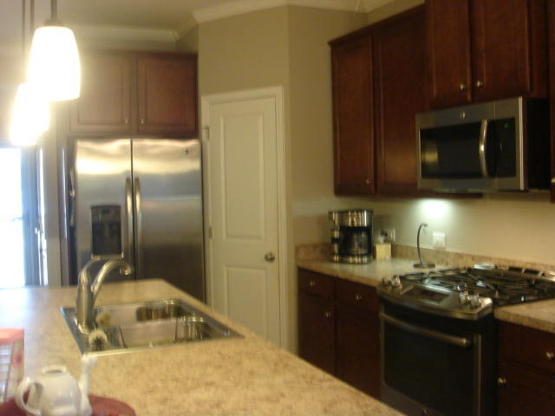
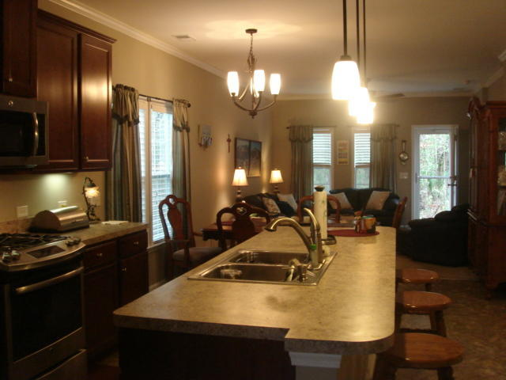
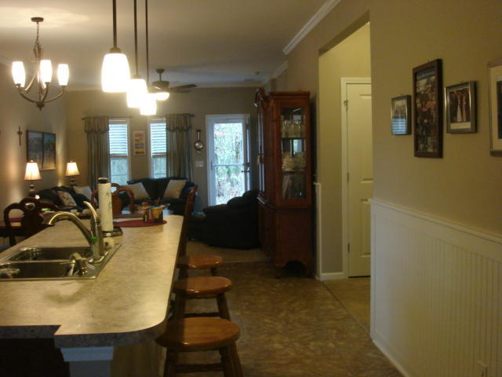
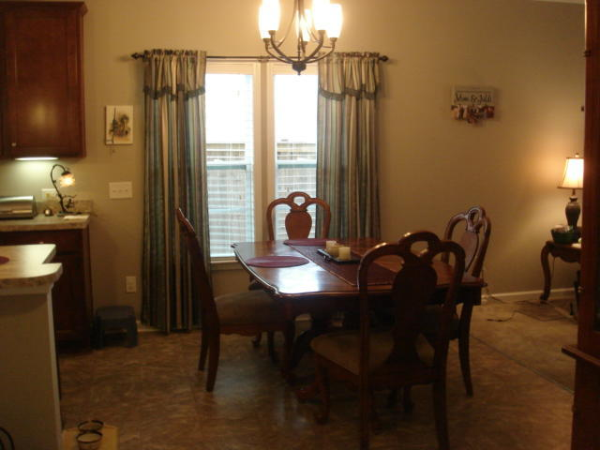
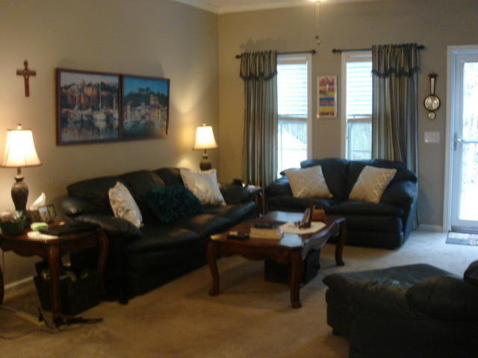
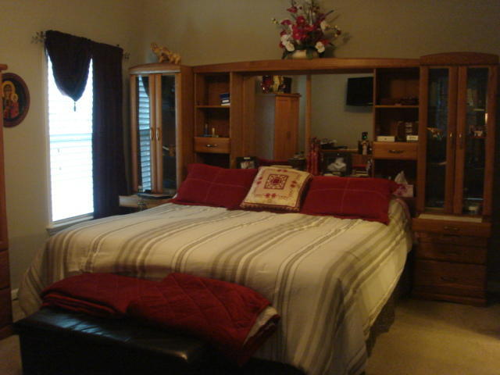
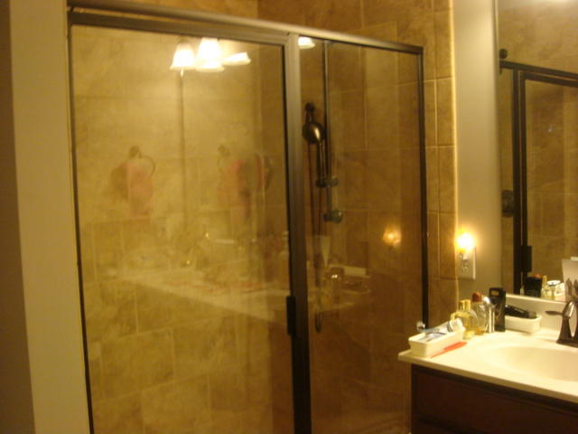
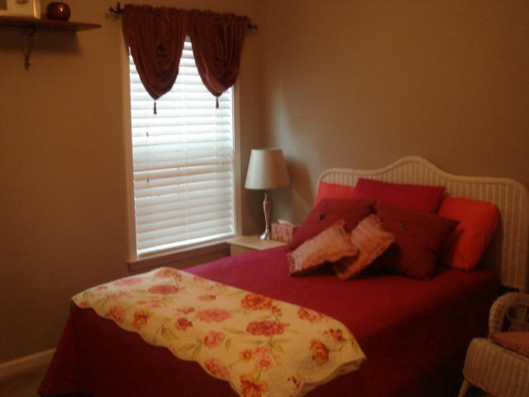
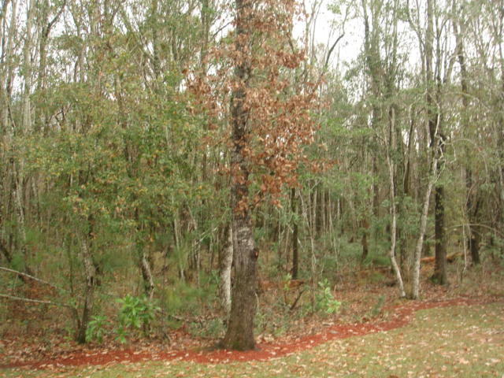


One Story Home Like New In Tupelo
3814 Tupelo Church Lane
Mt Pleasant ~ MLS# 17000185 ~ $310,000
Perfect one story, 3 Bedroom, 2 bath home, with 2 car garage. This home has upgraded cabinets and lighting, with bead board in foyer and kitchen areas. Stainless steel appliances include, refrigerator, gas stove and new micro-wave. Living area has trim mold and ceiling fans throughout. Master Bedroom has a luxury tile shower and bowl vanity. The wooded backyard is completely private with flood lights around the home. Enjoy living in an energy efficient home, with scenic jogging trails and a new neighborhood pool.
Marilyn Stewart, Realtor
Realtor of Distinction
843-297-4098 M
843-416-2200 F
marilyn@charlestonsells.com
Keller Williams Realty
496 Bramson Ct Ste 200
Mt. Pleasant, SC 29464

