Slide 1
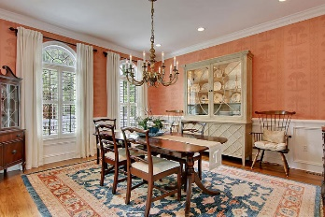
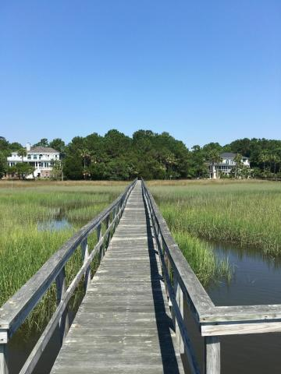

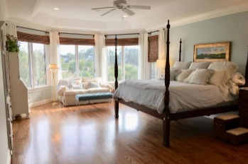
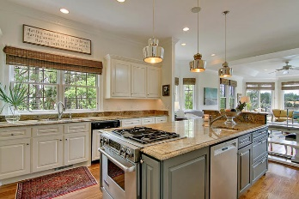
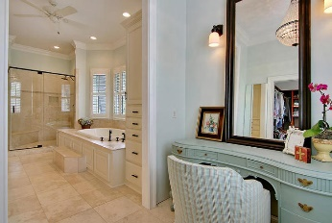
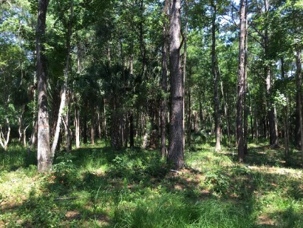
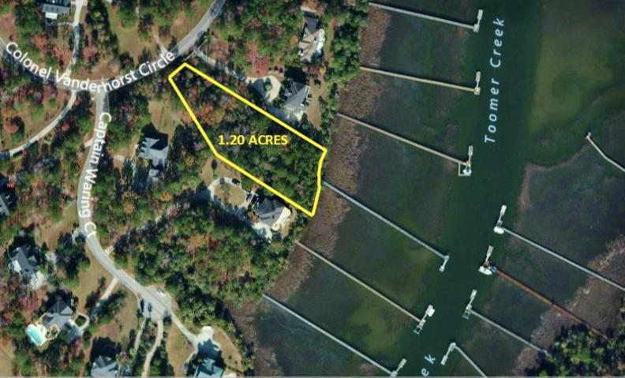
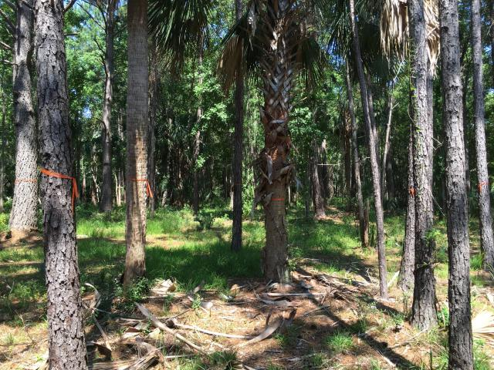
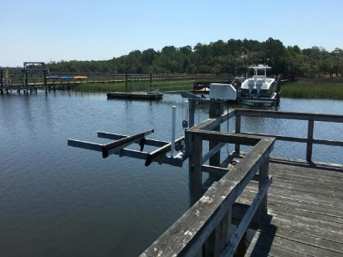
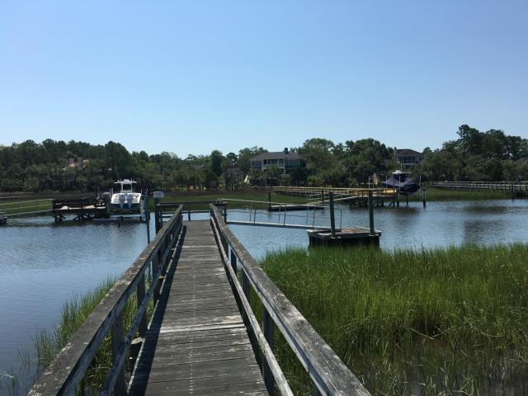


Last Remaining Deep Water Lot
3817 Col Vanderhorst Cir
Dunes West Mount Pleasant, SC 29466 MLS# 19024923 ~ $474,999
Gorgeous wooded 1.2 acre deep water lot in the estate section of Dunes West. Private dock in place with the ability to increase the size of the pier head, float and lift. Custom home plans available. Combine it with the next door estate located at 2282 Captain Waring Court for the ultimate private deep water estate. Agent is related to seller of 3817 Colonel Vanderhorst Circle and is the owner of 2282 Captain Waring Court.
MLS ID: | 19012803
Sale Price: | $1,100,000
Area: | 77 - Daniel Island
Bedrooms: | 3
Bathrooms | 3½
Apx. SqFt: | 3,251
Year Built: | 2008
County: | Berkeley
Tax Map #: | 2760502005
John Teffeau
(843) 813-1228
john@teffeau.com
The Brokerage, LLC
3404-202A Salterbeck Street
Mt. Pleasant, SC 29466
www.seaydevelopment.com

