Slide 1
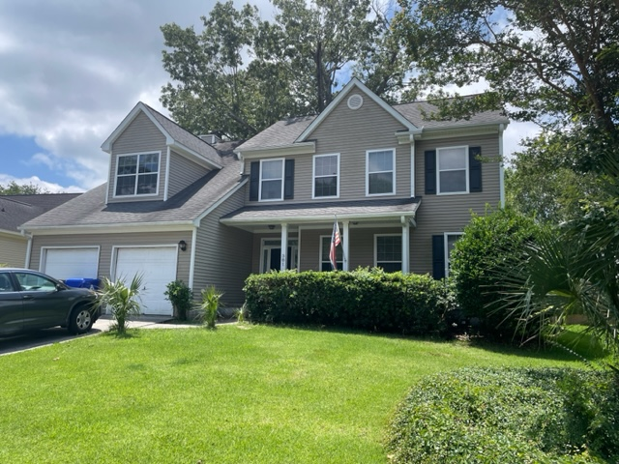
Price Improvement!
381 Antebellum Lane
Belle Hall | Mount Pleasant, SC 29464
MLS# 23015211 | Reduced to $699,000
Well maintained home with updated kitchen with ''blue pearl'' granite and an eat-in area. Nice size family room, dining room and bedrooms. Screen porch and two car garage. Large fenced back yard. Tenant occupied until August 11. Showings to begin on July 13. Easy to show but please schedule 24 hours in advance. Please allow a 48 hour response time for offer given the three owners live in 3 different time zones. Washer, Dryer and Refrigerator convey in ''as is'' condition.
Bob & Shari Alford
843-442-9215
bob@bobalford.com
www.bobalford.com
Carolina One Real Estate
195 W Coleman Blvd
Mt Pleasant, SC 29464-3495

