Slide 1
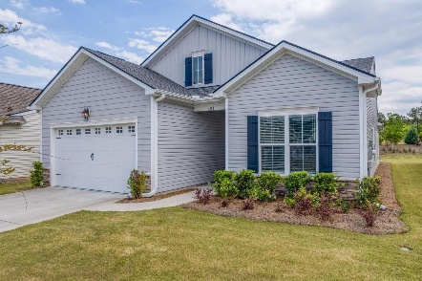
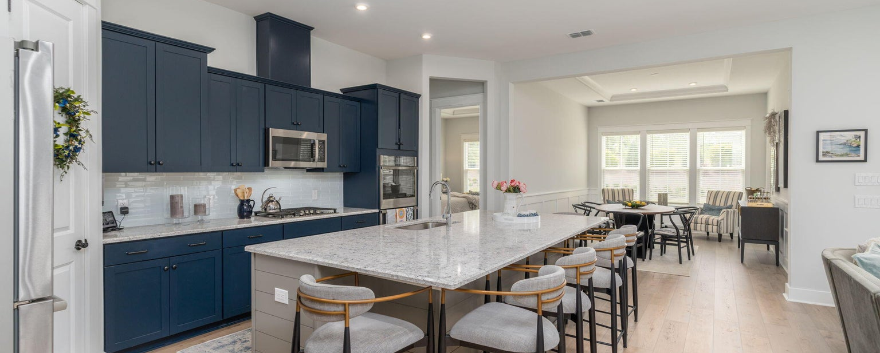

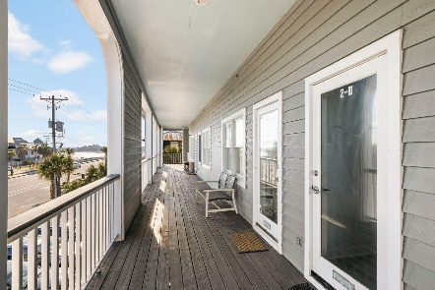
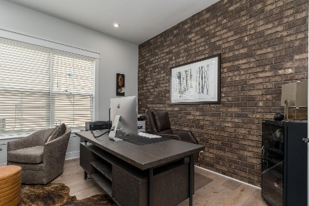
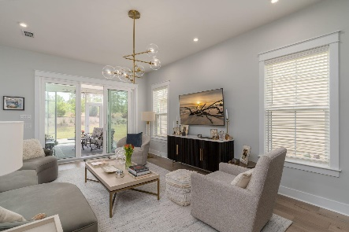
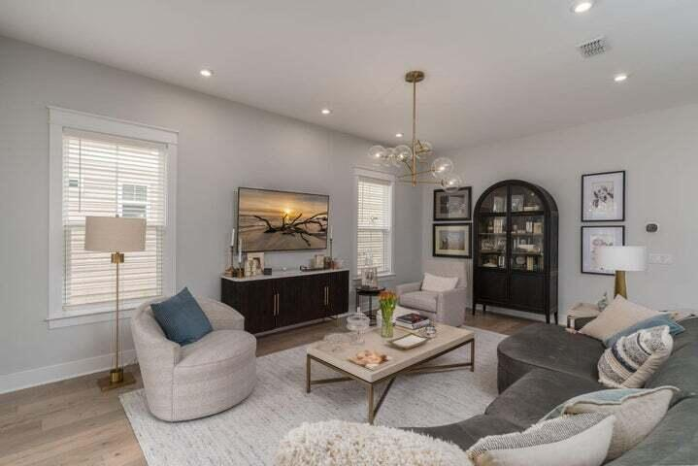
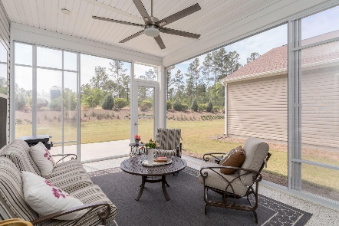
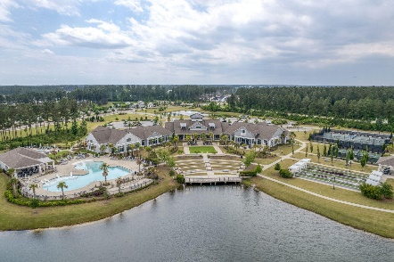
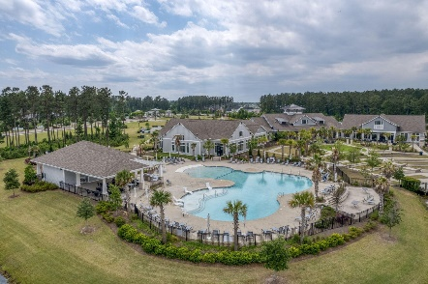
381 Seaside Trail Four Seasons at Cane Bay | Summerville, SC 29486 | MLS# 23011932 | $544,000
Darrell Creek Elevated Home With Elevator & Salt Pool
$3,000 Agent Bonus + 3% Commission
For Ratified Contract by June 15
Co-sponsored by
Offering $3000
Lender Credit
Summerville's Premier Active Adult Community...Four Seasons
No expenses spared on upgrades
Less than 2-year-old home
Sun-Drenched Open Floorplan with 10’ Ceilings
Gourmet Chef's Kitchen with quartz countertops, subway tile, custom cabinetry
Great Room has custom light fixtures + wooden blinds
Extended Sunroom with epoxy flooring and multiple sliding doors to make this a fully heated & cooled addition
Master Suite with tray ceilings
Master Bath with high-end tile + large walk-in shower with bench
Shiplapped Drop Zone and custom cabinetry in the Laundry Room
2.5 Car Garage with an abundance of space for a golf cart and additional storage with epoxy flooring installed
Take a Video Tour
Take a Video Tour
Elissa Campbell
843-853-1433 | elissa.campbell@agentownedrealty.com
AgentOwned Realty Preferred Group | 824 Johnnie Dodds Blvd | Mt Pleasant, SC 29464

