Slide 1
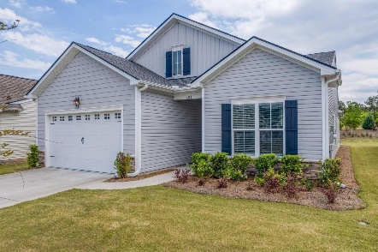
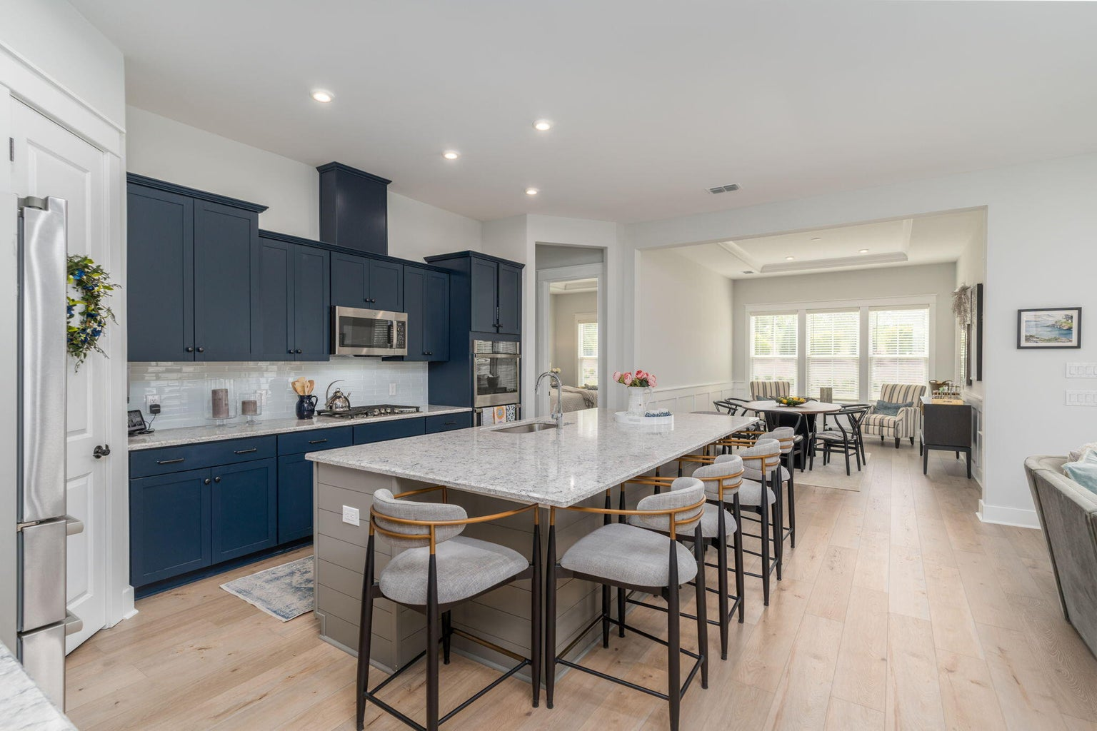
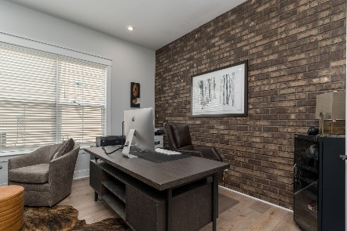
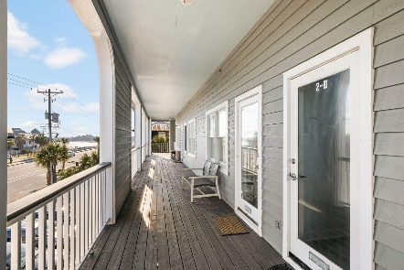
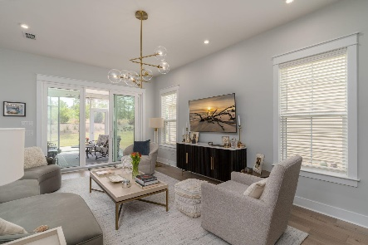
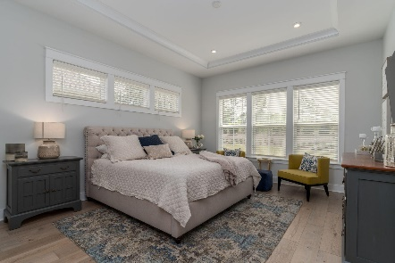
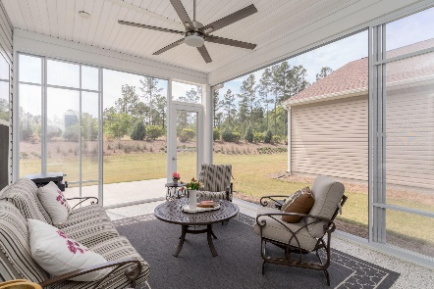
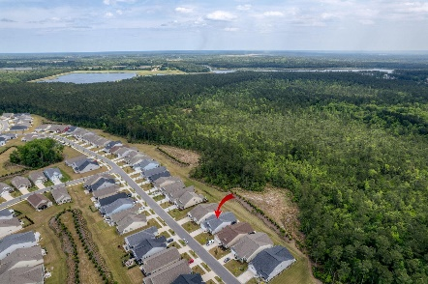
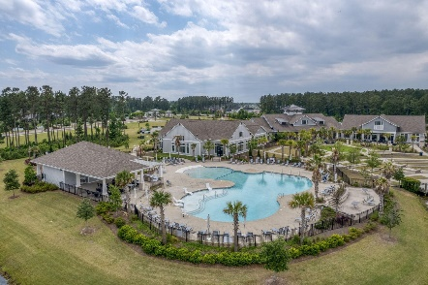
381 Seaside Trail
Cane Bay Plantation | Summerville, SC 29486
MLS# 23009274 | $549,000
Darrell Creek Elevated Home With Elevator & Salt Pool
$20K Price Reduction + Open Houses
Friday Happy Hour 3-6 & Saturday 1-3
$3,000 IN CLOSING COSTS NOW AVAILABLE!
Welcome Home to 381 Seaside Trail in Summerville's Premier Active Adult Community...Four Seasons! The Owners have spared no expense in upgrading this less than 2-year-old home. As you walk into the Foyer, you are greeted by a Sun-Drenched Open Floorplan with 10-Ft Ceilings that looks like you are stepping into a Pottery Barn Catalog. The first thing you will notice is all the customization, from shiplap to tray ceilings, to crown molding and wainscoting throughout the home. To the right is the Guest Bedroom and Guest Bath with a walk-in shower. The must-see Office boasts glass French doors and a full bricked wall added by the owners. To the left is a 2.5 Car Garage with an abundance of space for a golf cart and additional storage with epoxy flooring installed. Also added by the Owners is the shiplapped Drop Zone and custom cabinetry in the Laundry Room. The attention to detail will continue to amaze you as you walk into the Gourmet Chef's Kitchen, complete with quartz countertops that accent the subway tile and custom cabinetry beautifully! The kitchen opens up to a large separate Dining Room with tray ceilings. The Master Suite has been upgraded with tray ceilings as well and additional upper windows to let even more sunlight fill the room. The Master Bath has been upgraded with a high-end tile and a large walk-in shower with bench...and don't forget the enviable Master Closet! Upgrades in the Great Room are custom light fixtures and wooden blinds that convey.
If you enjoy the outdoors, the highlight of the home will be the Extended Sunroom. It is larger than any other and the owners have added epoxy flooring and multiple sliding screen/ glass doors to make this a fully heated & cooled addition. Watch the birds and deer on this protected preserve lot. It is by far the most private lot, backing up to a preserve where Four Seasons is no longer building. The owners also love the privacy of how the lot is placed strategically so that you cannot see your neighbors from the Sunroom. So go ahead and sip your morning coffee in your PJ's!
In Four Seasons you will never be bored, as this is the only Active Adult Community in the area that is built around a 300-acre lake with its own private boat dock! Other amazing amenities include an indoor and outdoor pool, fitness center, dog park, bocce, pickleball, tennis courts, a kayak launch and so much more! There is also a packed monthly events calendar and Full-time Lifestyle Director. Once you move to the Four Seasons, you will never want to leave! And this home is the perfect way to retire in LUXURY!
Take a Video Tour
Elissa Campbell
843-853-1433 | elissa.campbell@agentownedrealty.com
AgentOwned Realty Preferred Group | 824 Johnnie Dodds Blvd | Mt Pleasant, SC 29464

