Slide 1
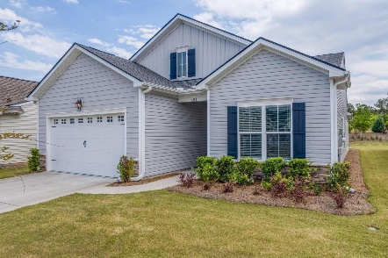

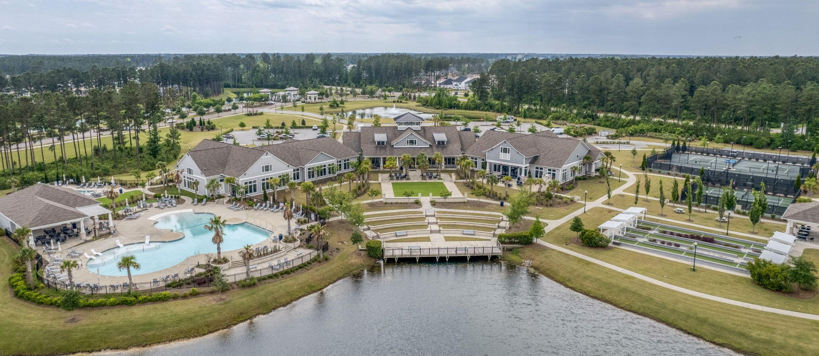
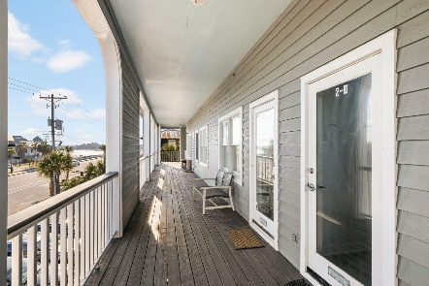
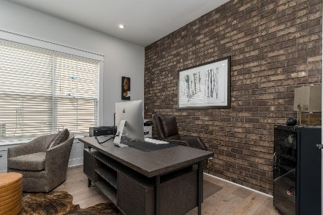
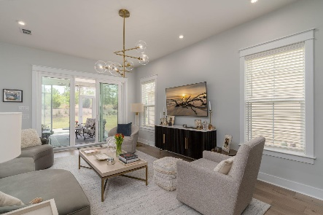

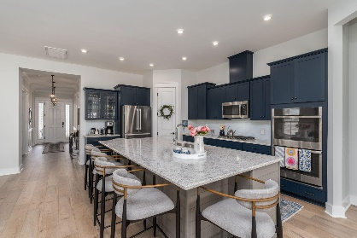
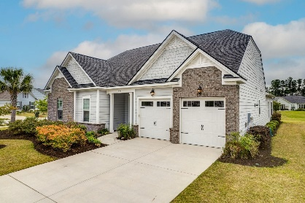
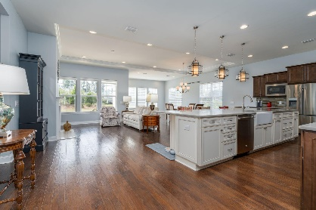
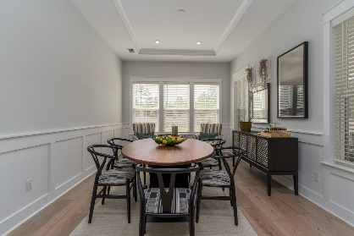

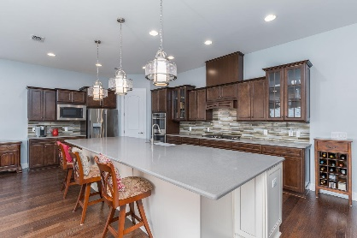
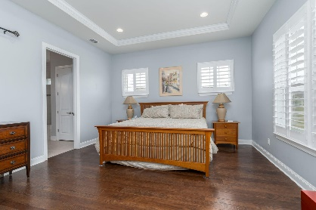
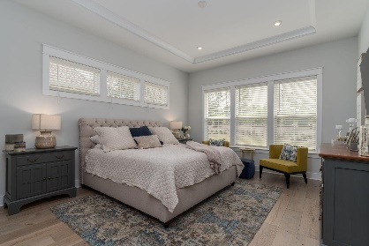
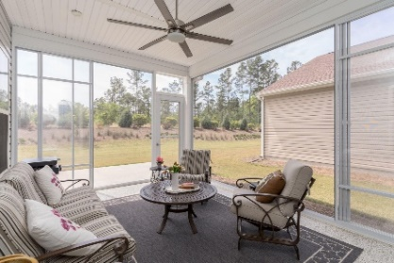

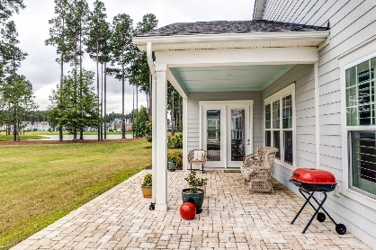
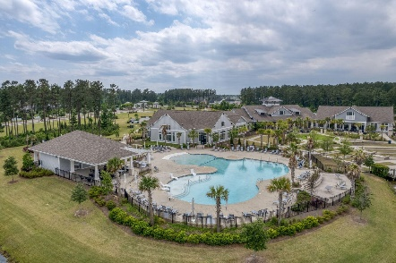
381 Seaside Trail MLS# 23011932 | $544,000
Darrell Creek Elevated Home With Elevator & Salt Pool
2 Homes Just Reduced in Four Seasons
Both Homes Ready For Your Client
Co-sponsored by
Offering $3000
Lender Credit
328 Fish Creek Court
MLS# 23013511 | $599,000
Take a Video Tour
Elissa Campbell
843-853-1433 | elissa.campbell@agentownedrealty.com
AgentOwned Realty Preferred Group | 824 Johnnie Dodds Blvd | Mt Pleasant, SC 29464

