Slide 1
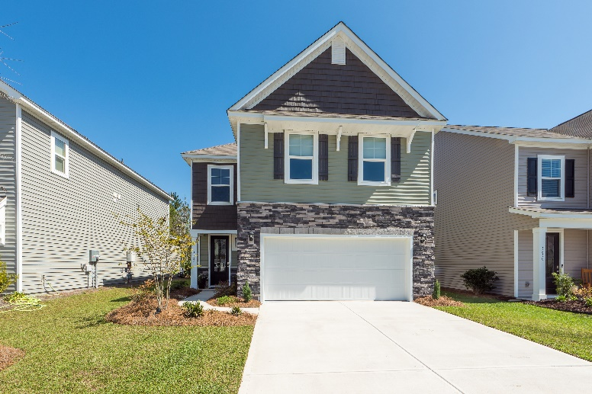
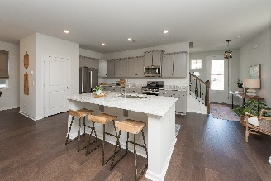
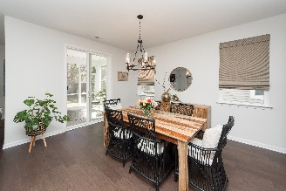
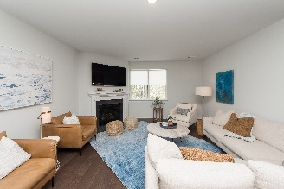
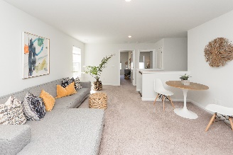
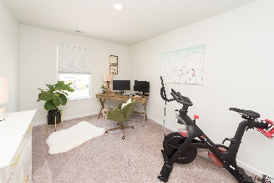
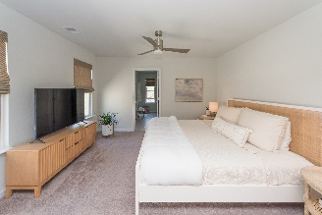
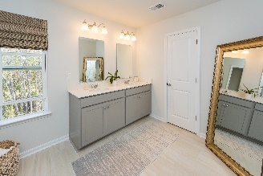
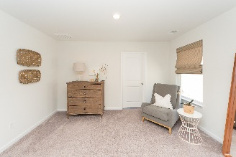
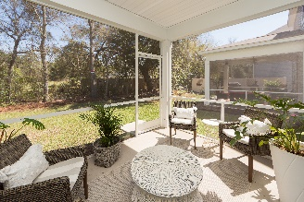
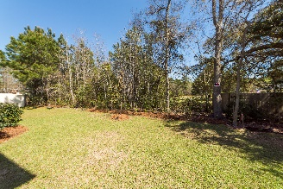



LIKE NEW!!
Impeccably Decorated Home In Mt. Pleasant!!
3826 Sawmill Court
Bees Crossing
Mount Pleasant, SC 29466
MLS# 22007999
$649,900
Impeccable Like new home, decorated like a Model, available now without the wait! Located in the peaceful and serene neighborhood of Bee's Ferry, and completed in Dec. 2021! All available warranties are still in place and this home is Zoned for all Mount Pleasant Schools! Upon entering this tasteful home, you are greeted with a gorgeous bright and airy neutral palette. The downstairs level is complete with durable engineered wood floors, an open concept kitchen with oversized island/eat in Kitchen/ and Den area with gas fireplace, perfect for your entertaining needs! Quartz countertops, and all stainless appliances. The screen porch in back is the perfect place to enjoy your morning coffee, and is surrounded by beautiful landscaping and a tree buffer for privacy. Upstairs you will find a Loft area perfect for a second Den, Game room, or Playroom, three generous sized additional bedrooms, and an additional bath. The Upstairs Master suite features a sitting area, plenty of room for your King bed, and an oversized closet to host an extensive wardrobe! The master bath has his and her dual sink vanity, modern finishes and ample space! Do not delay this like NEW property will not last long!
Virtual Tour: https://charlestonvirtualhomes.com/2220060
Chrissy Strickland
843-906-5553
chrissyresiderealestate@gmail.com
www.residerealestatellc.com
Reside Real Estate LLC
155 Wingo Way Unit 421
Mt. Pleasant, SC 29464

