Slide 1
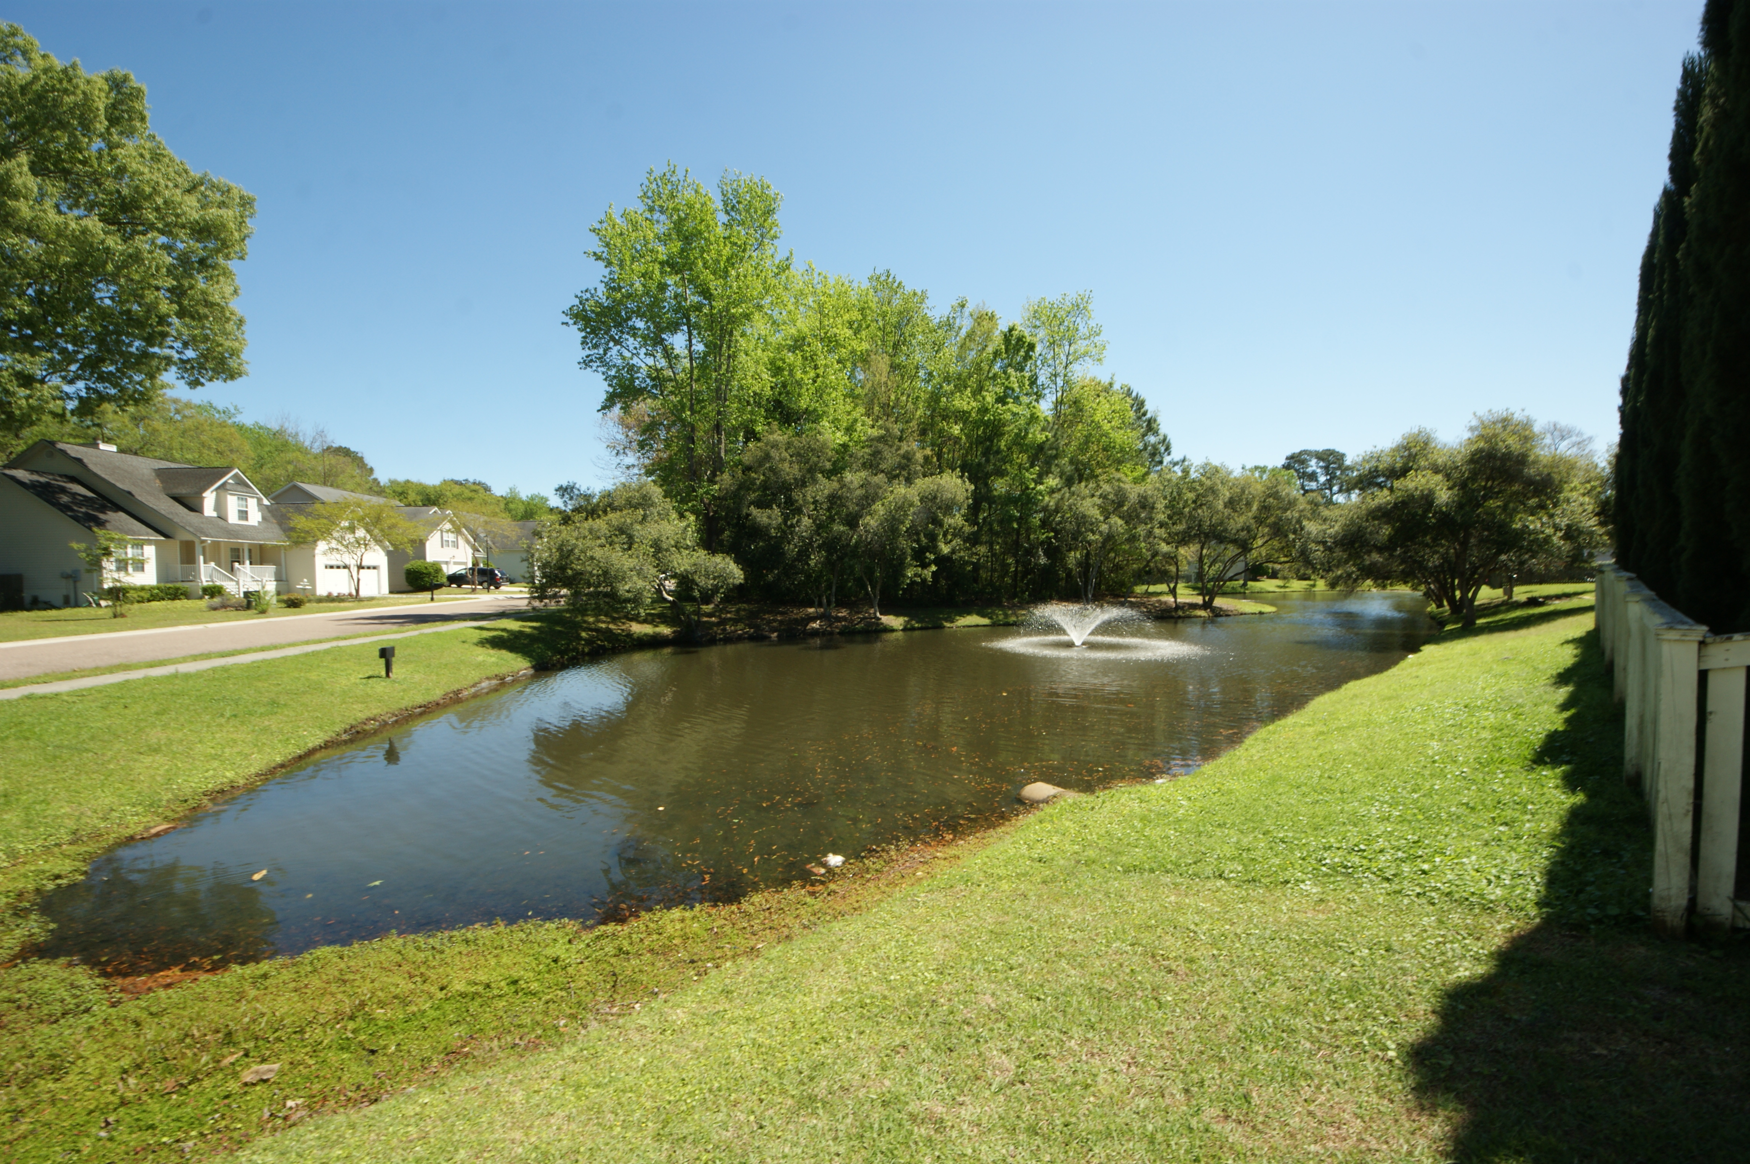
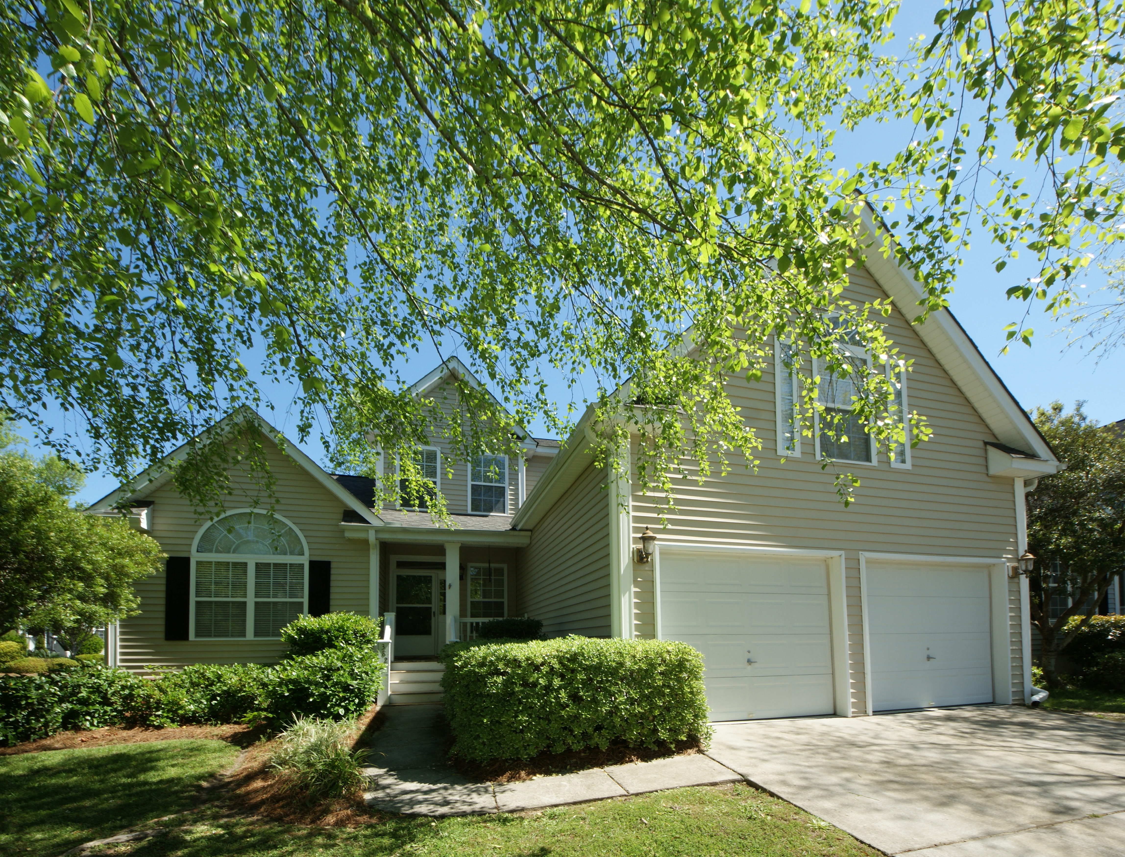
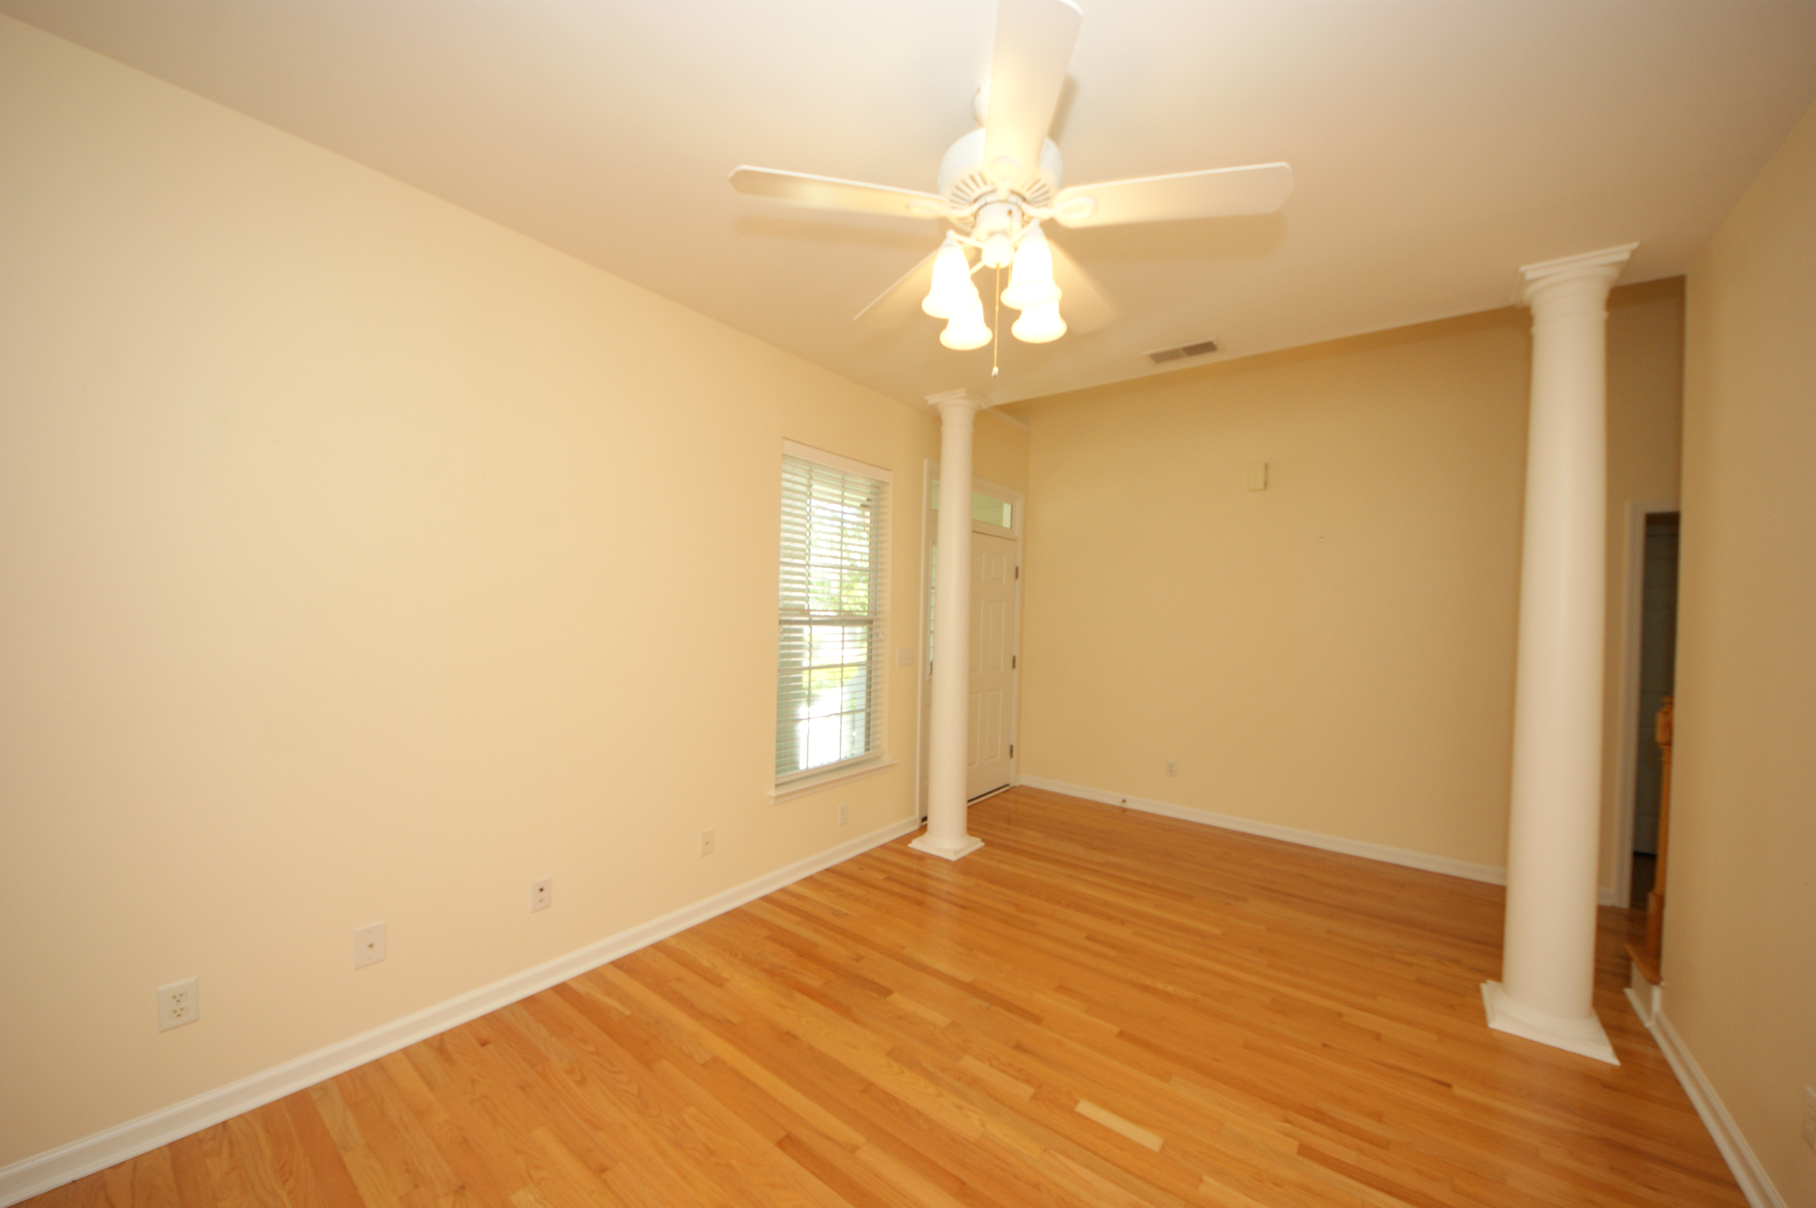
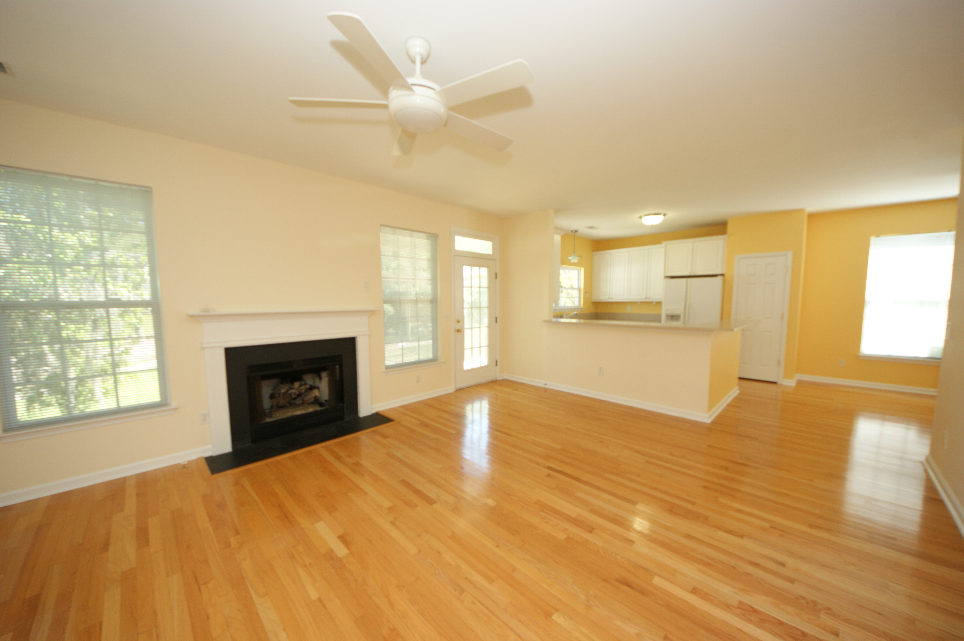
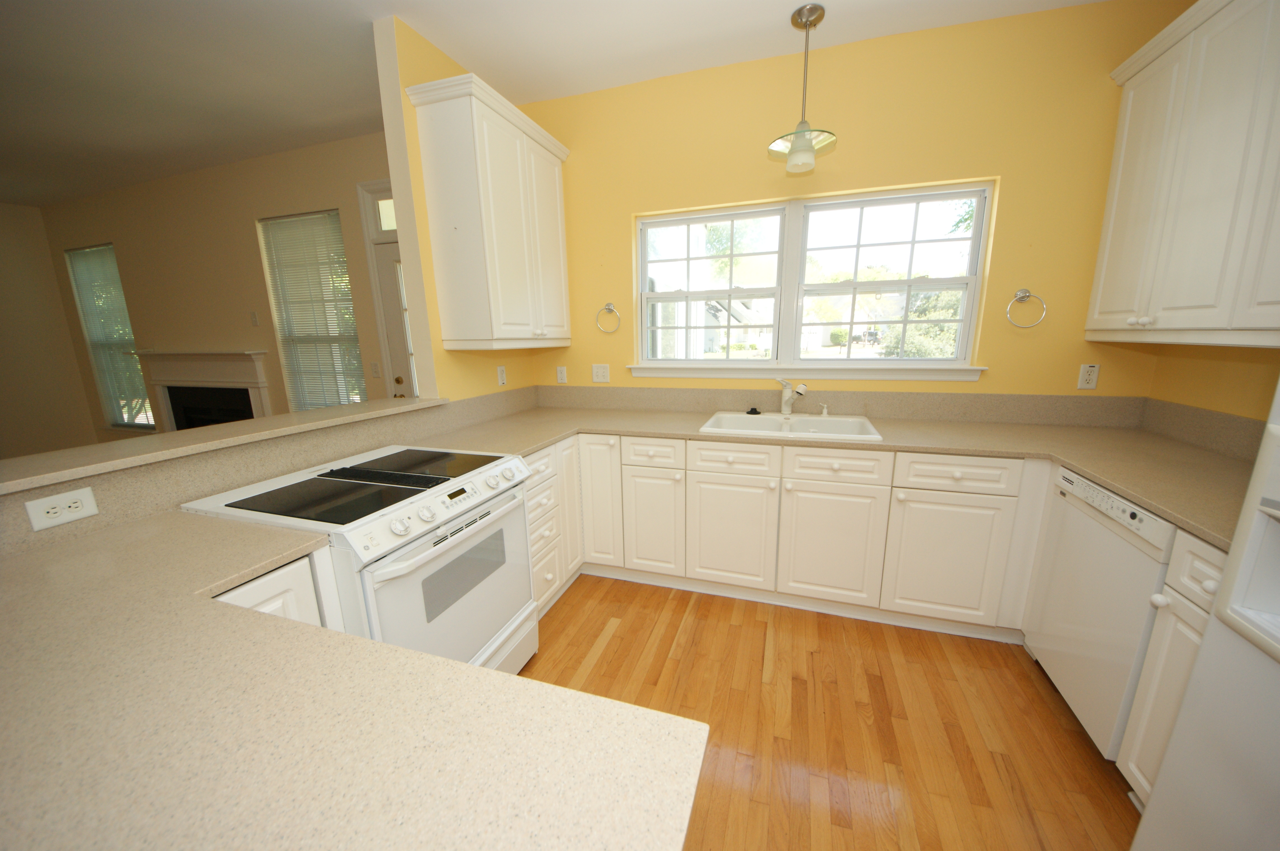
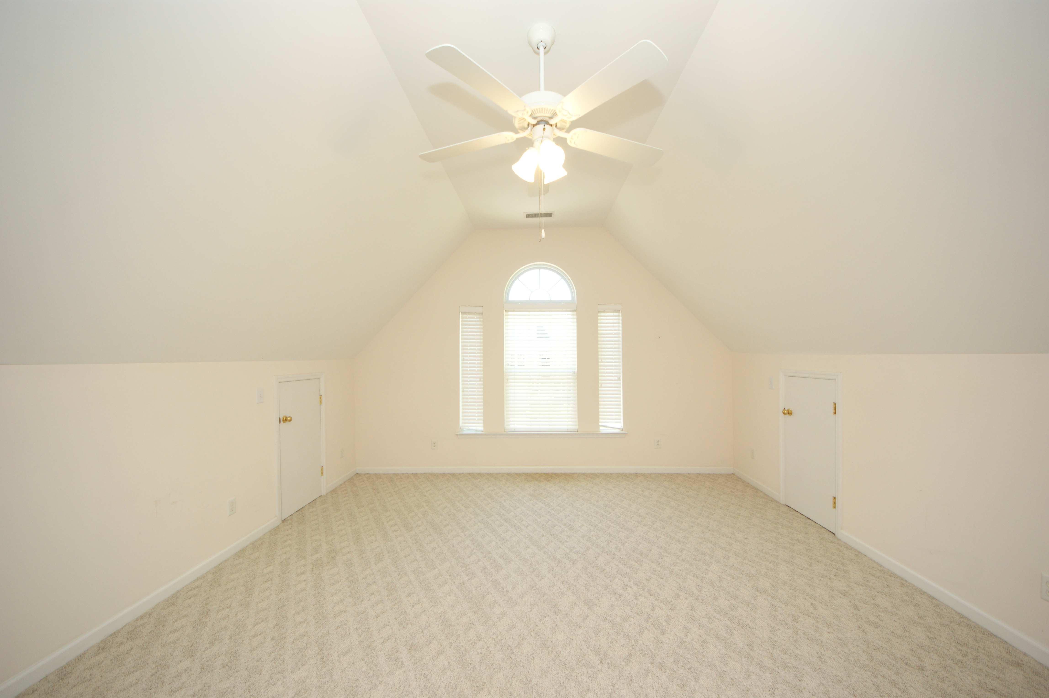
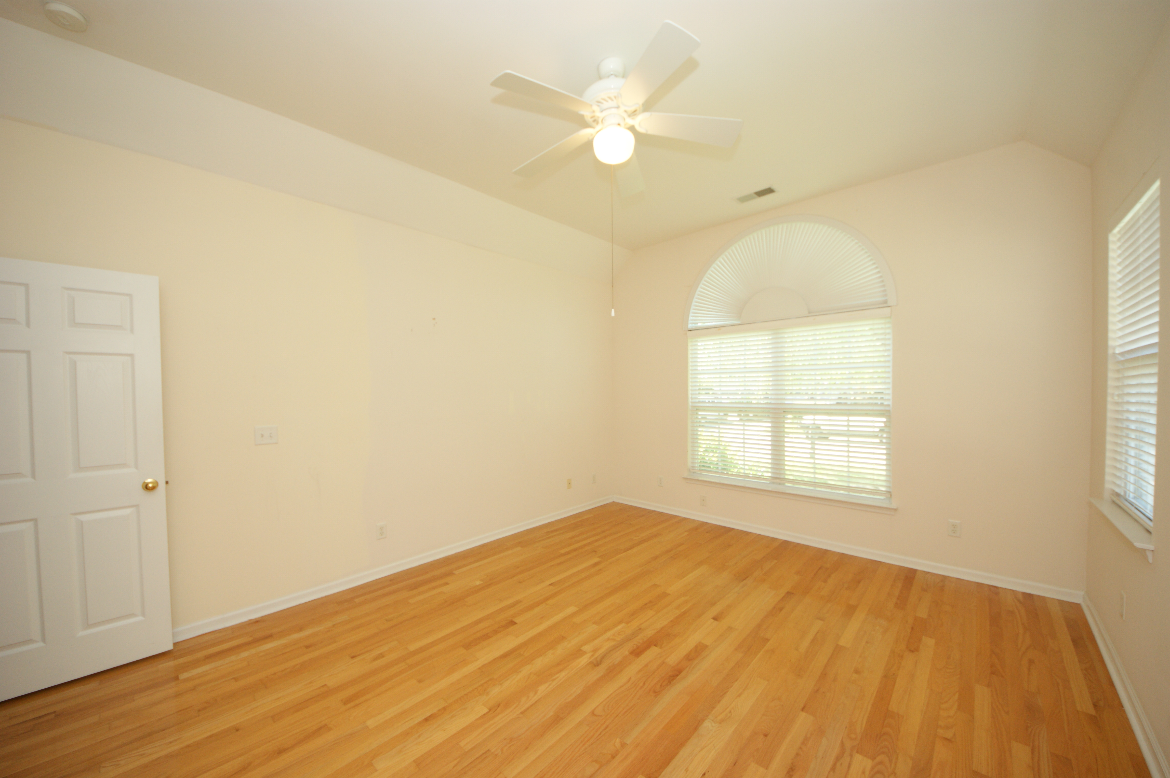
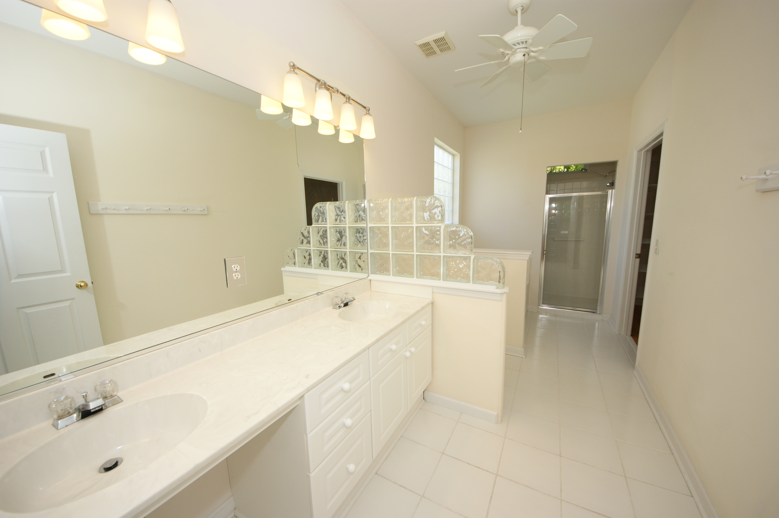
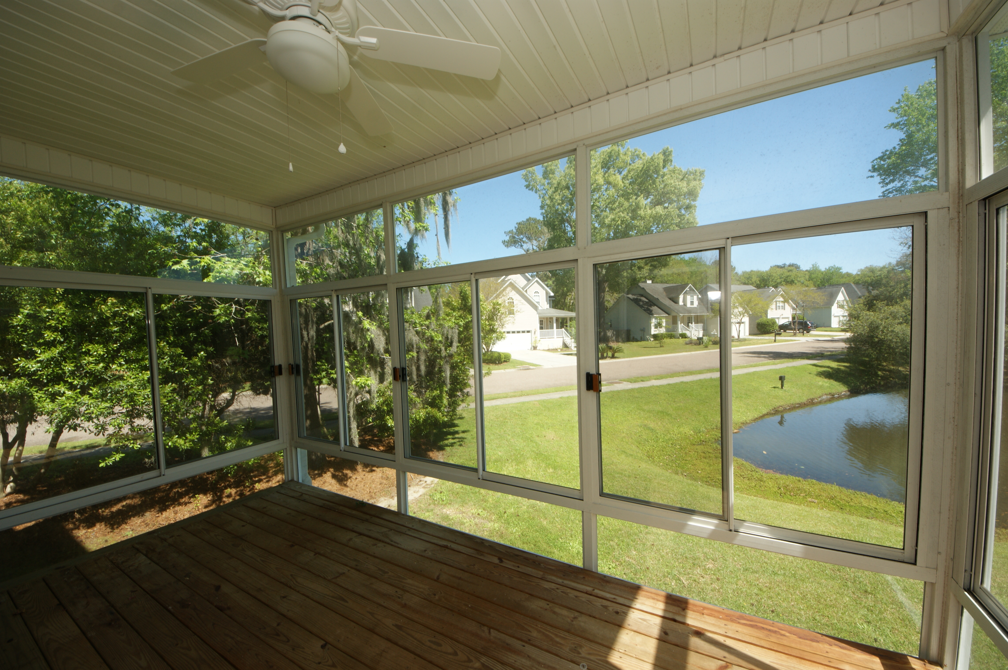


Just Listed in Stone Creek
382 Clayton Drive, Charleston, SC 29414 MLS# 16009283 ~ $315,000
Wonderful open floor plan with hardwood floors throughout the downstairs including the DOWNSTAIRS Master Bedroom! This amazing house lives as large (or as small) as you want it to....The downstairs is comprised of a large Master BR and Master Bath... with Formal Dining Room, Roomy Family Room with Gas Logs, Open kitchen with breakfast bar. Powder Room. Very nice Laundry Room with lots of storage...and a nearly brand-new Washer/Dryer too! ANOTHER living space on the first floor is the enclosed 4-Season Room...glass or screen for whatever the season (off the Family Room)with windows all around and lovely pond views. Take the stairs up to the second floor and fine an even bigger surprise 4 more bedrooms and another large full bath. Two of these bedrooms (one is FROG) are super large and would be great for a home office or guest suite...or for that older child who needs extra room. Definitely plenty of room to do whatever you need! The full bath is roomy with a tub/shower combo and large vanity. Outside, there is this lovely corner lot overlooking a pond...what a view! A small patio off the 4-Season Room great for grilling. The double car garage is oversized and has plenty of workspace for the handy person....and neat as a pin! This home is under a transferrable Termite Bond. Yearly Flood Insurance $757.This seller has had a pre-Home Inspection and completed the few small repairs that were noted on the report. This home is MOVE-IN Ready! Has been professionally cleaned! Convenient to shopping and dining.... Downtown Charleston and the beaches are just minutes away. Come see this beauty today!
Susan Weeks
(843) 813-0495
susanweeksdesign@gmail.com
www.agentownedrealty.com
AgentOwned Charleston Group
902 Savannah Hwy
Charleston, SC 29407-7802

