Slide 1
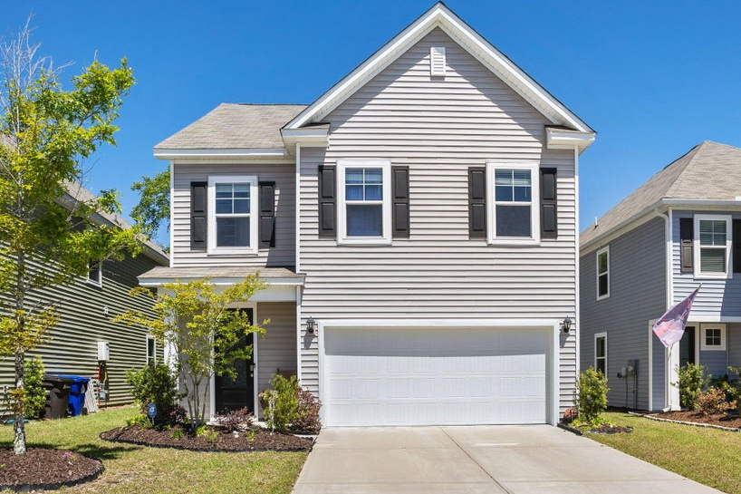
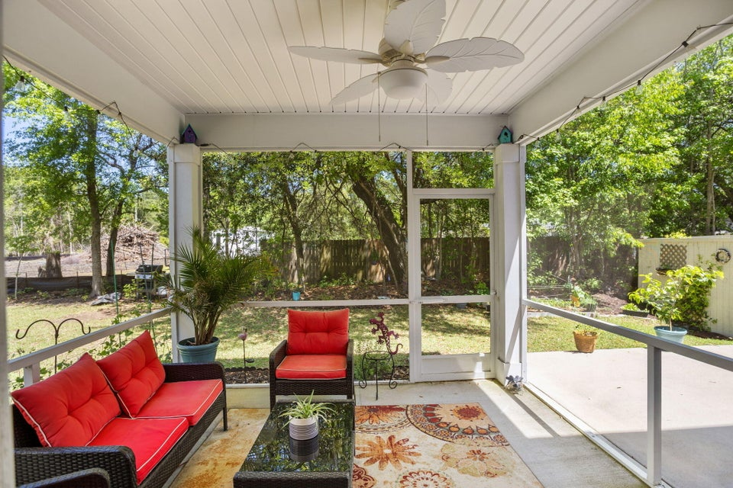
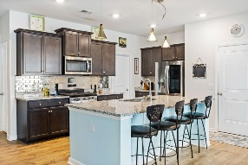
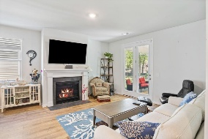
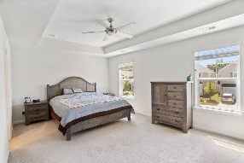
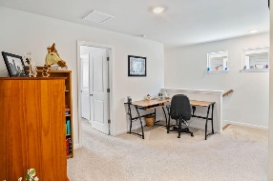
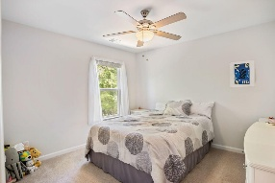
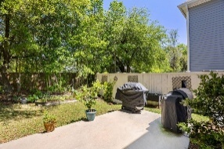
3830 Sawmill Court Bees Crossing | Mount Pleasant, SC 29429 | MLS# 26001637 | $665,000
Make This One Yours ~ Move in Ready
Beautiful 5-bedroom, 3 full bath home in one of north Mount Pleasant's newer subdivisions by DR Horton. The home features custom lighting, fans, and plumbing fixtures throughout. Enter through the foyer and note the luxury laminate wood flooring that appears throughout the downstairs. To the right is the stylish kitchen with wood Shaker-style cabinetry, stainless steel appliances (including a gas range), kitchen island with breakfast bar, granite countertops, and tile backsplash. The kitchen is open to the dining area and family room. The family room features a gas fireplace and full-light French doors that look out to the screened porch, patio, and back yard. A 1st-level bedroom overlooks the back yard and sits opposite a full bathroom.
Upstairs, you'll find a common loft area amidst the primary suite, three additional bedrooms, the 3rd full bath, and the laundry room. The spacious primary bedroom features a tray ceiling, and it's en suite bath has a double-sink vanity with wood Shaker-style cabinets and separate tub and shower. 2-car garage. Less than 1.5 miles to the public boat landing. Convenient to north Mount Pleasant shopping and dining, Mount Pleasant Hospital, excellent schools, and more!
VIEW LISTING
Andrea Rogers
843-532-3010 | andrearogers1@gmail.com | www.andrearogersrealtor.com
AgentOwned Preferred Group | 1400-G Palm Blvd | Isle Of Palms, SC 29451

