Slide 1
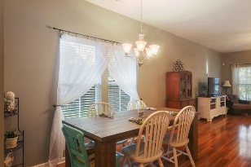
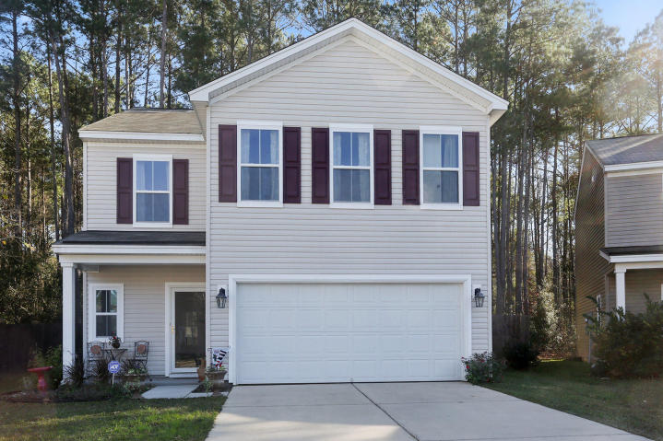
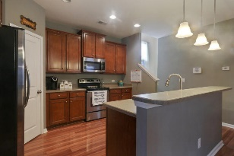
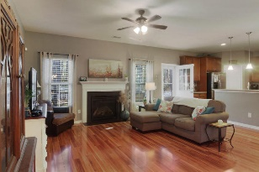
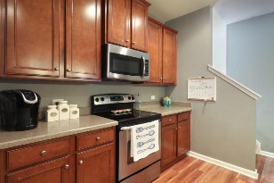
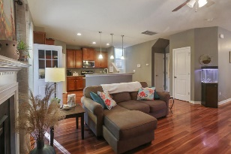
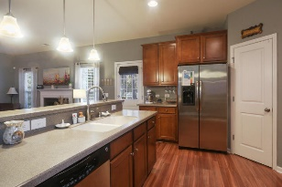
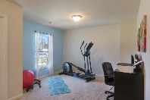

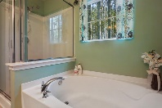
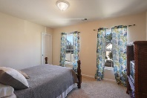

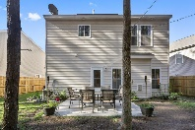


3836 Annapolis Way
Price Reduced in Wellborn Village
Wellborn Village
Ladson, SC 29456
MLS# 16000664
$190,000
Gorgeous like-new home with many upgrades including beautiful laminate hardwood floors on entire first level, 42'' maple cabinets with Corian countertops, stainless steel appliances and a gas fireplace. Upstairs are three nice sized bedrooms, all with walk-in closets, a large loft area, two bathrooms and laundry are also located on 2nd floor. The master suite is extra large with large walk-in closet and separate garden tub and shower along with dual sinks. This home has a beautifully landscaped front yard and a nice private back yard. LOCATION is within walking distance to the brand new Walmart and one intersection down from Palmetto Commerce Parkway.
Stephanie Deaton
M – 843-743-4219
O – 843-769-5100
stephanie.deaton@agentownedrealty.com

