Slide 1
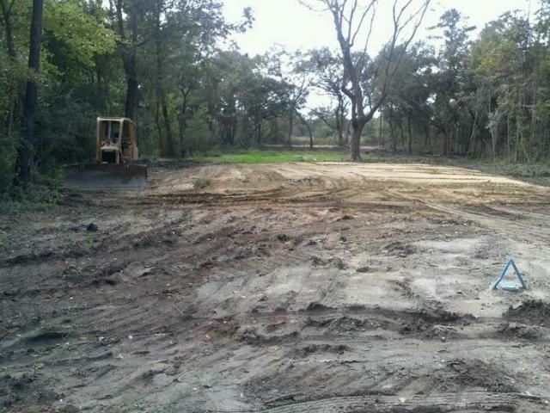
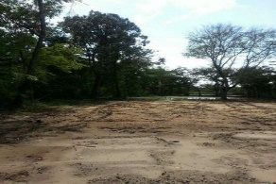
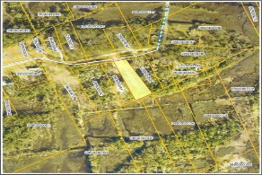
Marsh Front Lot!
3843 James Bay Road
Marshfield
Johns Island, SC 29455
MLS# 15022560
$85,000
The views are amazing! Lot is partially cleared with building pad site already in place. Marshfield subdivision. Red top area. Land sits close to Rantowles Creek and seconds from the Stono River. The location is minutes from shopping, beaches, I526. Water and Sewer are already tied in to the city. All information is deemed accurate however, it is recommended buyer to do own due diligence. Great opportunity to build your dream home on the marsh! You have earned it! More pictures on the way.
David Hickman | 843.505.0456 | davidisyouragent@gmail.com | www.omnicarolinarealestate.com
Omni Carolina Real Estate | 126 Eston Dr | Goose Creek, SC 29445

