Slide 1
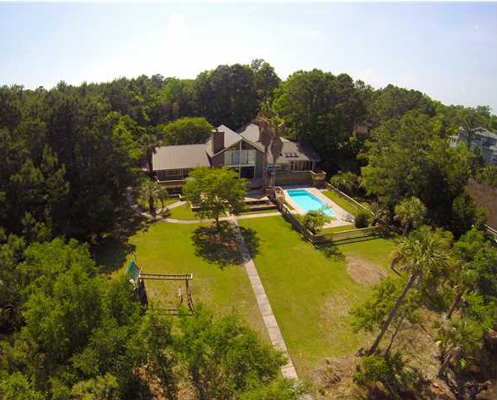
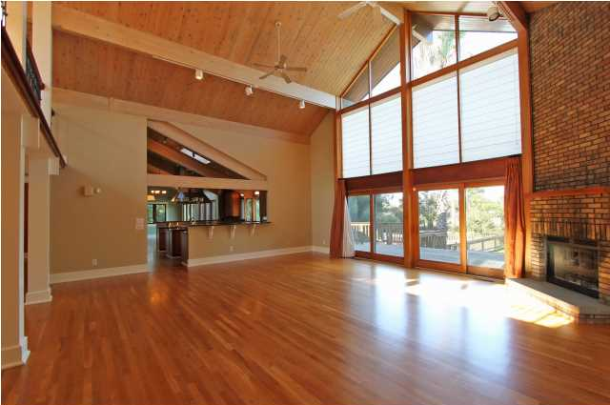
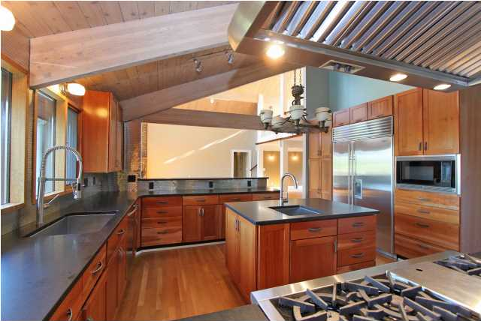
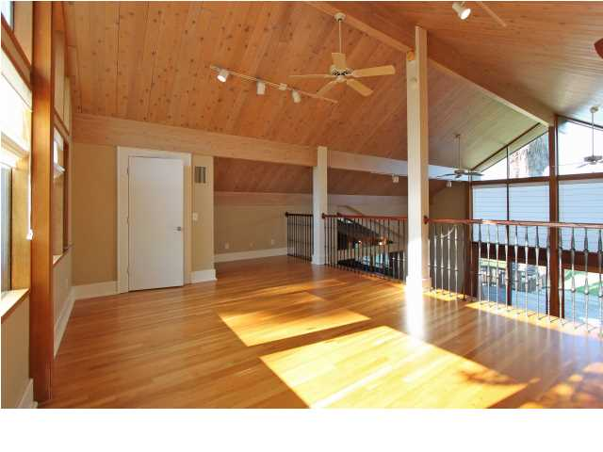
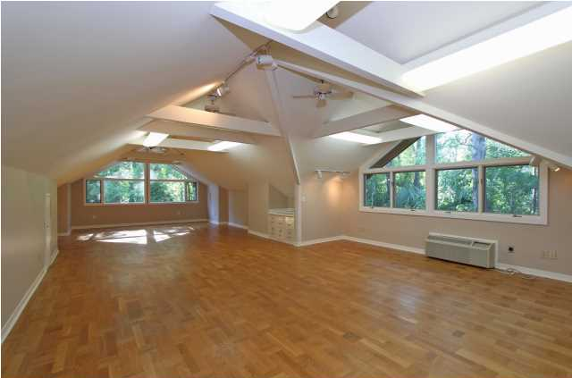
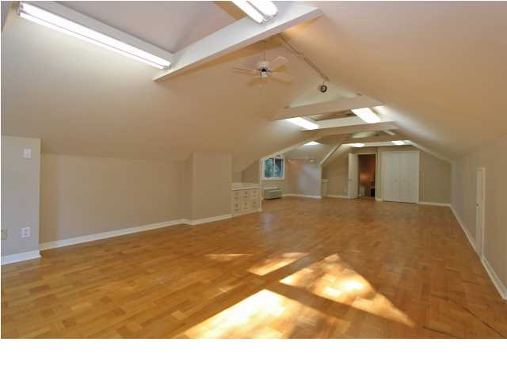
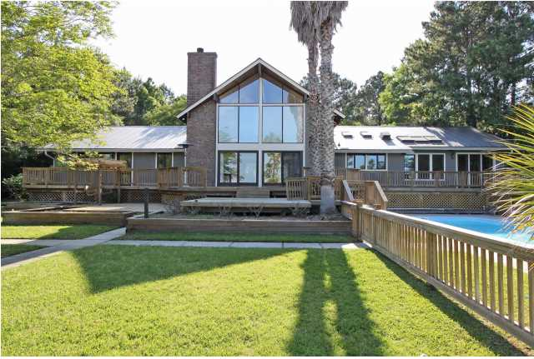
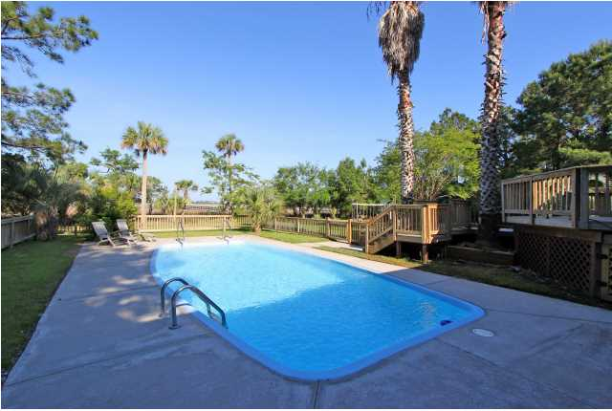
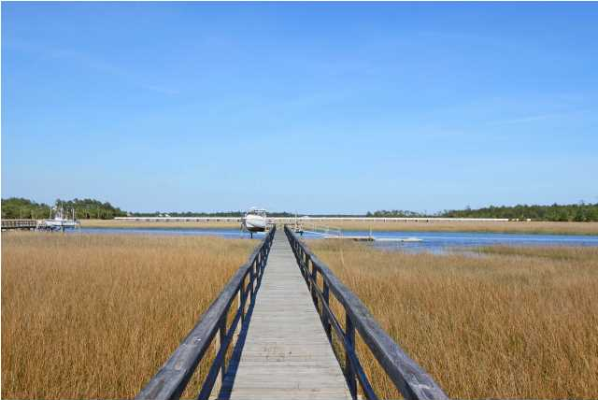


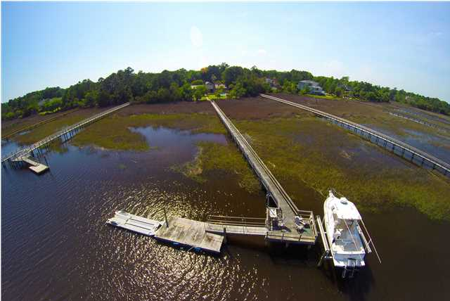
3845 Col Vanderhorst Cir Dunes West ~ Mt Pleasant MLS# 1412158 ~ $985,000
Fantastic true deep water home on Toomer Creek in the gated community of Dunes West. Featuring a short 300 ft walkway to a pier head with floater and boat lift. Home sits on a very private wooded lot of 1.12 acres with panoramic marsh views. In-ground pool, large back yard and a long winding driveway. The interior floor plan is wide open with high ceilings. The gourmet kitchen was recently upgraded and overlooks the pool and Toomer Creek, flowing easily to the living room and breakfast area. The master bedroom is downstairs and features a large walk-in closet and master bath. A large FROG sits atop the 3 car garage and is ideal for a game room, study or to be used as a 4th bedroom. Other rooms include; two additional bedrooms, private dining room, loft/den/game room, office, laundry room, mud room and lots of open decks. Dunes West offers resort style amenities with three pools, waterslide, tennis, workout facility, golf club with 18 holes, club house and restaurant, boat ramp, storage, jogging/biking trails and more. This beautiful home and private deep water setting must be seen to be appreciated!
Clay Cunningham
Office - (843) 886-8110
Cell - (843) 345-4647
Fax - (843) 202-2921
clay@carolinaone.com
Carolina One Real Estate
1400-E Palm Boulevard
Isle of Palms, SC 29451

