Slide 1
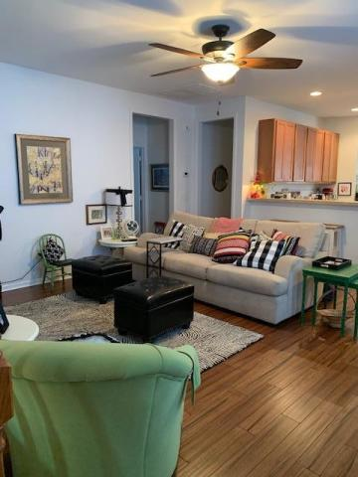
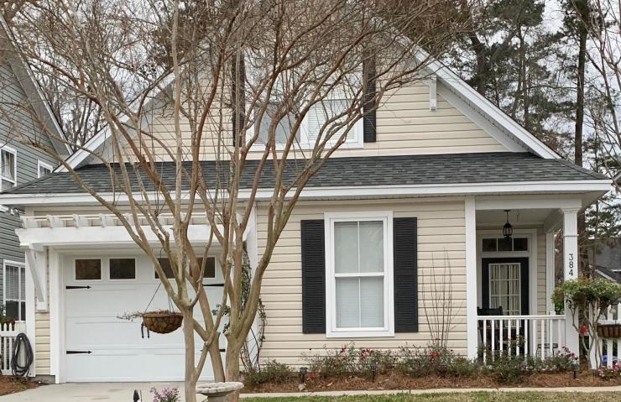
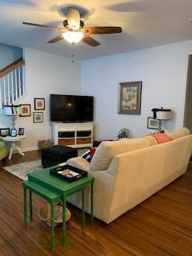
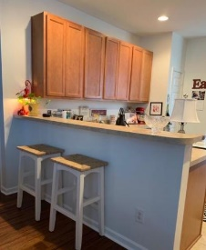
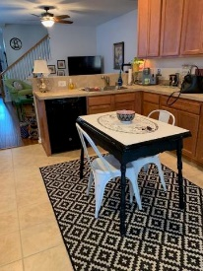
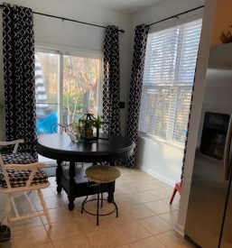
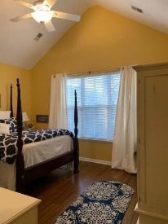
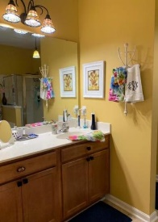
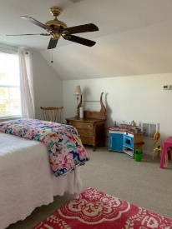
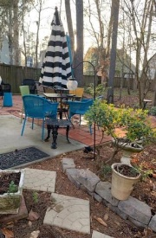
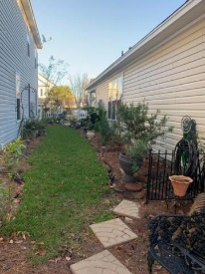


384 Chemistry Circle
Eagle Run ~ Ladson, SC 29456
MLS# 19005110 ~ $225,000
New On The Market
Awesome well kept one owner home. Professionally decorated. Great Room, Eat in Kitchen with Bar. Master with private bath and walk-in closets. All living space on first level. Two Bedrooms down with another full bath. Finished room above the garage that can be used as a bedroom as it has a closet, or a great get a way for the Kids to play. Brand new Carpet in Room above garage and Hardwoods in the downstairs. Last year the owner put a huge deck on the back of the house which backs up to wooded common area, privacy is there...This is a wonderful home, lots of TLC put in it by owner. Listing Agent is related to the owner.
John H. Beckroge
ABR, EPRO, REALTOR
jbeckroge@gmail.com
(843) 367-3196
Brand Name Real Estate | 4 Carriage Lane Suite 106 | Charleston, SC 29407

