Slide 1
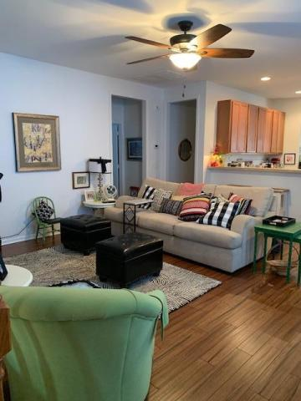
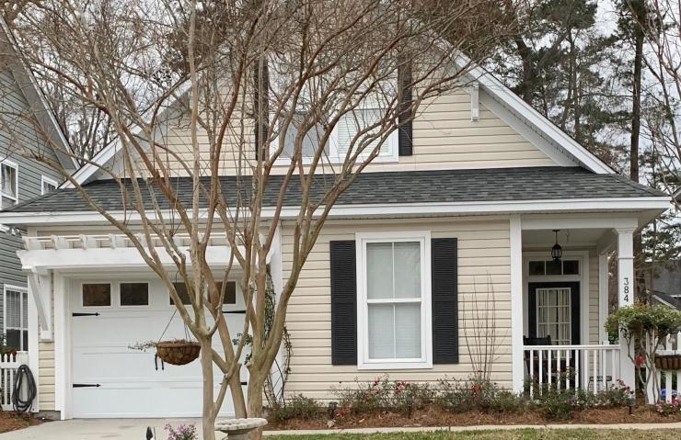
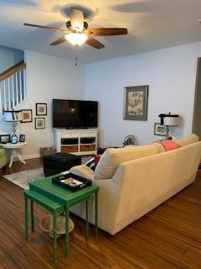
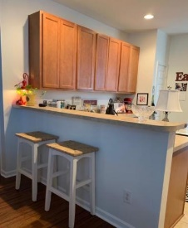
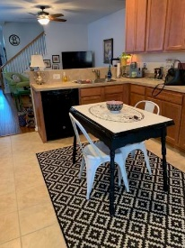
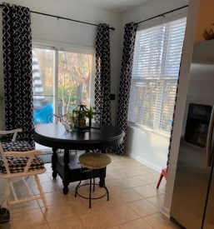
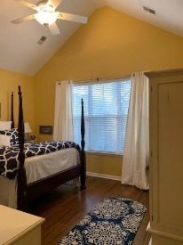
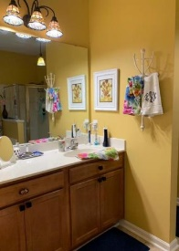
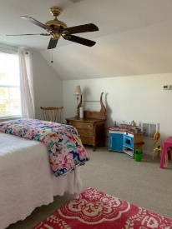
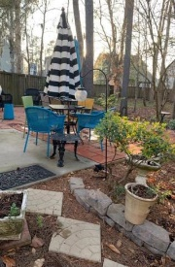
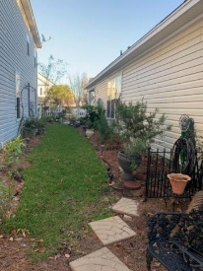


384 Chemistry Circle
Eagle Run ~ Ladson, SC 29456
MLS# 19005110 ~ $219,900
New Price! Seller Highly Motivated!
Awesome well kept one owner home with almost 1700 sq ft most on one level and guest, playroom or bedroom in room above the garage. Professionally decorated. Great Room, Eat in Kitchen with Bar. Master with private bath and walk-in closets. All living space on first level. Three Bedrooms down with another full bath. Finished room above the garage that can be used as a bedroom as it has a closet, or a great get a way for the Kids to play. Brand new Carpet in Room above garage and New Hardwoods in the downstairs. Last year the owner put a huge deck on the back of the house which backs up to wooded common area, privacy is there...This is a wonderful home, lots of TLC put in it by owner.
Listing Agent is related to the owner.
Buyers Agent to verify square footage if there is a problem.
John H. Beckroge
ABR, EPRO, REALTOR
jbeckroge@gmail.com
(843) 367-3196
Brand Name Real Estate | 4 Carriage Lane Suite 106 | Charleston, SC 29407

